Slide 1
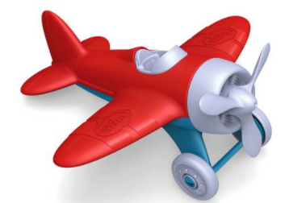
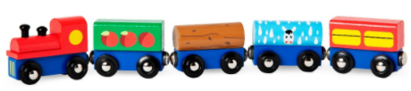
Bob has a toy plane and a toy train.
The plane is 10cm long.
The train is 5cm longer than the plane.
How long is the train?

Slide 2
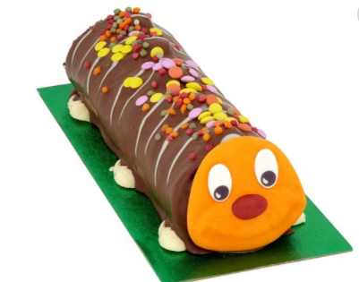
Jake has a caterpillar cake for his birthday. It was 30cm long. Then his friends ate 15cm of it.
How much cake is left?

Slide 3
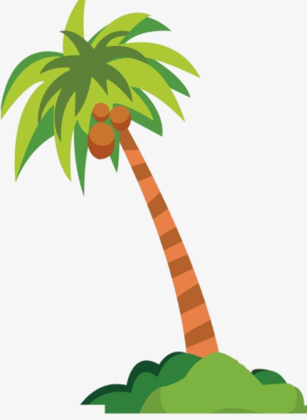
The apple tree is 4m tall.
The coconut tree is twice as tall.
How tall is the coconut tree?

Slide 4
Bob has a toy plane and a toy train.
The plane is 8cm long.
The train is twice as long as the plane.
How long is the train?

Slide 5
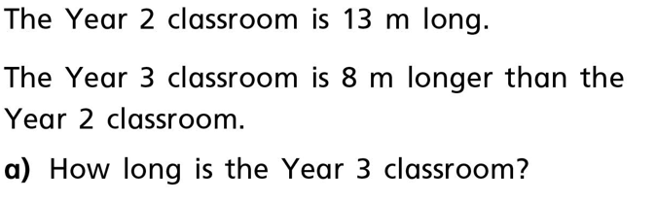
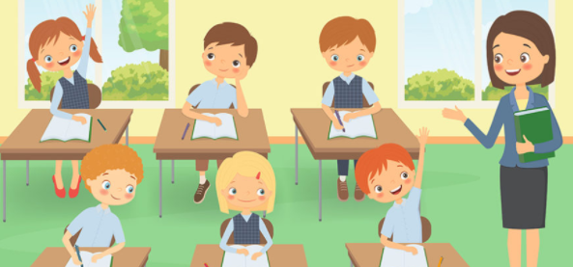

Slide 6
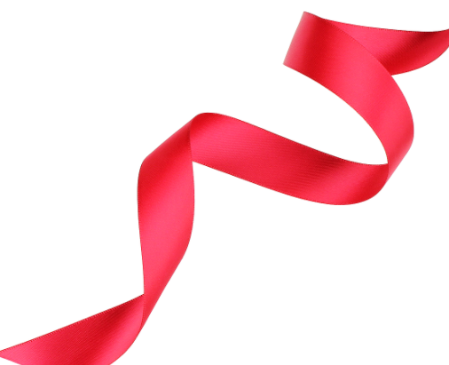
Mabel had a ribbon for her dance. It was 64cm long. She cut it in half to share with Suzie.
How long is each ribbon?

Slide 7
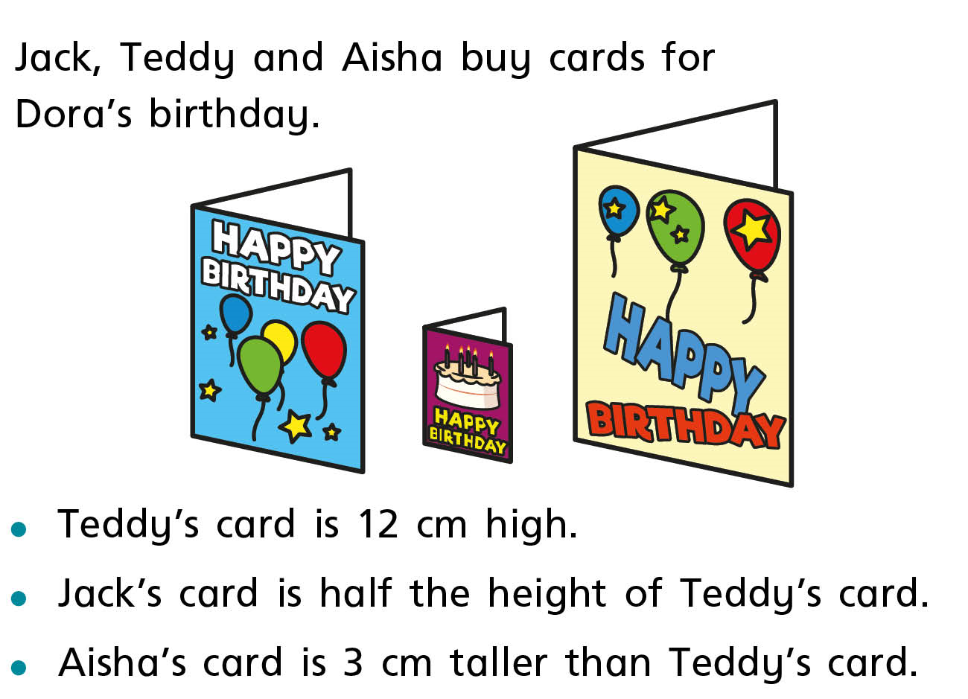
a) What is the height of Jack’s card?
b) What is the height of Aisha’s card?

Slide 8
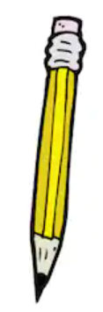
Boris has a pencil which is 14.5 cm long. Jeff’s pencil is 3cm shorter.
How long is Jeff’s pencil?

Slide 9
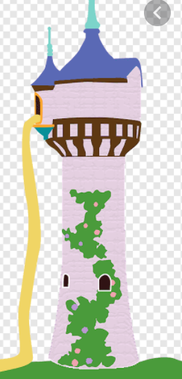
Tinsel Tower is 14m high.
Tongo Tower is 3m shorter than Tinsel Tower.
Plaza Tower is 5m taller than Tongo Tower.
How tall is Plaza Tower?

