Slide 1
11:35-12:25
Friday 9th October 2020
L.O: To use measures
C: Four Operations with Length

Slide 2
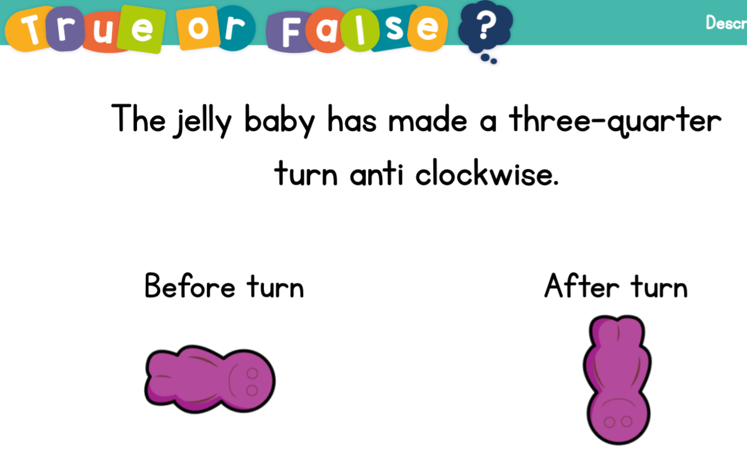
11:35-12:25
Starter

Slide 3
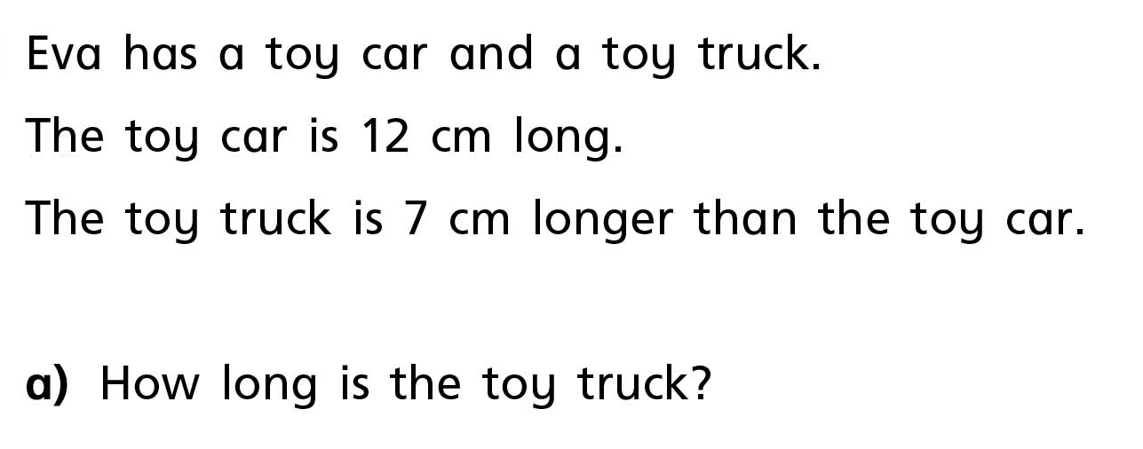
11:35-12:25
Let’s make a
bar model to help us!
Challenge: How long are both the toys together?

Slide 4
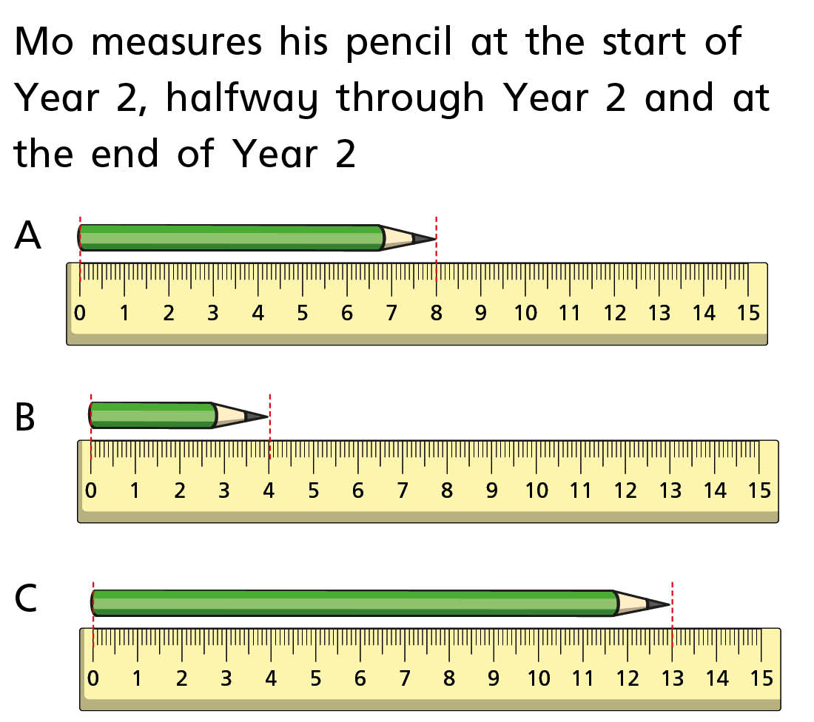
11:35-12:25
Let’s work out what each picture shows?
What is the difference in the pencil’s length from the start to the end of year 2?

Slide 5
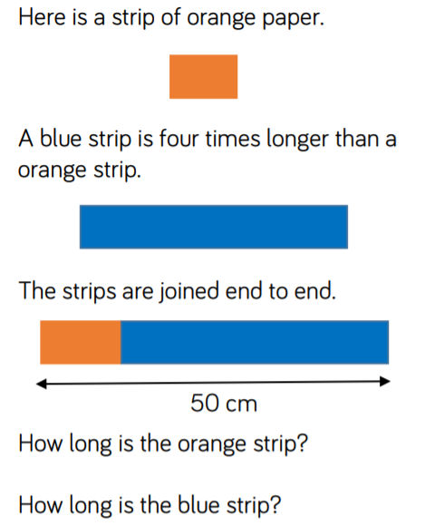
11:35-12:25

Slide 6
11:35-12:25
Your turn! Cut and stick a question card in your book one at a time.
Draw a bar model in your book to help you work out your answers.

Slide 7
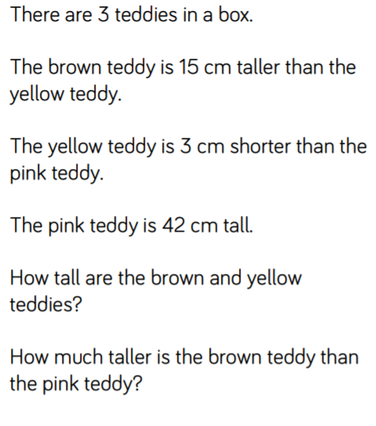
11:35-12:25
Plenary!

