Slide 1
11:35-12:25
Thursday 8th October 2020
L.O: To use measures
C: Order lengths

Slide 2
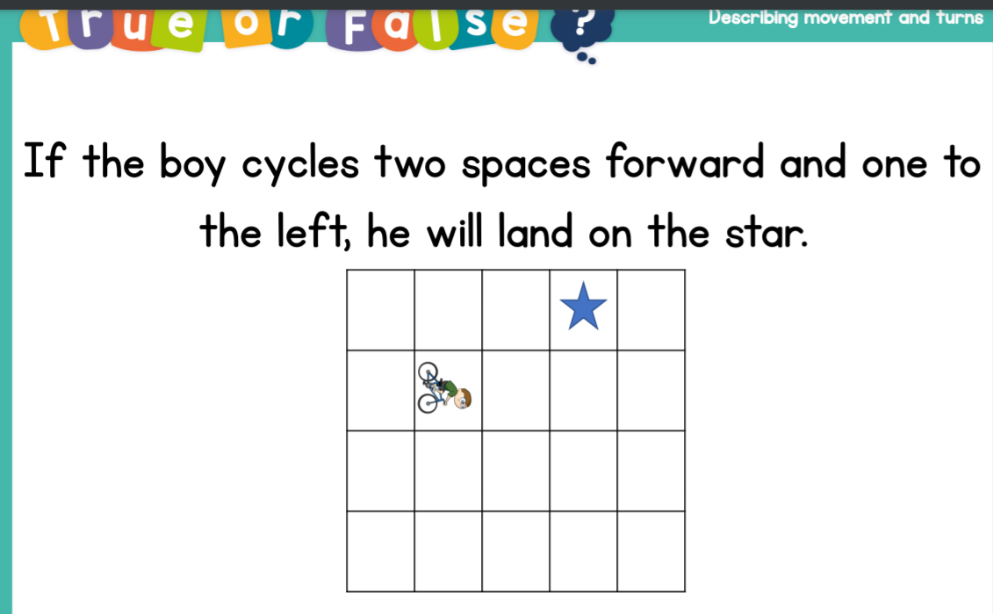
11:35-12:25
Starter

Slide 3
11:35-12:25
Part One: In the BOLE!
You are going to take your ruler, whiteboard and pen. We are going to measure lots of things in the BOLE!

Slide 4

11:35-12:25
What could you measure?

Slide 5
11:35-12:25
Please draw a table like this on your whiteboard.
Item Length in cm

Slide 6
11:35-12:25
Now it’s time to order these measurements from smallest to biggest!

Slide 7
11:35-12:25
Now it’s time to order these measurements from smallest to biggest!

Slide 8
11:35-12:25
Please lay out in a table like this!
Item | Length (cm)
Highlighter

Slide 9
11:35-12:25
Divers Bonus Challenge:
In red pen, please write a sentence about your shortest and longest item.
Can you find the difference between the shortest and longest measurement?

Slide 10
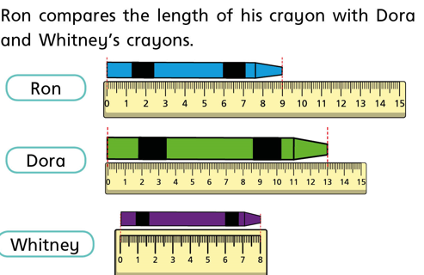
11:35-12:25
Plenary

Slide 11
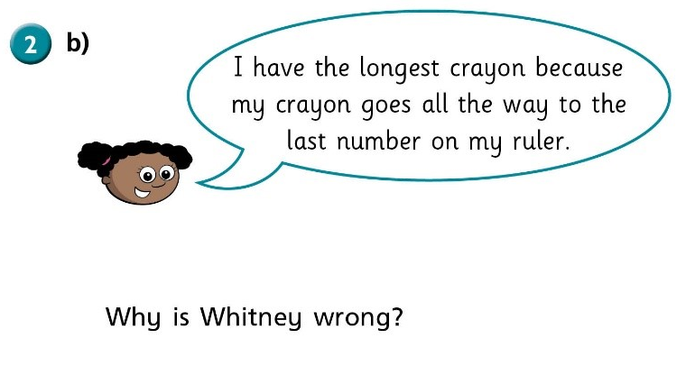
11:35-12:25

