Slide 1

Friday 20th November 2020
L.O: To summarise key events.
C: Let’s do the Pharaoh.

Slide 2
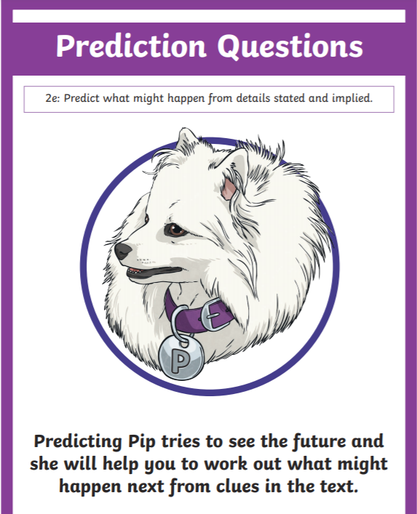
Rapid Recap Challenge!
Class Read : p.122-123
Let’s see if our predictions from yesterday were true!

Slide 3
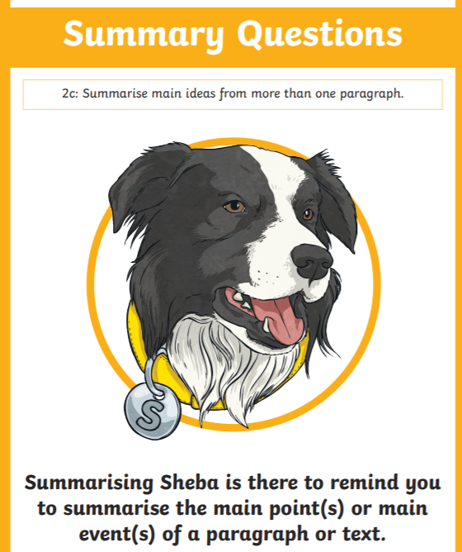
Summarising Sheba Time!
Today we are going to use our summary skills to explain the main events of the story!

Slide 4
Summarising Sheba Time!
Today we are going to use our summary skills to explain the main events of the story!
Class Read p.123-125

Slide 5

How did the Lightspeeds find Sennapod?

Slide 6
How did the Lightspeeds find Sennapod?
My turn to summarise!

Slide 7
How did the Lightspeeds find Sennapod?
Now it’s your turn summarise!

