Slide 1
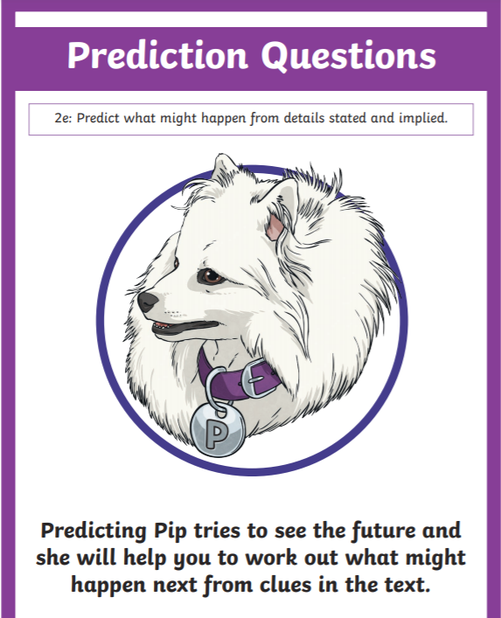
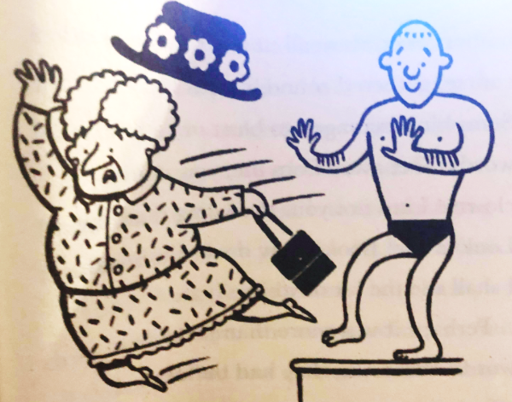
Predicting Pip Time!
How might she be feeling?
What might she say?
What might she do?

Slide 2
Predicting Pip Time!
How might she be feeling?
What might she say?
What might she do?

Slide 3
Paddlers:
I think Serraphina might be feeling _______________________________________________________
I think Serraphina might _________________” _________________
________________________________________________________
__________________________________!”
I believe Serraphina might react by __________________________
_______________________________________________________
_______________________________________________________

