Slide 1

Thursday 19th November 2020
L.O: To predict a character’s actions.
C: Let’s do the Pharaoh.

Slide 2

Fastest Finger Challenge!
Class Read : p.119-121
Fastest finger:
On page 119, can you find: Blood Donor (What does it mean?), Baby, Physiotherapy (What does it mean?)

Slide 3
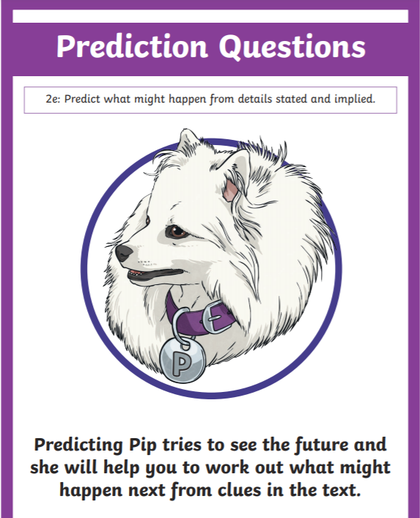
Predicting Pip Time!
Today we are going to use our understanding of the characters to make predictions!

Slide 4

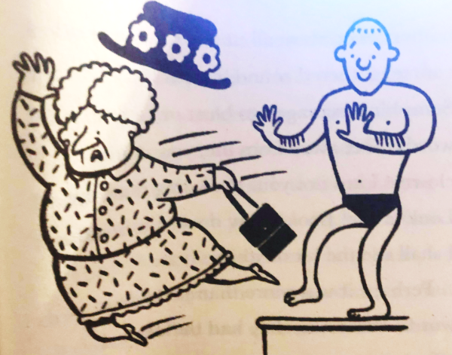
What has happened to Serraphina?

Slide 5
Predicting Pip Time!
How might she be feeling?
What might she say?
What might she do?

Slide 6
Predicting Pip Time!
Paddlers: Complete your sheet using the sentence stems.
Snorklers: Complete your sheet using the sentence stems on the board.
Divers: Complete your sheet using the sentence stems on the board. Complete the red pen question.

Slide 7
Predicting Pip Time!
I think Serraphina might be feeling ….. Because….
I think Serraphina might cry/shout/exclaim “…….!” because…
I think Serraphina might ….

