Slide 1

Wednesday 18th November 2020
L.O: To infer a character’s feelings.
C: Let’s do the Pharaoh.

Slide 2

Fastest Finger!
Class Read: p.114 (It just so happened) – p.118
On p.115 please can you find: Noticeable, Podgy, Confusing?

Slide 3

Let’s use Rex Retriever!
What did Grimstone and Jelly do when they entered the house?

Slide 4

Let’s use Inference Iggy!
Why do you think Jelly is hesitant to go to the hospital?

Slide 5
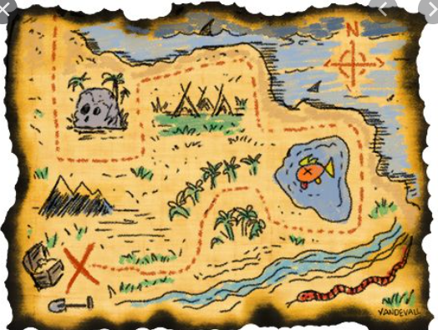
Time for your opinion!
If you were Sennapod where would you hide your map and why?

