Slide 1
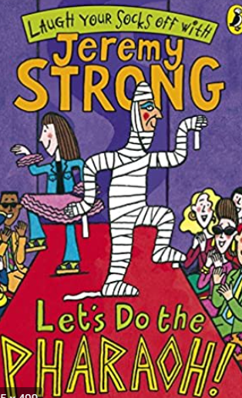
Tuesday 17th November 2020
L.O: To understand a character’s actions.
C: Let’s do the Pharaoh.

Slide 2

Fastest Finger!
Class read: p.112-114
On p.112 can you find: Bandages, Knocked, Slipped?
Who do think that is in the picture? How do you know?

Slide 3

Let’s use Rex Retriever!
What did Grimstone and Jelly do when they entered the house?

Slide 4
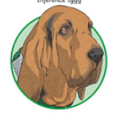
Let’s use Inference Iggy!
Why do you think Jelly is hesitant to go to the hospital?

Slide 5
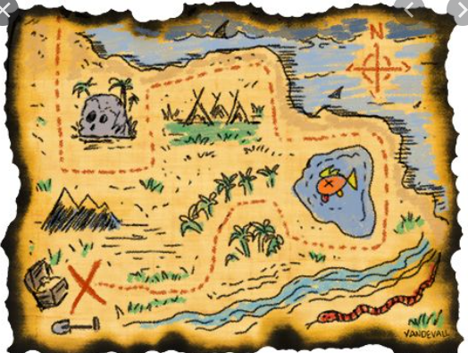
Time for your opinion!
If you were Sennapod where would you hide your map and why?

