Slide 1

Monday 16th November 2020
L.O: To use new vocabulary in context.
C: Let’s do the Pharaoh.

Slide 2

Fastest Finger Challenge!
Class Read : p.106-111
Look for the pronouns on p.106. Is this story written in the 1st, 2nd or 3rd person?

Slide 3
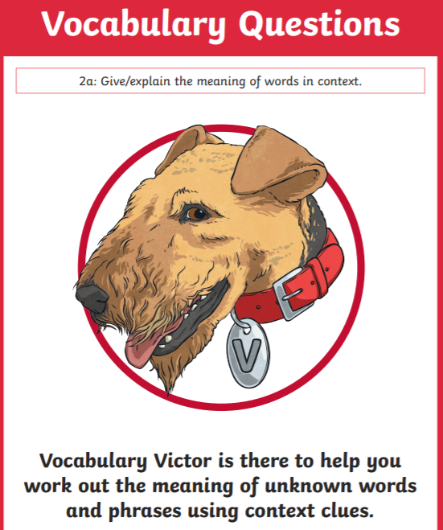
Vocabulary Victor Time!
Today we are going to find some new words and learn what they mean!
We are going to try and use them in context too!

Slide 4
Vocabulary Victor Time!
Today we are going to find some new words and learn what they mean!
We are going to try and use them in context too!
Why should we learn new words?

Slide 5
Vocabulary Victor Time!
Can you draw a table like this in your book?
Word | Meaning | Applied in a sentence

Slide 6
Vocabulary Victor Time!
Paddlers: Define and apply the new words in a sentence.
Snorkelers: Define and apply the new words in a sentence which includes a FANBOYS conjunction.
Divers: Define and apply the new words in a sentence which includes a FANBOYS conjunction and an adverbial phrase.

