Slide 1
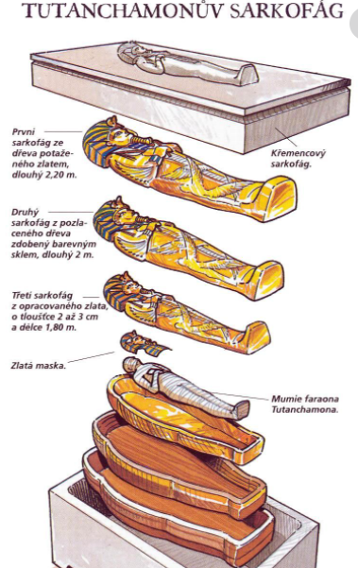
Wearing:
Mummy of:
Coffin made of:
Coffin plated in:
Coffin plated in:
Sarcophagus made of:

Slide 2
Wearing:
Mummy of:
Coffin made of:
Coffin plated in:
Coffin plated in:
Sarcophagus made of:

