Slide 1
Tuesday 17th November 2020
L.O: To write a recount.
C: Recount

Slide 2
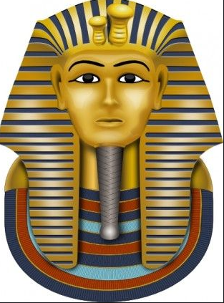
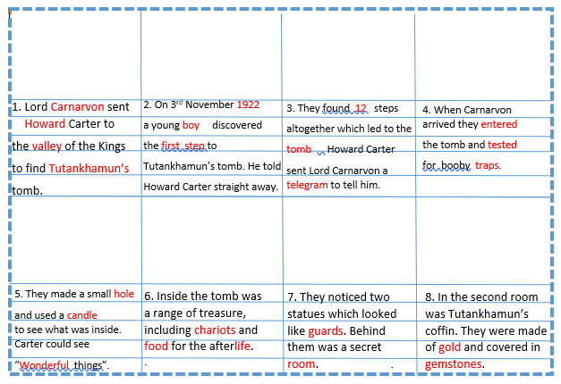
Today we are going to continue writing the middle sections of our recounts!
Can you find your plan we made?
It should look like this with pictures.

Slide 3

Today we are going to continue writing the last sections of our recounts!
Now it is time to try writing the last few sections.

Slide 4
Let’s remind ourselves how Tutankhamun’s mummy was discovered.
https://www.youtube.com/watch?v=V3U1IcB3ecU

Slide 5
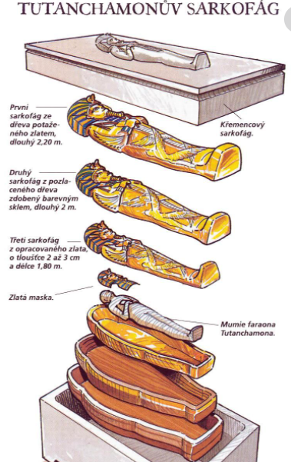
Let’s remind ourselves how Tutankhamun’s mummy was discovered.
https://www.youtube.com/watch?v=V3U1IcB3ecU

Slide 6
It’s your turn!
Have a go at writing using the new checklist and your help sheet!

Slide 7
Let’s look at my model conclusion!
Over all, this was a once-in-a-lifetime experience. Despite the long tiring hours of archaeological digs, the reward was well worth it! Whenever I close my eyes, I can still see the blinding sparkle of the wealth of treasures. It was truly magnificent.

Slide 8
What features can you spot?
Over all, this was a once-in-a-lifetime experience. Despite the long tiring hours of archaeological digs, the reward was well worth it! Whenever I close my eyes, I can still see the blinding sparkle of the wealth of treasures. It was truly magnificent.

Slide 9
It’s your turn!
Have a go at writing using your conclusion!

Slide 10

Book on book!
Work with your partner to RED PEN your work against the checklist!

