Slide 1
Monday 16th November 2020
L.O: To write a recount.
C: Recount

Slide 2
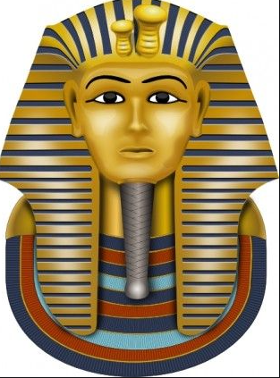
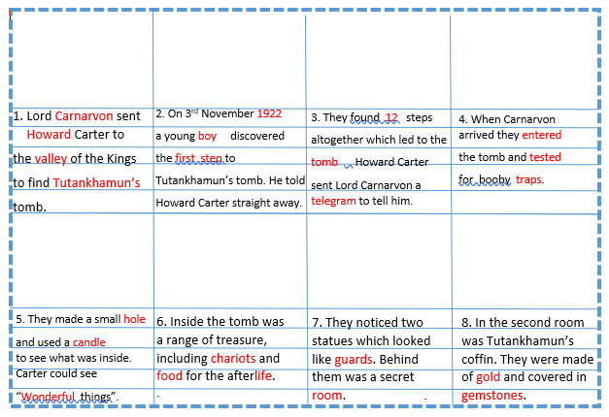
Today we are going to continue writing the middle sections of our recounts!
Can you find your plan we made?
It should look like this with pictures.

Slide 3

Today we are going to continue writing the middle sections of our recounts!
Now it is time to try writing the next few sections.

Slide 4
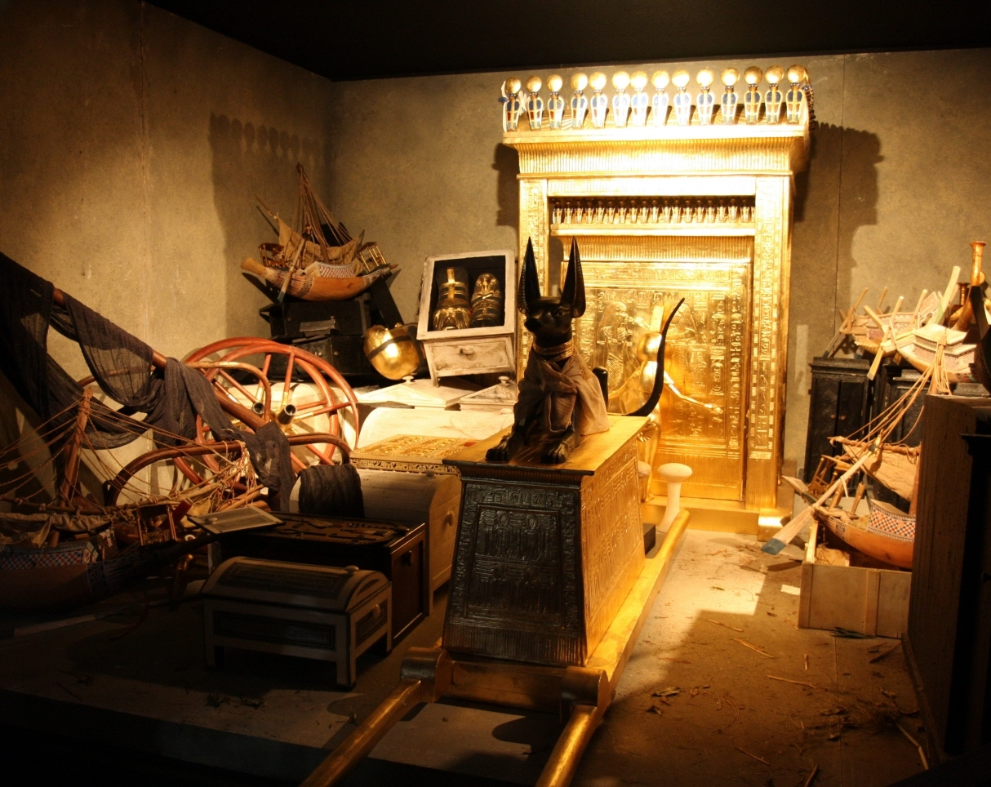
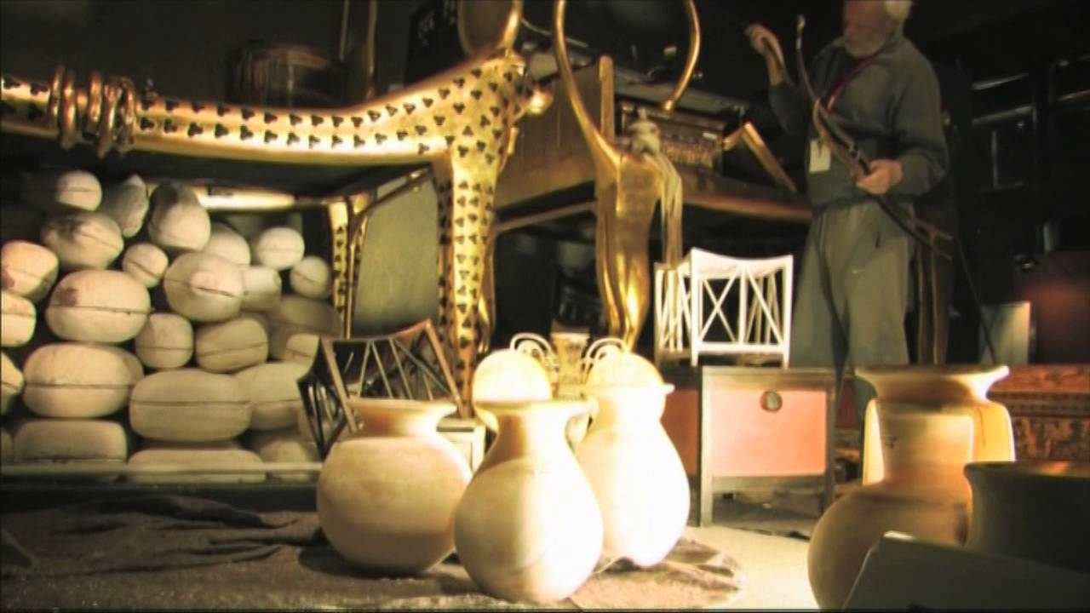
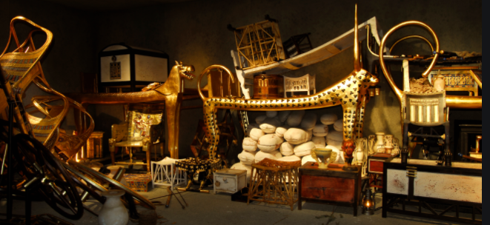
Let’s try to remember what treasure was in Tutankhamun’s treasure chamber!

Slide 5
Let’s try to remember what treasure was in Tutankhamun’s treasure chamber!
Let’s think of some adjectives to describe it too!
You can add some to your magpie word bank!

Slide 6
It’s your turn!
Have a go at writing using the new checklist and your magpie word bank!

Slide 7

Book on book!
Work with your partner to RED PEN your work against the checklist!

