Slide 1
19.11.20
LO: To add and subtract
C: Subtract a 2-digit number
from a 2-digit number –
crossing 10 - subtract ones
& subtract tens

Slide 2
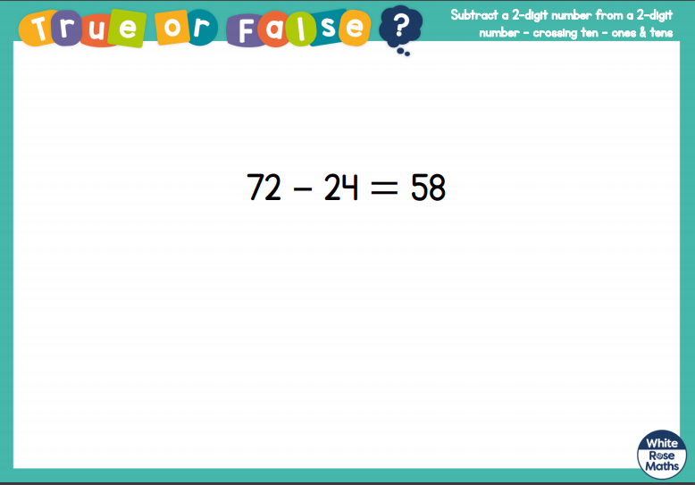

Slide 3
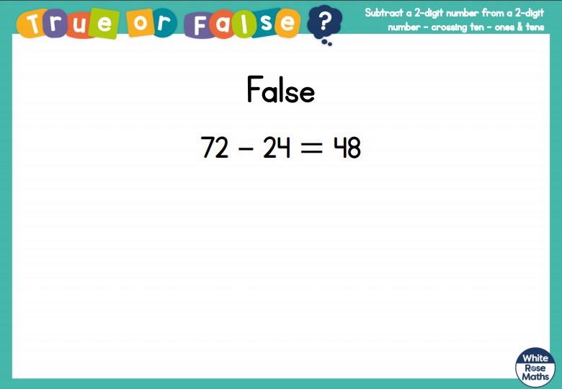

Slide 5
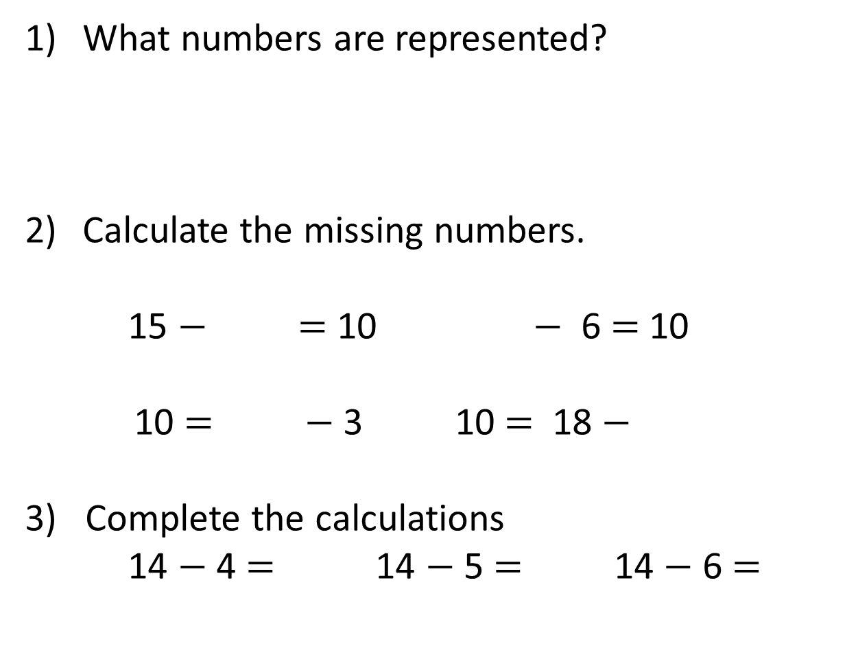
What numbers are represented?
Calculate the missing numbers.
15 $−$ $=$ 10 $−$ 6 $=$ 10
10 $=$ $−$ 3 10 $=$ 18 $−$
3) Complete the calculations
14 $−$ 4 $=$ 14 $−$ 5 $=$ 14 $−$ 6 $=$
c
c
c
c

Slide 6
What numbers are represented?
Calculate the missing numbers.
15 $−$ $=$ 10 $−$ 6 $=$ 10
10 $=$ $−$ 3 10 $=$ 18 $−$
3) Complete the calculations
14 $−$ 4 $=$ 14 $−$ 5 $=$ 14 $−$ 6 $=$
25
20
25
5
c
c
16
c
c
c
c
c
13
c
8
10
9
8

Slide 8
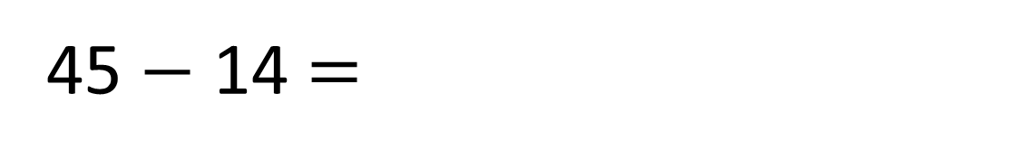
45 $−$ 14 $=$
31

Slide 9

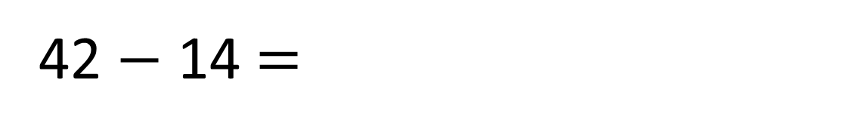
42 $−$ 14 $=$
28
10 ones $=$ 1 ten

Slide 10

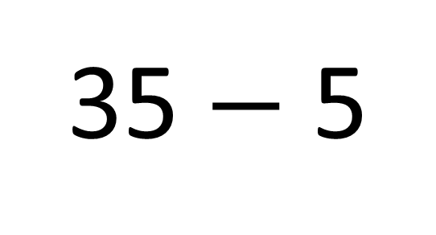
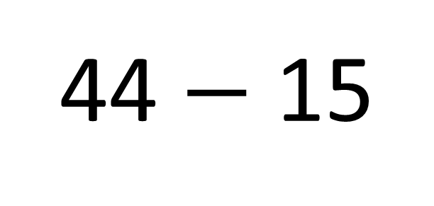
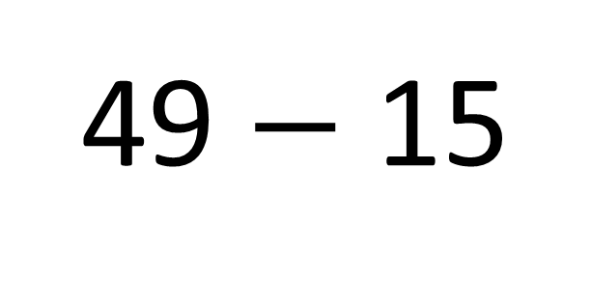
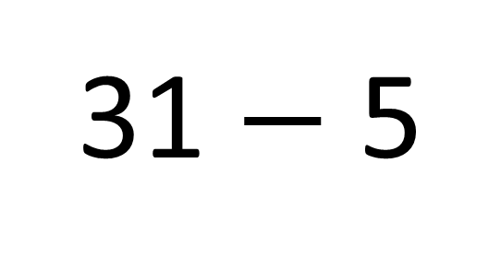
Need an exchange
Do not need an exchange
31 $−$ 5
44 $−$ 15
35 $−$ 5
49 $−$ 15
Have a think

Slide 11
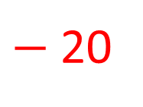
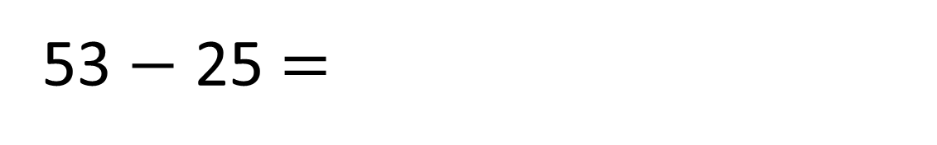
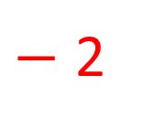
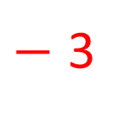
53 $−$ 25 $=$
28
Have a think
$−$ 2
$−$ 3
$−$20
28
30
33
53

Slide 12



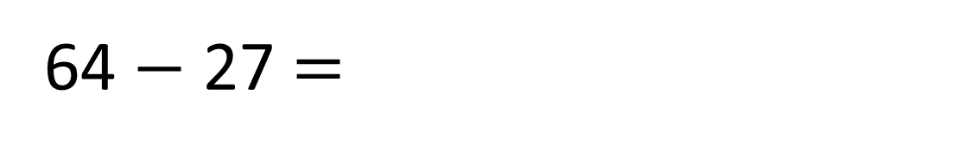
64 $−$ 27 $=$
37
Tens | Ones
T | O
6 | 4
2 | 7
5
1
$$−$$
3
7

Slide 13
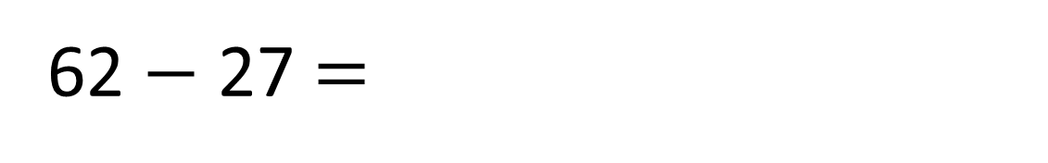
62 $−$ 27 $=$
35
Have a think
Tens | Ones
T | O
6 | 2
2 | 7
5
1
$$−$$
3
5

Slide 14
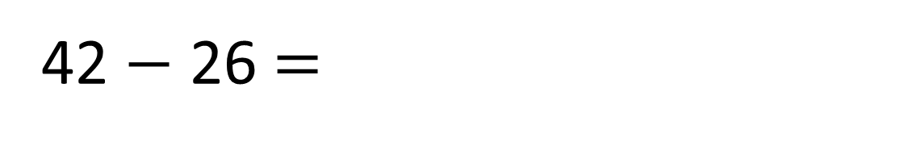
42 $−$ 26 $=$
16
Have a think
Tens | Ones
T | O
4 | 2
2 | 6
3
1
$$−$$
1
6

Slide 15
Have a go at the questions you have been given before trying the red pen question.

Slide 16




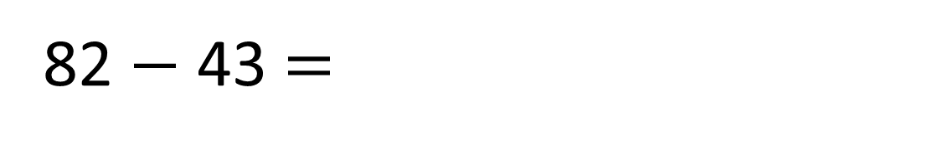
How many more cm did Ron’s marble roll?
?
39 cm
43 cm
82 cm
T | O
8 | 2
4 | 3
82 $−$ 43 $=$
39 cm
7
1
$$−$$
3
9

