Slide 1
18.11.20
LO: To add and subtract
C: Add two 2-digit numbers
- crossing 10
- add ones & add tens

Slide 3
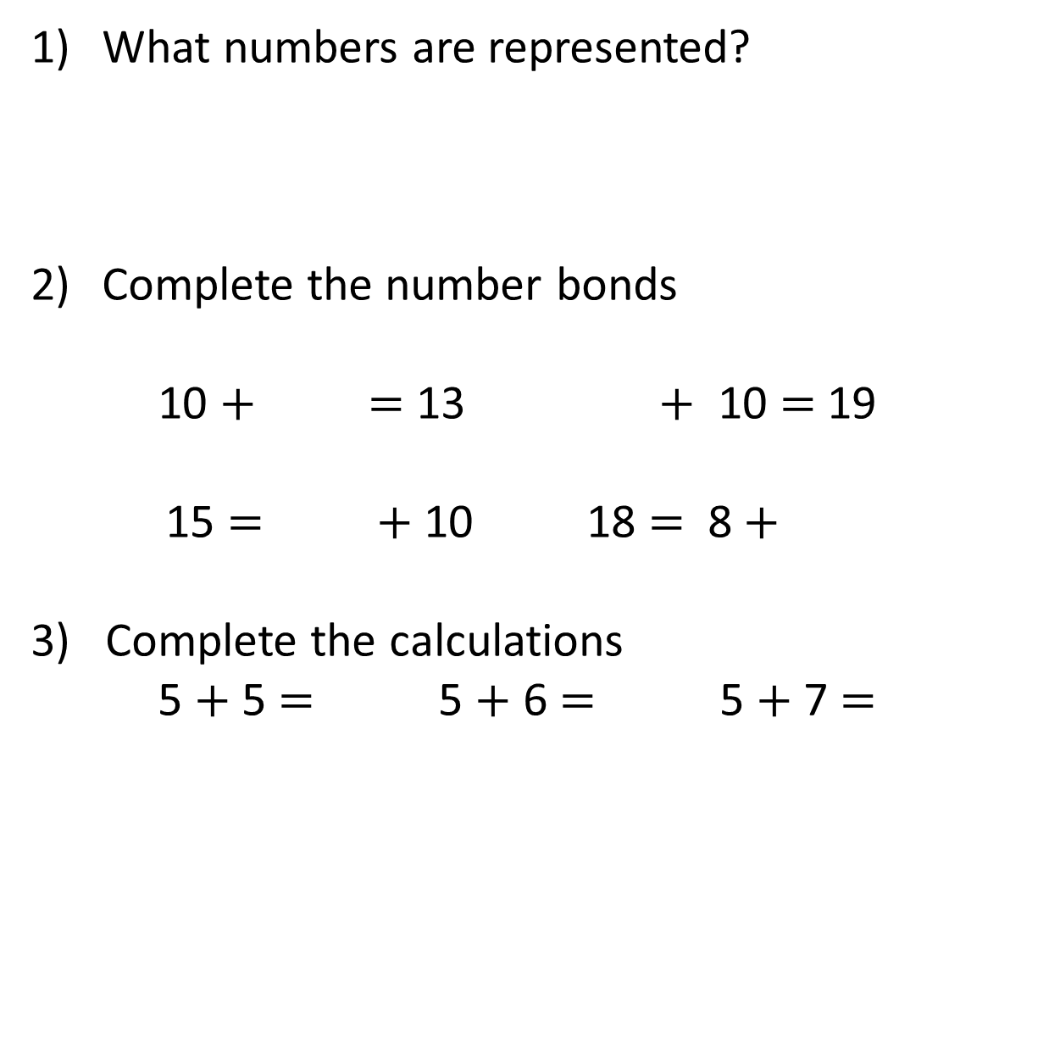
What numbers are represented?
Complete the number bonds
10 $+$ $=$ 13 $+$ 10 $=$ 19
15 $=$ $+$ 10 18 $=$ 8 $+$
3) Complete the calculations
5 $+$ 5 $=$ 5 $+$ 6 $=$ 5 $+$ 7 $=$
c
c
c
c

Slide 4
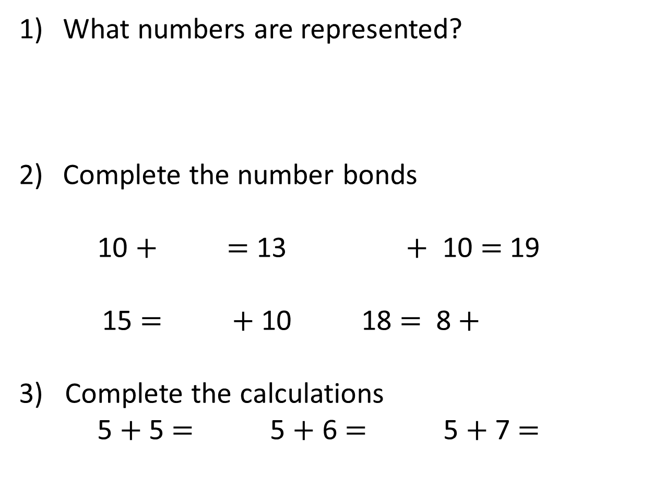
What numbers are represented?
Complete the number bonds
10 $+$ $=$ 13 $+$ 10 $=$ 19
15 $=$ $+$ 10 18 $=$ 8 $+$
3) Complete the calculations
5 $+$ 5 $=$ 5 $+$ 6 $=$ 5 $+$ 7 $=$
15
18
20
3
c
9
c
c
c
5
10
10
11
12

Slide 6
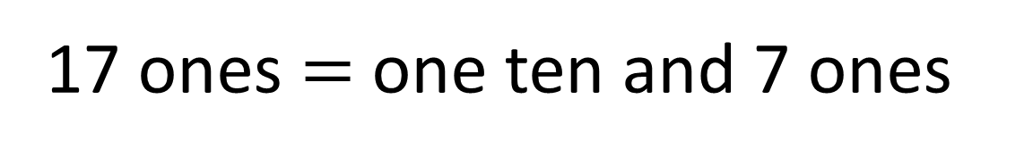
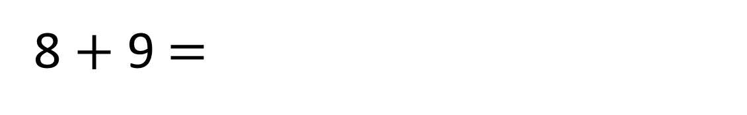
8 $+$ 9 $=$
17
17 ones $=$ one ten and 7 ones

Slide 7
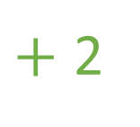
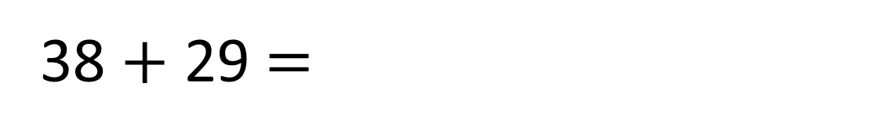
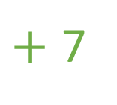
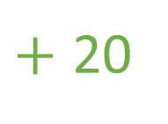
38 $+$ 29 $=$
67
$+$ 20
$+$ 2
$+$ 7
38
58
60
67

Slide 8
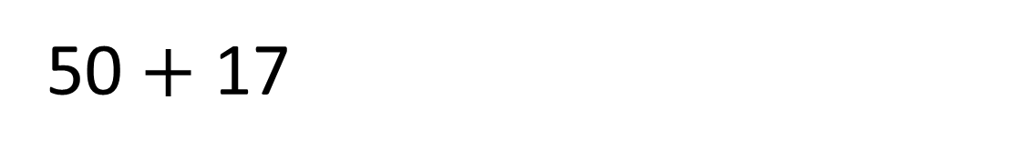
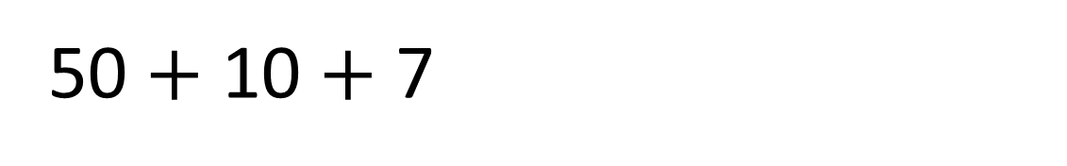
38 $+$ 29 $=$
67
50 $+$ 17
50 $+$ 10 $+$ 7

Slide 9



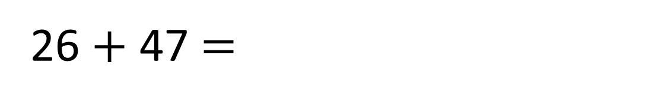
26 $+$ 47 $=$
73
Tens | Ones
 | T | O
 | 2 | 6
 | 4 | 7
$$+$$
3
7
7
3
1

Slide 10

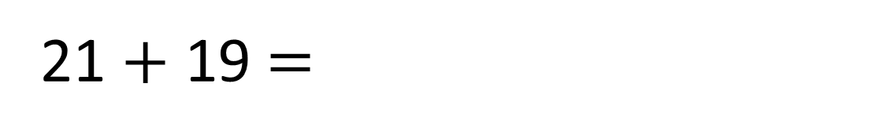
21 $+$ 19 $=$
40
Have a think
Tens | Ones
 | T | O
 | 2 | 1
 | 1 | 9
$$+$$
4
0
4
0
1

Slide 11
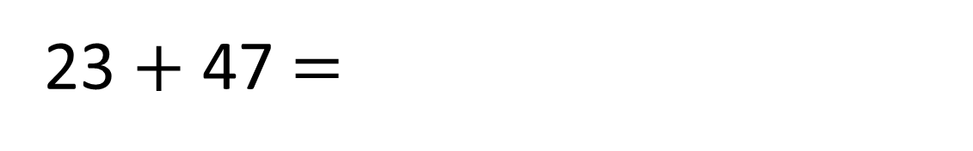
23 $+$ 47 $=$
70
Have a think
Tens | Ones
 | T | O
 | 2 | 3
 | 4 | 7
$$+$$
7
0
7
0
1

Slide 12
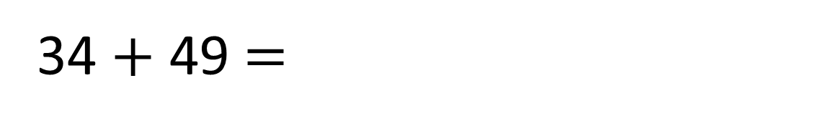
34 $+$ 49 $=$
83
Have a think
Tens | Ones
 | T | O
 | 3 | 4
 | 4 | 9
$$+$$
8
3
8
3
1

Slide 13
Have a go at questions
1 - 5 on the worksheet
Plenary

Slide 14


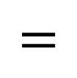

Have a think
1
5
3
5
5
0
$$+$$
v
$$=$$

Slide 15
2
5
2
5
5
0
$$+$$
v
$$=$$

Slide 16
3
5
1
5
5
0
$$+$$
v
$$=$$

