Slide 1
16.11.20
LO: To add and subtract
C: To add and subtract 100s

Slide 3


What is 100 more than 600?
What is 100 less than 600?
Continue the sequences
300, 400, 500, 600, ____, ____, ____
900, 800, 700, ____, ____, ____
3) What number is represented by the counters?

Slide 4
What is 100 more than 600?
What is 100 less than 600?
Continue the sequences
300, 400, 500, 600, ____, ____, ____
900, 800, 700, ____, ____, ____
3) What number is represented by the counters?
700
500
700
800
900
600
500
400
520

Slide 6


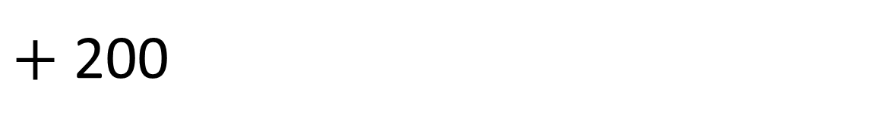
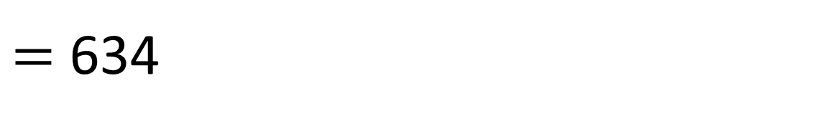
Add 200
$+$ 200
$=$ 634
434
What will their new number be?

Slide 7
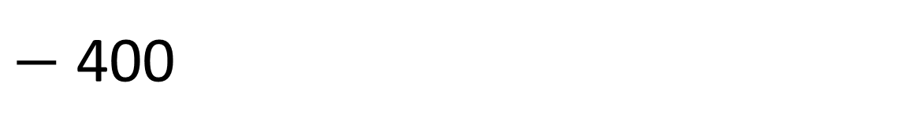
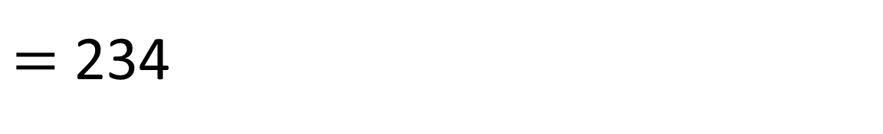
Subtract 400
634
$−$ 400
$=$ 234
What will their new number be?

Slide 8
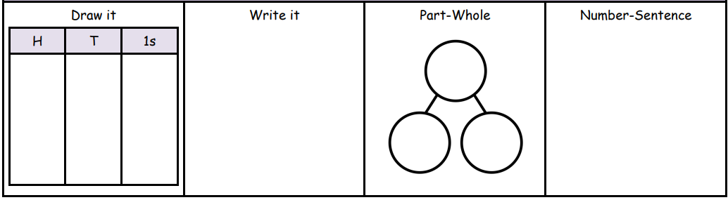
296 + 300=
465 - 200=

Slide 9





Complete each part-whole model.
412
200
212
300
112
412
Have a think

Slide 10
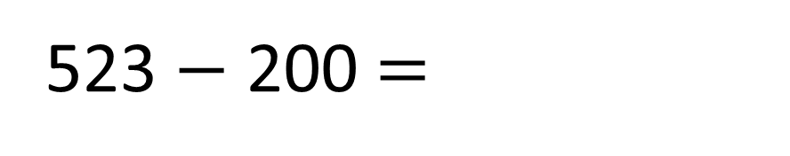
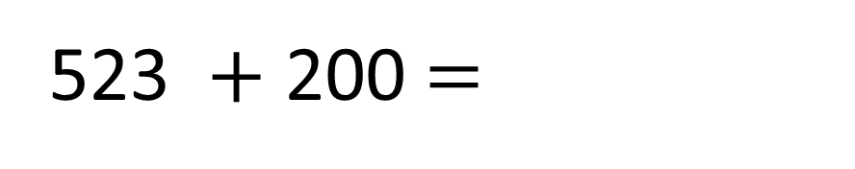
Complete the calculations.
523 $+$ 200 $=$
723
v
500
20
3
200
523 $−$ 200 $=$
323
v
500
20
3
300

Slide 11
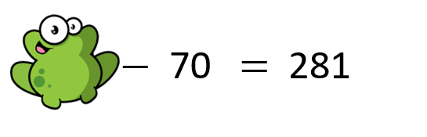
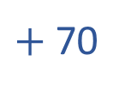
Challenge
Both girls finished with 721
Have a think
I subtracted 200 from my number
I added 500 to my number
$+$ 70
What number did each girl start with?

Slide 12
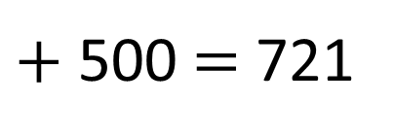
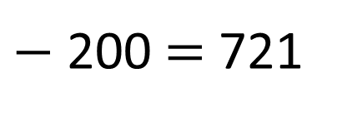
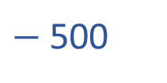
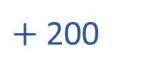
Both girls finished with 721
921
$−$ 200 $=$ 721
I subtracted 200 from my number
$+$ 200
I added 500 to my number
221
$+$ 500 $=$ 721
$−$ 500
What number did each girl start with?

Slide 13
Have a go at the rest of the questions on the worksheet

