Slide 1


Slide 3
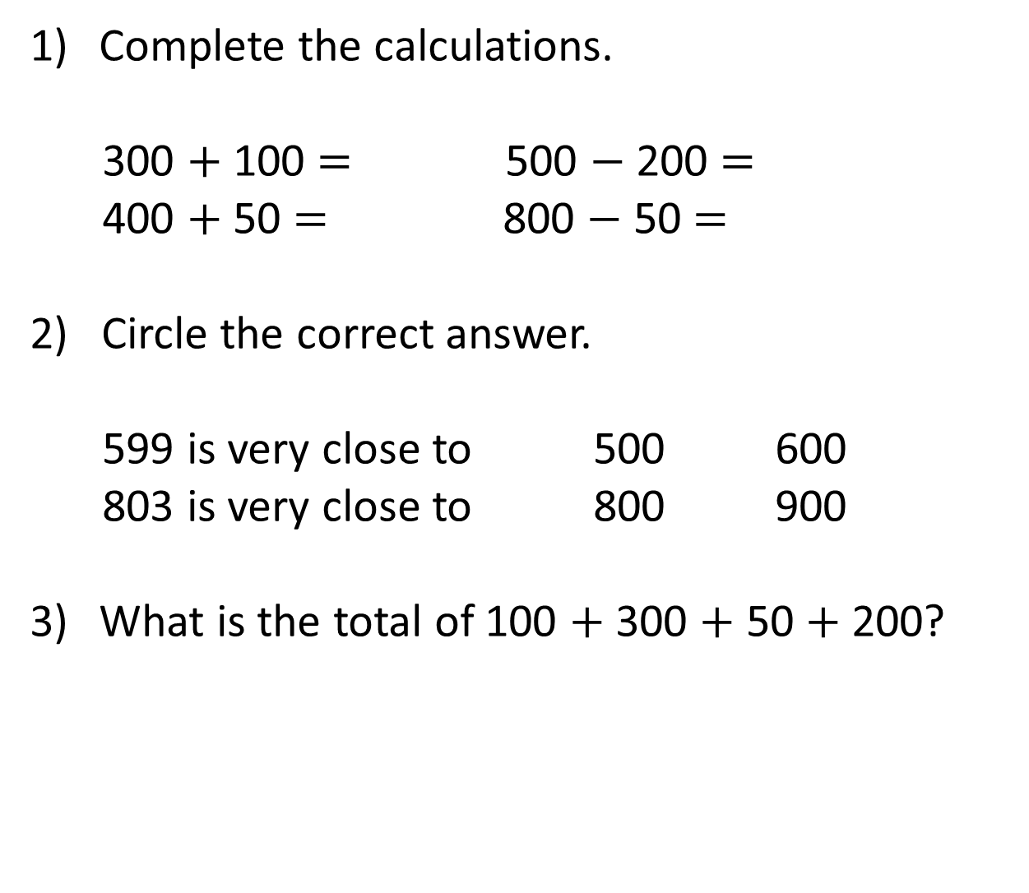
Complete the calculations.
300 $+$ 100 $=$ 500 $−$ 200 $=$
400 $+$ 50 $=$ 800 $−$ 50 $=$
2) Circle the correct answer.
599 is very close to 500 600
803 is very close to 800 900
What is the total of 100 $+$ 300 $+$ 50 $+$ 200?

Slide 4
Complete the calculations.
300 $+$ 100 $=$ 500 $−$ 200 $=$
400 $+$ 50 $=$ 800 $−$ 50 $=$
2) Circle the correct answer.
599 is very close to 500 600
803 is very close to 800 900
What is the total of 100 $+$ 300 $+$ 50 $+$ 200?
400
300
450
750
650

Slide 6
Estimate
To give an approximate answer
Check what an answer should be close to
To see approximately how many we have or need

Slide 7

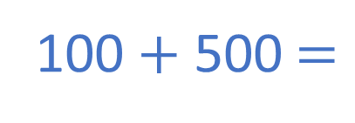
High Street School has 119 pupils.
Main Road School has 486 pupils.
Estimate how many pupils there are in total.
100
119 is close to ____
100
119
100 $+$ 500 $=$
600 pupils
200
500
486 is close to ____
400
486
500

Slide 8

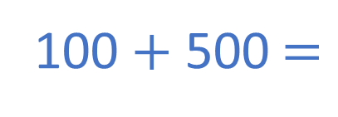
High Street School has 119 pupils.
Main Road School has 486 pupils.
Estimate how many pupils there are in total.
100 $+$ 500 $=$
600 pupils
H | T | O
1 | 1 | 9
4 | 8 | 6
There are approximately
600 pupils
$$+$$
6
0
5
1
1

Slide 9
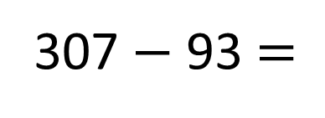
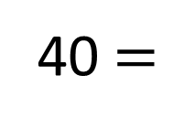
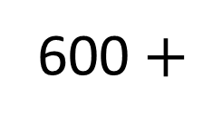
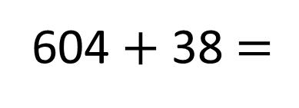
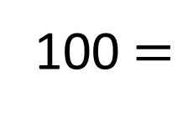
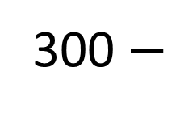
604 $+$ 38 $=$
307 $−$ 93 $=$
600 $+$
40 $=$
640
300 $−$
100 $=$
200

Slide 10

Have a think
Mr Brown saves some money each week.
Week 1 | Week 2 | Week 3 | Week 4
£181 | £291 | £254 | £93
£200
£300
£250
£100
Mr Brown needs to pay £700 for his holiday.
Has he saved enough?
£850
Yes, he has saved enough.

Slide 11

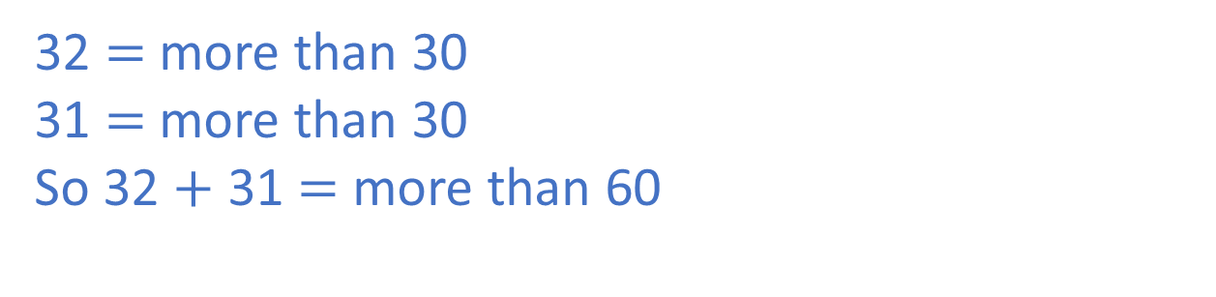
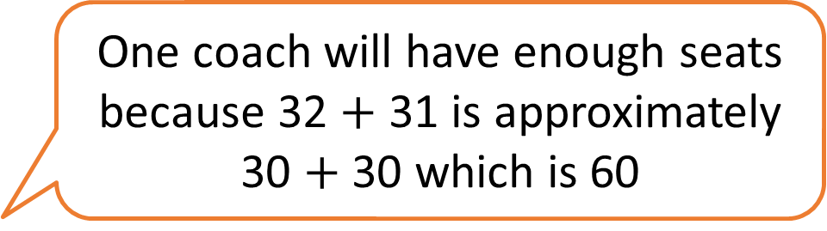
Two classes are going on a school trip.
In Class 2 there are 32 pupils.
In Class 3 there are 31 pupils.
One coach holds 60 pupils.
One coach will have enough seats because 32 $+$ 31 is approximately 30 $+$ 30 which is 60
Jack says,
Is Jack correct? Explain why.
Have a think
32 $=$ more than 30
31 $=$ more than 30
So 32 $+$ 31 $=$ more than 60

Slide 12

Now you are able to estimate, it is
your job to help Santa estimate how
many presents he has to deliver to
each area.

Slide 13

So there are 734 children on the nice list in Binfield and 426 in Wokingham. Roughly, how many presents do I need to deliver to these areas?

Slide 14
There are 67 staff at Binfield School. 23 are on the Naught List!! How many are on the Nice List?

Slide 15
There are 793 Elves in the Elf Workshop! 129 are too tired to work. How many Elves are left?

