Slide 1
Year 3 Big Christmas Quiz!
Please come up with a team name!
You will need a pencil, rubber and paper.

Slide 2
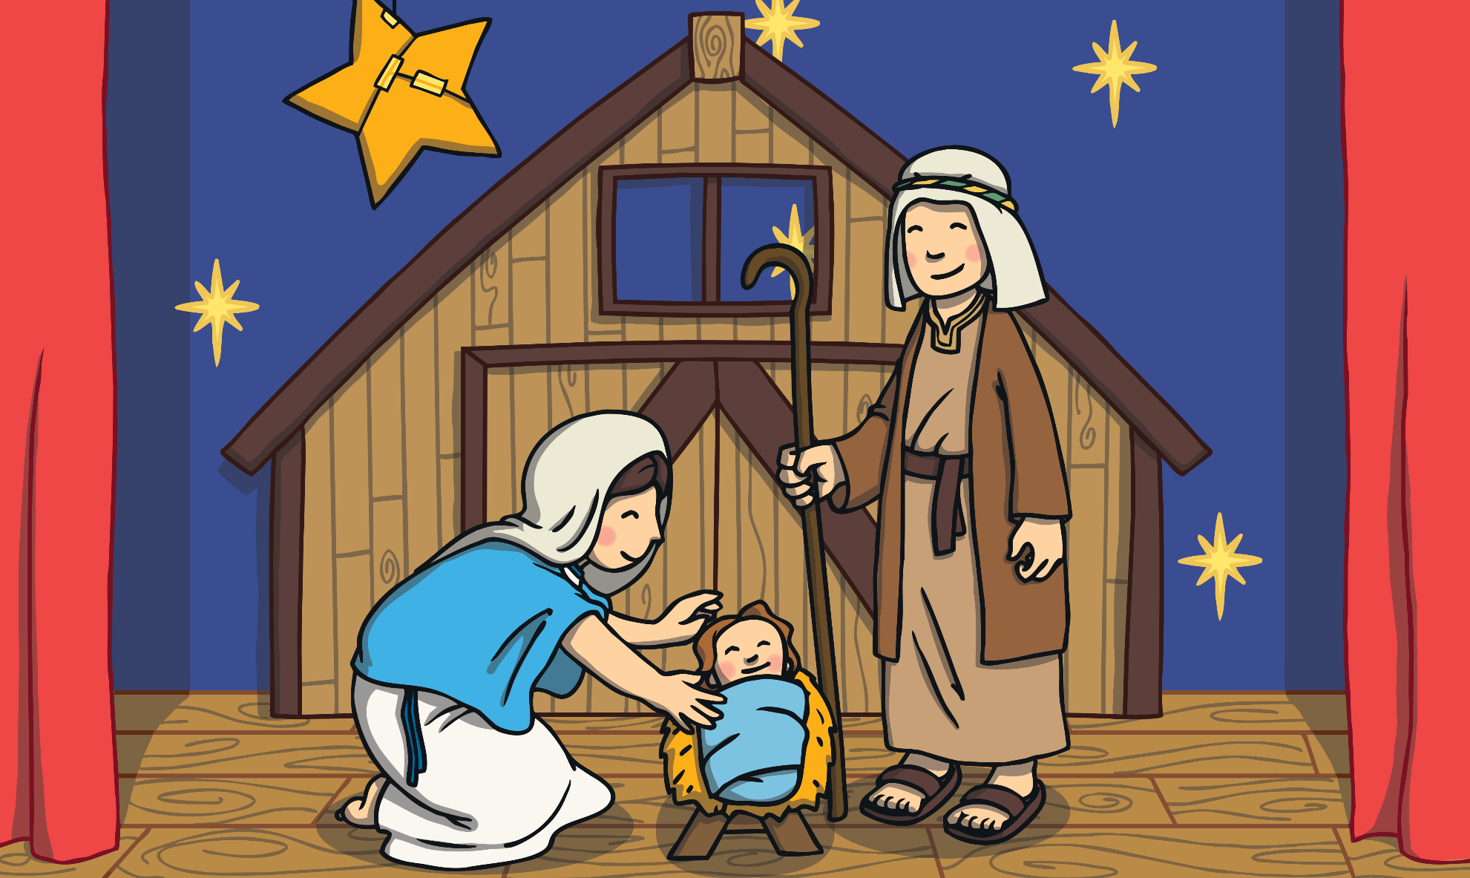
Round 1: Nativity

Slide 3
Question 1
Which angel visited Mary?
A) Angelica
B) Gabriel
C) Noel
D) Harmony

Slide 4
Question 2
What was Joseph’s occupation?
A) Butcher
B) Baker
C) Carpenter
D) Tax collector

Slide 5
Question 3
How many gifts were brought to Jesus by the wise men?
A) 5
B) 4
C) 2
D) 3

Slide 6
Question 4
Which was not a gift from the three wise men?
A) Gold
B) Frankincense
C) Chocolate
D) Myrrh

Slide 7
Question 5
Where was Jesus born?
A) Nazareth
B) Egypt
C) Bethlehem
D) Sheffield

Slide 8

Round 2: Christmas Carols

Slide 9
Question 1
Which Christmas carol demands figgy pudding?
A) Little donkey
B) Jingle bells
C) We wish you a Merry Christmas
D) Silent night

Slide 10
Question 2
On the first day of Christmas what does the true love give as a gift?
A) Five gold rings
B) A partridge in a
pear tree
C) Eight maids a milking
D) Four calling birds

Slide 11
Question 3
Deck the halls with…?
A) Sprigs of parsley
B) Bundles of raspberries
C) Bowls of candy
D) Boughs of holly

Slide 12
Question 4
Away in a manger…?
A) No cloth for a duvet
B) No food for
some soup
C) The stars in the bright sky
D) No crib for a bed

Slide 13
Question 5
Dashing through the snow in a…?
A) Great big caravan
B) Pair of snow shoes
C) One horse
open sleigh
D) Super-fast car

Slide 14
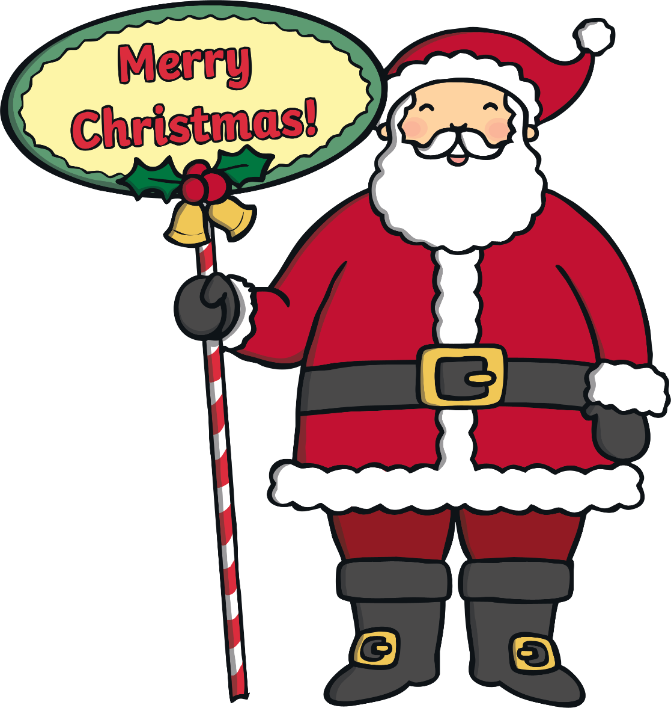
Round 3: Santa

Slide 15
Question 1
Where does Santa live?
A) The North Pole
B) The South Pole
C) South Africa
D) North Yorkshire

Slide 16
Question 2
Who makes Santa’s toys?
A) Angels
B) Elves
C) Reindeers
D) Snowmen

Slide 17
Question 3
Not including Rudolph, how many reindeer does Santa have?
A) 4
B) 6
C) 7
D) 8

Slide 18
Question 4
Which one of these is not one of Santa’s reindeer?
A) Dasher
B) Dobby
C) Prancer
D) Vixen

Slide 19
Question 5
What is Santa’s saint name?
A) Saint Santa Claus
B) Saint Snow
C) Saint Bethlehem
D) Saint Nicholas

Slide 20

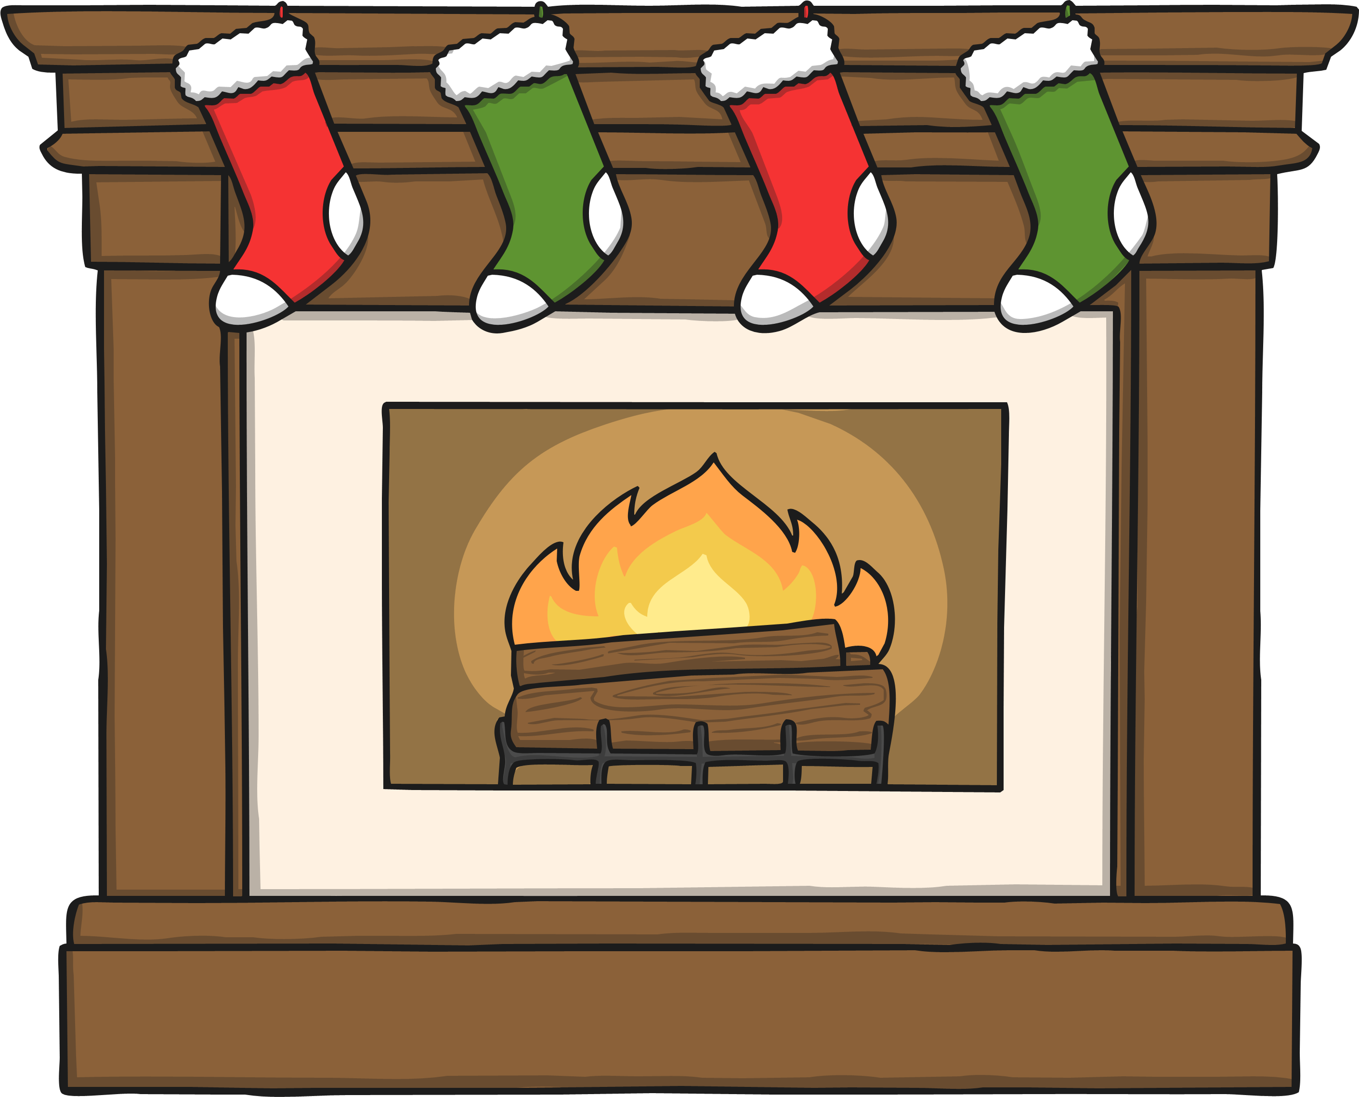
Round 4:
General Christmas Questions

Slide 21
Question 1
Where does the Christmas tree tradition originate from?
A) England
B) Russia
C) Germany
D) Africa

Slide 22
Question 2
Who invented the Christmas cracker?
A) Tom Smith
B) John Smith
C) Jacob Edwards
D) Edward White

Slide 23
Question 3
Which meat is traditionally eaten for Christmas dinner in the UK?
A) Rabbit
B) Turkey
C) Chicken
D) Beef

Slide 24
Question 4
At Christmas it is traditional to kiss under a sprig of which plant?
A) Mistletoe
B) Holly
C) Nettles
D) Poinsettia

Slide 25
Question 5
How many days are on a traditional
advent calendar?
A) 26
B) 24
C) 12
D) 5

Slide 26
Let’s see how you did!
We are going to mark your quizzes!

