Slide 1
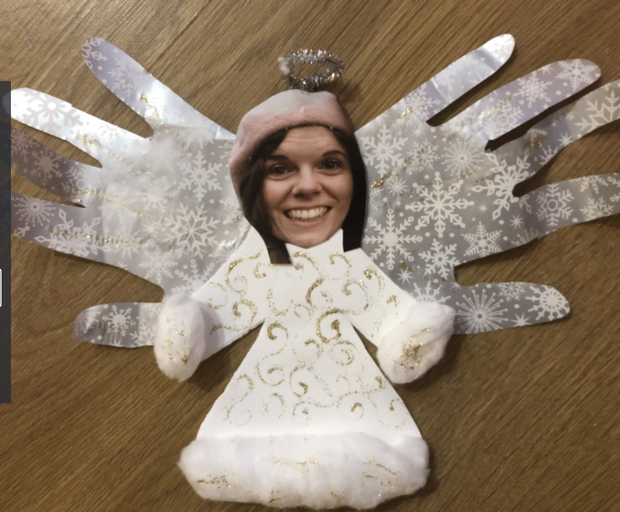
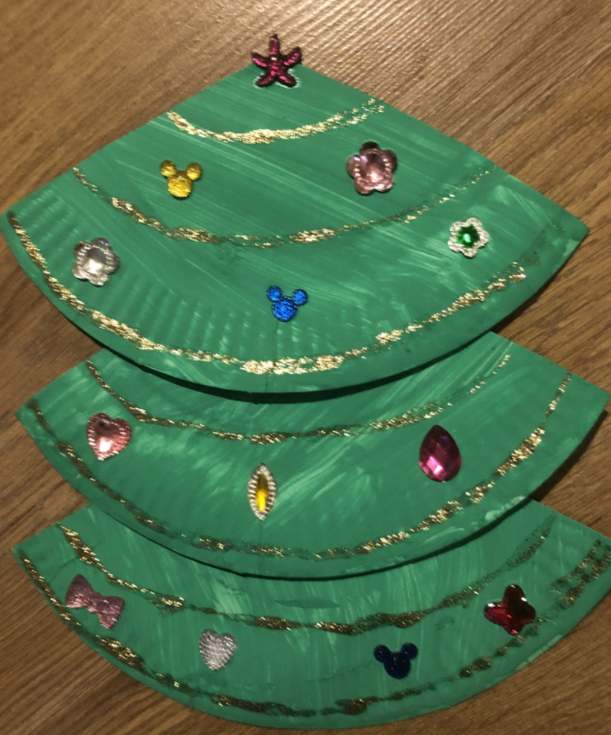
Christmas Craft Time!

Slide 2
Christmas Craft Time!
We are going to make some amazing angel Christmas Cards for your families!

Slide 3
Christmas Craft Time!
We are going to make some amazing Christmas trees!

Slide 4
If you are self-isolating…
If you are self-isolating you can try making a tree or angel!
Use whatever you have at home to make a beautiful festive creation!

