Slide 1
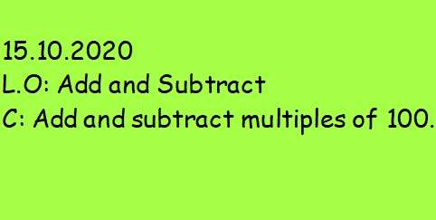

Slide 2
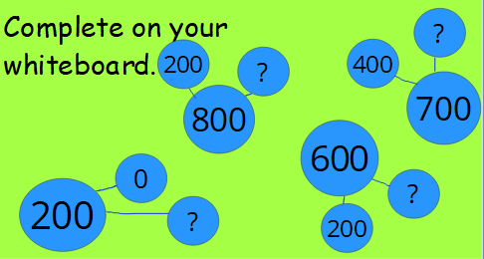

Slide 3
https://classroom.thenational.academy/lessons/adding-and-subtracting-multiples-of-100-tofrom-3-digit-numbers-crw62d

Slide 4


