Slide 1


Slide 3
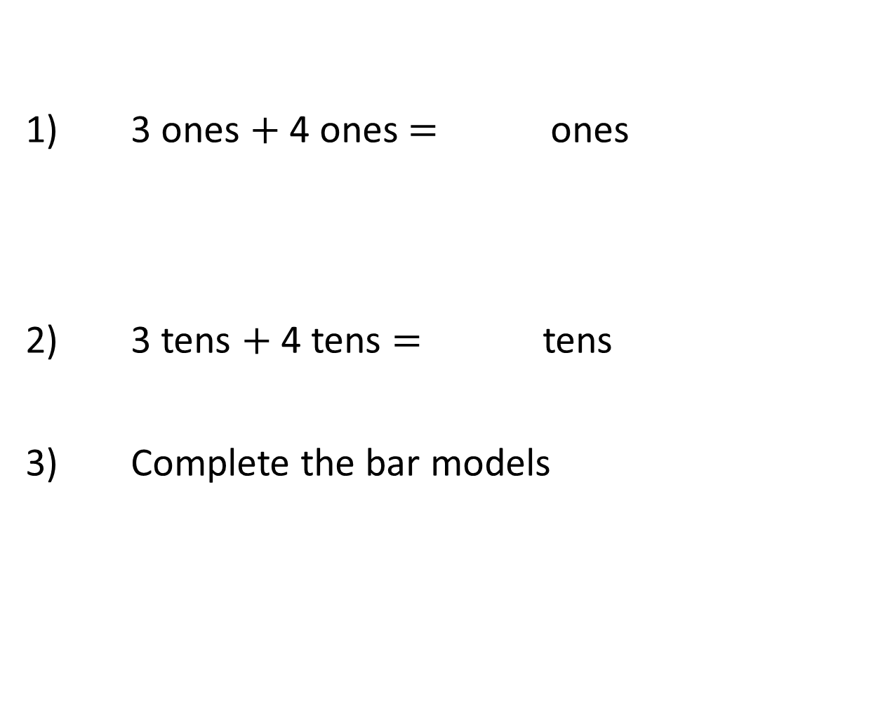
1) 3 ones $+$ 4 ones $=$ ones
2) 3 tens $+$ 4 tens $=$ tens
Complete the bar models
8
80
6
60

Slide 4
1) 3 ones $+$ 4 ones $=$ ones
2) 3 tens $+$ 4 tens $=$ tens
Complete the bar models
7
7
8
80
6
2
60
20

Slide 6

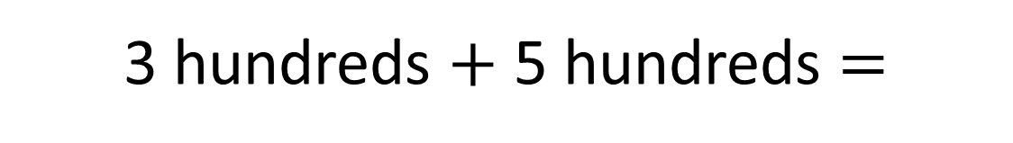

3 $+$ 5 $=$
8
3 hundreds $+$ 5 hundreds $=$
8 hundreds
300 $+$ 500 $=\text{800}$

Slide 7

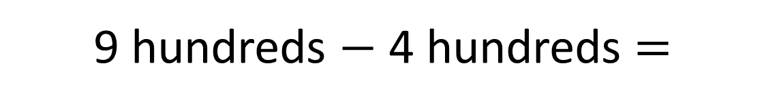

9 $−$ 4 $=$
5
9 hundreds $−$ 4 hundreds $=$
5 hundreds
900 $−$ 400 $=$ 500

Slide 8





Complete the calculations.
Have a think
600
200 $+$ 400 $=$
700
$=$ 300 $+$ 400
500
800 $−$ 300 $=$
$=$ 800 $−$ 400
400

Slide 9
Have a go at this…

Slide 10
Use the bar model to write 8 different calculations.
Whole
Part
Part

Slide 11








Use the bar model to write 8 different calculations.
Whole
Part
Part
part $+$ part $=$ whole
whole $−$ part $=$ part
part $+$ part $=$ whole
whole $−$ part $=$ part
whole $=$ part $+$ part
part $=$ whole $−$ part
whole $=$ part $+$ part
part $=$ whole $−$ part

Slide 12
Use the bar model to write 8 different calculations.
900
Have a think
700
200

Slide 13








Use the bar model to write 8 different calculations.
900
Have a think
700
200
700 $+$ 200 $=$ 900
900 $−$ 200 $=$ 700
200 $+$ 700 $=$ 900
900 $−$ 700 $=$ 200
900 $=$ 700 $+$ 200
700 $=$ 900 $−$ 200
900 $=$ 200 $+$ 700
200 $=$ 900 $−$ 700

Slide 14







Have a think
Which calculations match the model?
200 $+$ 700 $=$ 500
500
700 $=$ 500 $+$ 200
200 $=$ 700 $−$ 500
700
700 $=$ 500 $−$ 200
200
500 $−$ 200 $=$ 700
500 $=$ 700 $−$ 200
part $+$ part $=$ whole
whole $−$ part $=$ part

Slide 15


Have a think
Which calculations match the model?
200 $+$ 700 $=$ 500
500
700 $=$ 500 $+$ 200
200 $=$ 700 $−$ 500
700
700 $=$ 500 $−$ 200
200
500 $−$ 200 $=$ 700
500 $=$ 700 $−$ 200
part $+$ part $=$ whole
whole $−$ part $=$ part

Slide 16
Have a go at one of the sheets

