Slide 1

Friday 16th September 2020
LO: TO write the resolution and ending to a story
C: Finding something tale

Slide 2
You are going to help me pink and green mark a piece of work
You need to look out for:
Compound sentences
Adverbial phrases
Fronted adverbials
Expanded noun phrases

Slide 3
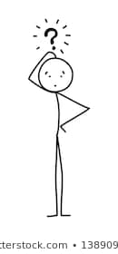
pIc of work goes here

Slide 4

Now use your marking skills to go through and improve your own work

Slide 5

Working as a pair, take it in turns to read over each others work. Can you spot any mistakes?

