Slide 1

Thursday 15th September 2020
LO: TO write the resolution and ending to a story
C: Finding something tale

Slide 2
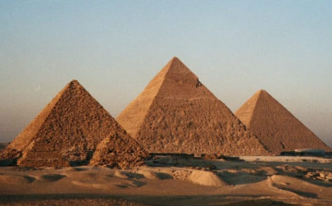
Let’s recap the grammar we have learnt so far…
Use this picture to help you write:
One adverbial phrase
One compound sentence
One expanded noun phrase
If you are stuck recap the grammar lessons from this week and last week

Slide 3

What needs to go in the resolution section?
If you cannot remember, click on the link below:
https://www.talk4writing.com/wp-content/uploads/2013/08/Adapted_Generic_Story_Plots_MR2.pdf

Slide 4

Let’s have a go at writing the start of the resolution section together!

Slide 5
Working as a pair, take it in turns to read over one persons work. Could they add in any expanded noun phrases?

