Slide 1

Monday 12th October 2020
LO: TO use compound sentences
C: Finding something tale

Slide 2
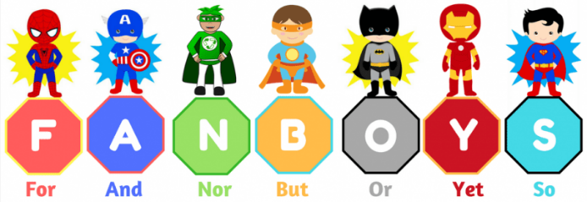
Compound sentences
What is a compound sentence?
Can you write one?

Slide 3
Let’s Write the build up section to our story
Can you spot any compound sentences?
Challenge: Can you spot any adverbial phrases?
One day, the British Government put out an advert for a brave explorer to visit the Valley of the Kings in Egypt and to bring back a precious amulet which lay in Tutenkahmun’s tomb. Even though he knew this was a dangerous trip, Jasper submitted an application. and He was chosen to go on the trip to Egypt the following week.
2
Filled with excitement, and not wanting to waste any more time, Jasper headed straight to the pyramids at the Valley of the Kings. When he arrived, his eyes immediately fell upon the crumbling stone entrance of the tomb but .He he was not sure whether he was brave enough to enter. However, he took a few, tentative steps inside as he knew he had a job to do!

Slide 4

How could you start your build up section?
Let’s write

