Slide 1
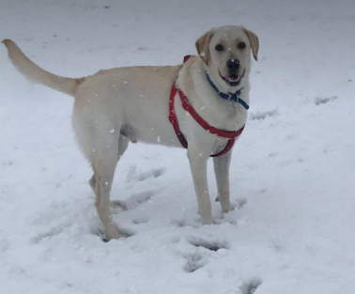

Friday 27th November 2020
L.O: Cold Task
C: Explanation Text

Slide 2
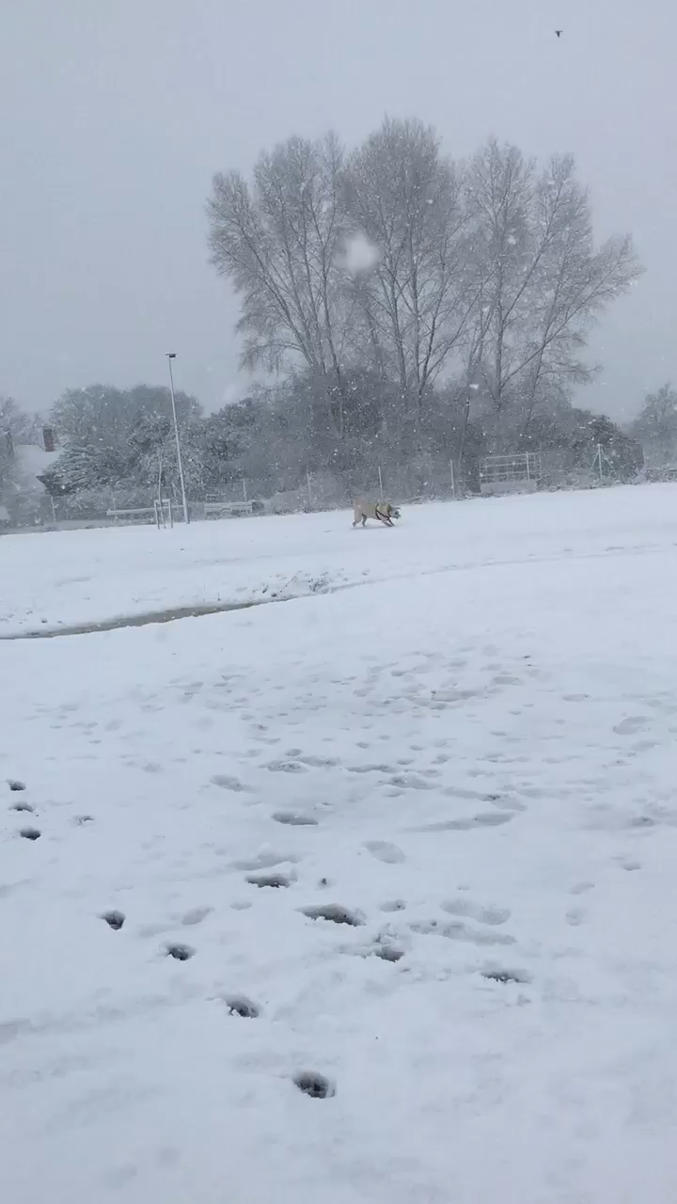
Buddy loves the snow!
He really wants to make a snowman, but he doesn’t know how!

Slide 3
Can you write an explanation text for him?
You need to explain how to make a snowman really clearly in lots of detail!

