Slide 1
Week 12 English- Let’s publish our amazing recounts!
L.O: To write a recount.
C: Recount

Slide 2
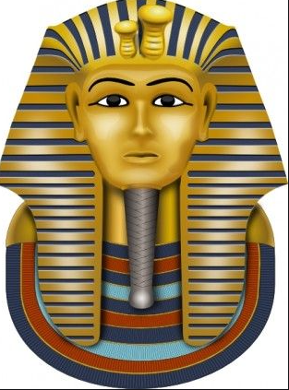
If you are working at home…
In school we are writing up our Tutankhamun recounts! You can try and write up what you remember or follow your recommended path on Century Tech.

Slide 3
Monday
L.O: To publish a recount

Slide 4
Today we are going to write up our amazing recounts on our tea-stained paper.
But first a game to practice our handwriting!

Slide 5
Today we are going to write up our amazing recounts on our tea-stained paper.
Can you write in your best handwriting…
Green 5 times in brown pencil
Yellow 5 times in red pencil
Pink 5 times in blue!

Slide 6
Tuesday
L.O: To publish a recount

Slide 7
Today we are going to write up our amazing recounts on our tea-stained paper.
But first a game to practice our handwriting!

Slide 8
Today we are going to write up our amazing recounts on our tea-stained paper.
Can you write in your best handwriting…
The alphabet backwards!

Slide 9
Wednesday
L.O: To publish a recount

Slide 10
Today we are going to write up our amazing recounts on our tea-stained paper.
But first a game to practice our handwriting!

Slide 11
Today we are going to write up our amazing recounts on our tea-stained paper.
Can you write in your best handwriting…
The names of everyone on your table!

Slide 12
Thursday
L.O: To publish a recount

Slide 13
Today we are going to write up our amazing recounts on our tea-stained paper.
But first a game to practice our handwriting!

Slide 14
Today we are going to write up our amazing recounts on our tea-stained paper.
Can you write in your best handwriting…
The alphabet in upper and lower case.

Slide 15
Friday
L.O: To publish a recount

Slide 16
Today we are going to write up our amazing recounts on our tea-stained paper.
But first a game to practice our handwriting!

Slide 17
Today we are going to write up our amazing recounts on our tea-stained paper.
Can you write in your best handwriting…
Can you write your name five times- each version needs to be neater than the last.

