Slide 1


Slide 3
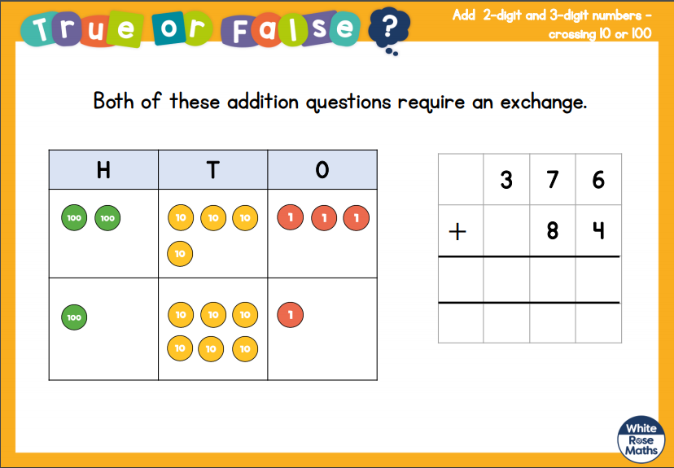

Slide 4
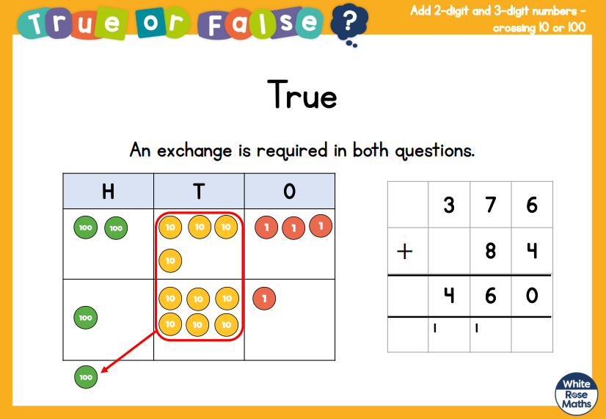

Slide 5


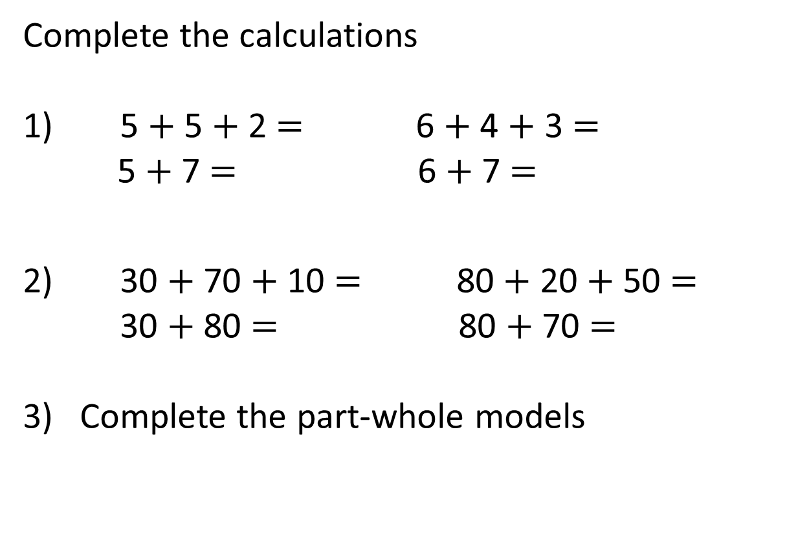
Complete the calculations
1) 5 $+$ 5 $+$ 2 $=$ 6 $+$ 4 $+$ 3 $=$
5 $+$ 7 $=$ 6 $+$ 7 $=$
2) 30 $+$ 70 $+$ 10 $=$ 80 $+$ 20 $+$ 50 $=$
30 $+$ 80 $=$ 80 $+$ 70 $=$
3) Complete the part-whole models
9
29
29
20
4

Slide 6
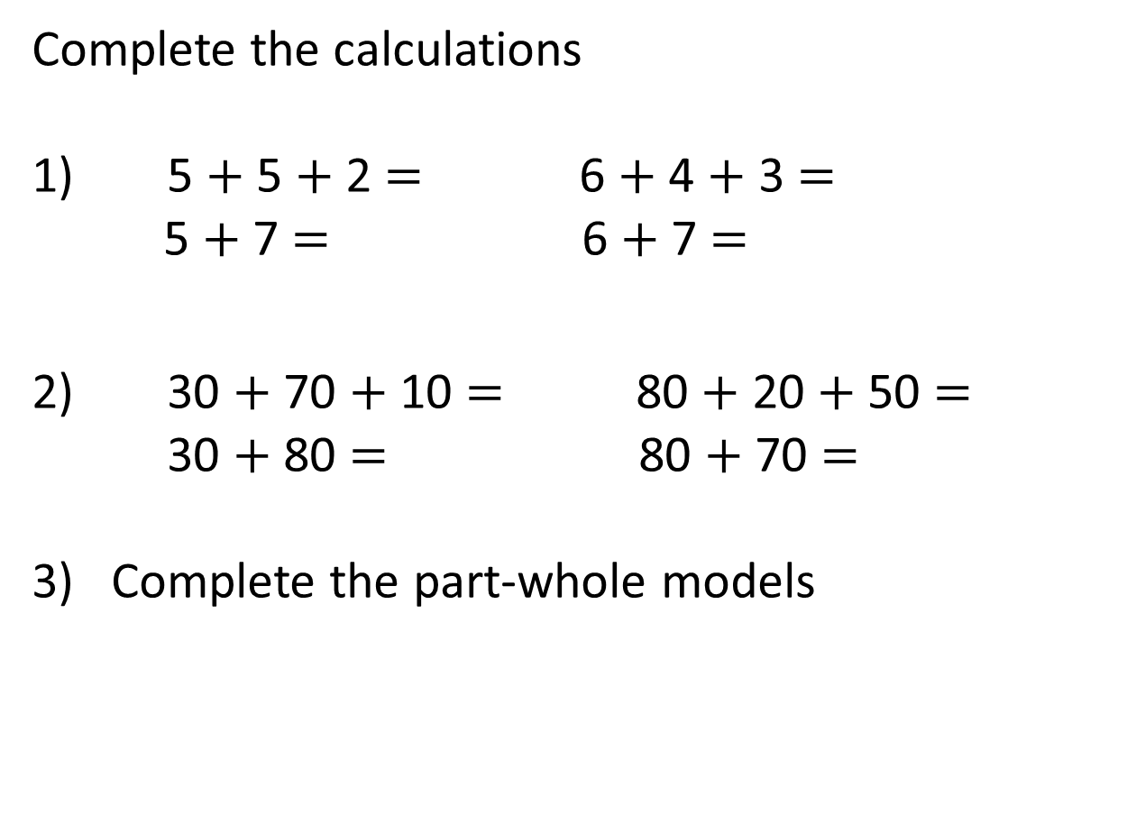
Complete the calculations
1) 5 $+$ 5 $+$ 2 $=$ 6 $+$ 4 $+$ 3 $=$
5 $+$ 7 $=$ 6 $+$ 7 $=$
2) 30 $+$ 70 $+$ 10 $=$ 80 $+$ 20 $+$ 50 $=$
30 $+$ 80 $=$ 80 $+$ 70 $=$
3) Complete the part-whole models
12
13
12
13
110
150
110
150
9
29
29
20
20
5
4

Slide 8
Hundreds | Tens | Ones
H | T | O
1 | 4 | 8
 | 4 | 3
+
1
9
1
1

Slide 9



Hundreds | Tens | Ones
H | T | O
2 | 5 | 5
 | 7 | 1
+
3
2
6
1
Notes:
Can we simplify?
Discuss reduction structure – take away

Slide 10

Hundreds | Tens | Ones
I think you’ll need more than one exchange this time
+
H | T | O
2 | 5 | 5
 | 7 | 8
+
3
3
3
1
1
Notes:
Can we simplify?
Discuss reduction structure – take away

Slide 11

Have a think
H | T | O
5 | 6 | 2
 | 6 | 5
H | T | O
4 | 8 | 2
 | 1 | 8
+
+
6
2
7
5
0
0
1
1
1
Notes:
Can we simplify?
Discuss reduction structure – take away

