Slide 1
Thursday 5th November 2020
LO: To create detailed factual sentences
C: Recount

Slide 2
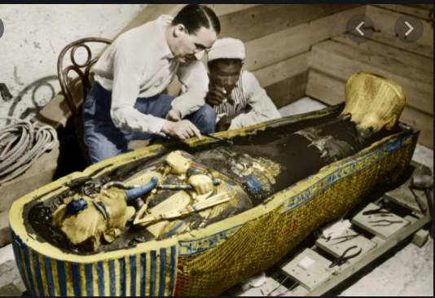
Starter
Let’s watch a couple of videos!
While you are watching, try to write down some facts on your scrap paper!
We will be using these to add detail to our recounts!

Slide 3
Starter
https://www.bbc.co.uk/bitesize/articles/zjrgcqt
https://www.youtube.com/watch?v=dmkDPaHSBzg

Slide 4
Let’s think!
Now you’ve collected some facts let’s have a look at a recount I have written!

Slide 5
My recount!
The rich man paid another man to look for the pharaoh’s tomb. He found it. There was some sparkly things inside. They thought the discovery was good.

Slide 6

White Hat Time!
I want you to wear your white hat and think GLOOMY thoughts.
How could I improve my recount?

Slide 7
White Hat Time!
The rich man paid another man to look for the pharaoh’s tomb. He found it. There was some sparkly things inside. They thought the discovery was good.

Slide 8
I tried to improve it!
The rich man paid another man to go to Egypt and look for the pharaoh’s tomb. When he was digging he found the tomb. He checked for traps. There was some sparkly treasure inside. They also found a hidden room with the mummy in. They thought the discovery was great.

Slide 9
White Hat Time!
I want you to wear your white hat and think GLOOMY thoughts.
How could I still improve my recount?

Slide 10
Let’s try to improve it together!
The rich man paid another man to go to Egypt and look for the pharaoh’s tomb. When he was digging he found the tomb. He checked for traps. There was some sparkly treasure inside. They also found a hidden room with the mummy in. They thought the discovery was great.

Slide 11
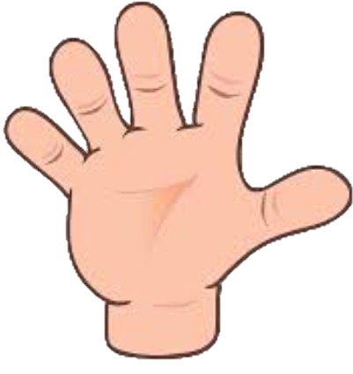
Let’s try to improve it together!
Remember our five w’s.

Slide 12
Let’s try to improve it together!
The rich man paid another man to go to Egypt and look for the pharaoh’s tomb. When he was digging he found the tomb. He checked for traps. There was some sparkly treasure inside. They also found a hidden room with the mummy in. They thought the discovery was great.

Slide 13
Your turn!
We are going to create some factual sentences which we can save and use in our recounts!

Slide 14
Plenary!
Let’s share some of our sentences!

