Slide 1
Tuesday 3rd November 2020
LO: To understand emotions
C: Recount

Slide 2
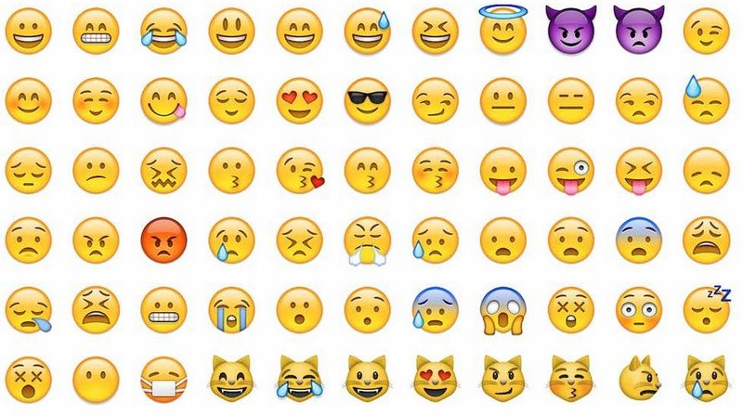
Starter!
Can you write as many emotions on your whiteboard as you can?
You have two minutes!

Slide 3
Let’s Share!
The Challenge! We could earn a class marble!
Can we come up with
30 different emotions?

Slide 4
Word Jail! What words could we use instead?
Sad
Good
Happy
Nice
Bad

Slide 5
Emotion Mapping
We are going to think about how emotions can develop and change over time.

Slide 6
Miss Watton’s Morning!
Mood
8am
9am
6am
7am
Time

Slide 7
Miss Watton’s Morning!
Full Class!
Yummy Breakfast
3AW come in!
Traffic
Mood
Fixed it!
Printer wasn’t working!
Alarm
8am
9am
6am
7am
Time

Slide 8
Howard Carter’s Emotions
Mood
Long hours of searching
Finding the first steps
Waiting for Lord Carnarvon
Seeing the wonderful things
Waiting again due to Egyptian Law
Finding
the treasure
Finding
the second room
Time

Slide 9
Your Turn!
Paddlers: Use a word mat to write emotion words in the boxes.
Snorkellers: Use a word mat to write emotion words in the boxes. Complete a red pen question.
Divers: Write a full sentence in each box. E.g. Howard Carter felt ecstatic because the tomb was completely in tact and full of marvelous treasure.

Slide 10

Plenary!
I’m thinking of an emotion game!

