Slide 1


Slide 3

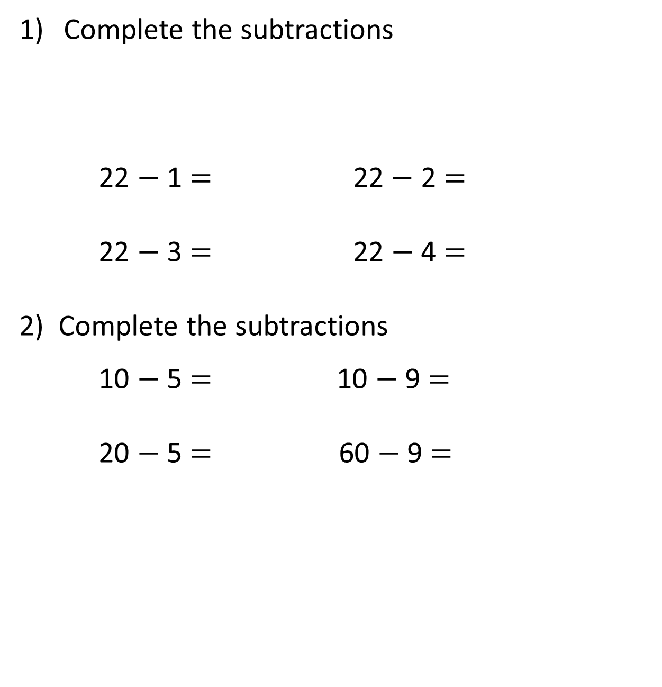
Complete the subtractions
22 $−$ 1 $=$ 22$−$ 2 $=$
22 $−$ 3 $=$ 22 $−$4 $=$
2) Complete the subtractions
10 $−$ 5 $=$ 10 $−$ 9 $=$
20 $−$ 5 $=$ 60 $−$ 9 $=$
16 | 17 | 18 | 19 | 20 | 21 | 22 | 23 | 24

Slide 4
Complete the subtractions
22 $−$ 1 $=$ 22$−$ 2 $=$
22 $−$ 3 $=$ 22 $−$4 $=$
2) Complete the subtractions
10 $−$ 5 $=$ 10 $−$ 9 $=$
20 $−$ 5 $=$ 60 $−$ 9 $=$
16 | 17 | 18 | 19 | 20 | 21 | 22 | 23 | 24
21
20
19
18
5
1
15
51

Slide 6


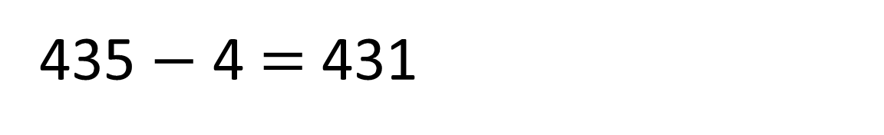
How many pencils will be left?
10 pencils
435 $−$ 4 $=$ 431
100
pencils
100
pencils
10 pencils
100
pencils
100
pencils
10 pencils
I’ve been sent to fetch 4 pencils

Slide 7

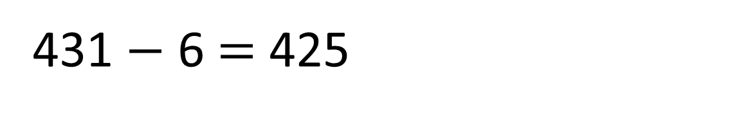
How many pencils will be left?
10 pencils
100
pencils
100
pencils
10 pencils
100
pencils
100
pencils
431 $−$ 6 $=$ 425
10 pencils
Please can I have 6 pencils?

Slide 8




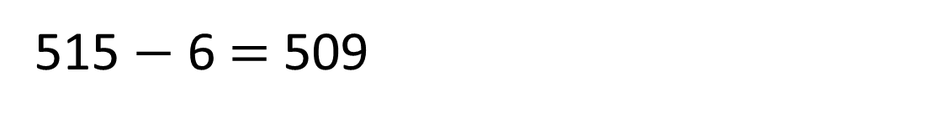
Work out 515 $−$ 6
Hundreds | Tens | Ones
515 $−$ 6 $=$ 509

Slide 9

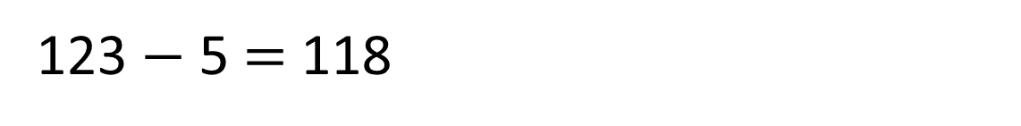
Work out 123 $−$ 5
Hundreds | Tens | Ones
123 $−$ 5 $=$ 118

Slide 10

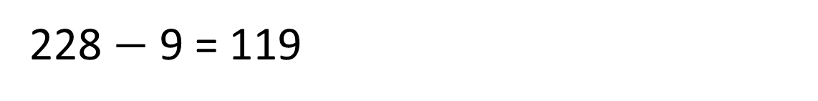
Work out 228 $−$ 9
Hundreds | Tens | Ones
228 $−$ 9 = 119

Slide 11
Paddlers:
Using your place value counters, can you solve the following?
145 – 6 =
819 – 3 =
284 – 5 =
Be prepared to have your work photographed and for you to explain what you have done!

Slide 12

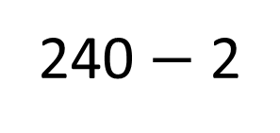
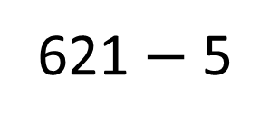
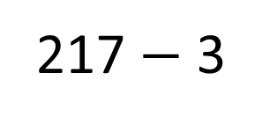
Challenge
217 $−$ 3
621 $−$ 5
240 $−$ 2
Exchange not needed | Exchange needed

