Slide 1
04.11.20
LO: To add and subtract
C: Subtract a 1 digit number from
a 2 digit number –crossing 10 recap

Slide 3
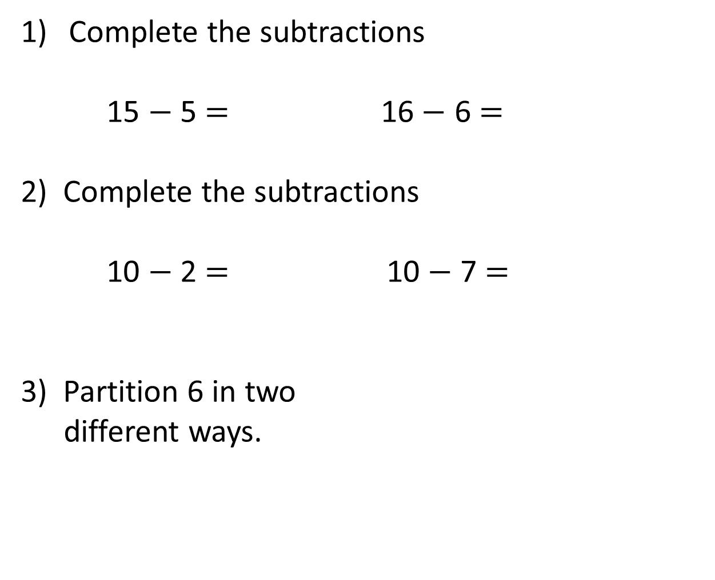
Complete the subtractions
15 $−$5 $=$ 16$−$ 6 $=$
2) Complete the subtractions
10 $−$ 2 $=$ 10 $−$ 7 $=$
3) Partition 6 in two
different ways.
6
6

Slide 4
Complete the subtractions
15 $−$5 $=$ 16$−$ 6 $=$
2) Complete the subtractions
10 $−$ 2 $=$ 10 $−$ 7 $=$
3) Partition 6 in two
different ways.
10
10
8
3
6
6
1
4
3
0
6
2
5
3

Slide 6

We can use number bonds to help us subtract!
8
6
2
Notes:
In this lesson we are going to use number bonds to help us add.
I am going to show a number, then I want you to shout what number you would add to it to make ten.
Let’s do one together.
Here is 6 so you would shout…..4! 6 + 4 makes 10
Here we go.

Slide 7
We can use number bonds to help us subtract!
8
7
1
Notes:
In this lesson we are going to use number bonds to help us add.
I am going to show a number, then I want you to shout what number you would add to it to make ten.
Let’s do one together.
Here is 6 so you would shout…..4! 6 + 4 makes 10
Here we go.

Slide 8
We can use number bonds to help us subtract!
7
4
3
Notes:
In this lesson we are going to use number bonds to help us add.
I am going to show a number, then I want you to shout what number you would add to it to make ten.
Let’s do one together.
Here is 6 so you would shout…..4! 6 + 4 makes 10
Here we go.

Slide 9
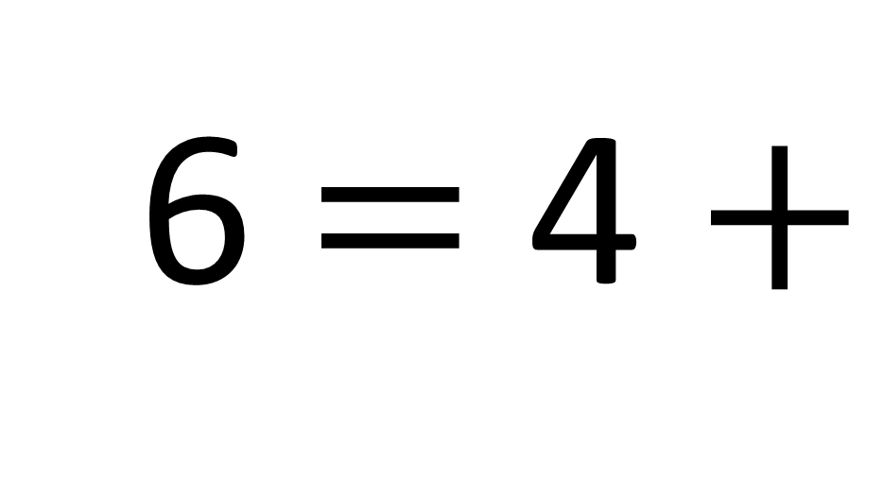
6 $=$ 4 $+$
2
Notes:
In this lesson we are going to use number bonds to help us add.
I am going to show a number, then I want you to shout what number you would add to it to make ten.
Let’s do one together.
Here is 6 so you would shout…..4! 6 + 4 makes 10
Here we go.

Slide 10
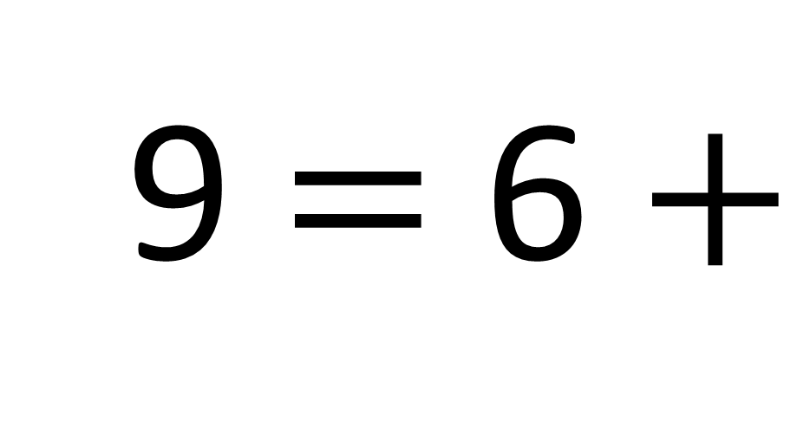
9 $=$ 6 $+$
3
Notes:
In this lesson we are going to use number bonds to help us add.
I am going to show a number, then I want you to shout what number you would add to it to make ten.
Let’s do one together.
Here is 6 so you would shout…..4! 6 + 4 makes 10
Here we go.

Slide 11
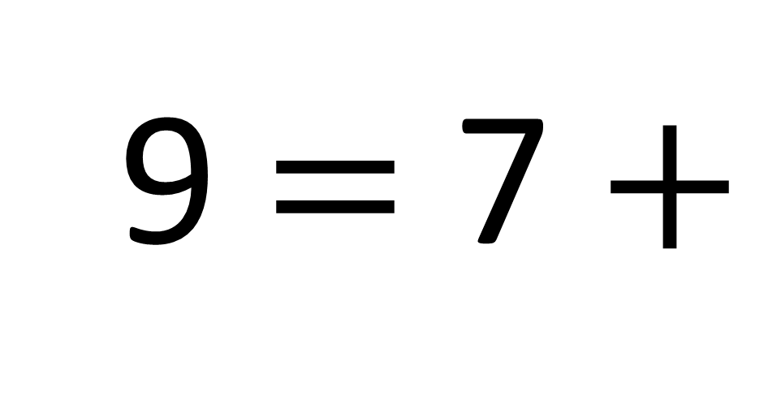
9 $=$ 7 $+$
2
Notes:
In this lesson we are going to use number bonds to help us add.
I am going to show a number, then I want you to shout what number you would add to it to make ten.
Let’s do one together.
Here is 6 so you would shout…..4! 6 + 4 makes 10
Here we go.

Slide 12
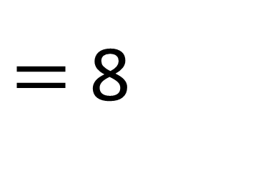
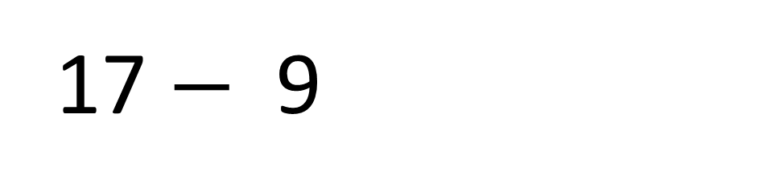
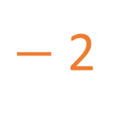
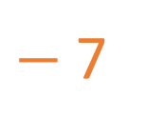
$−$2
$−$7
7
8
9
10
11
12
13
14
15
16
17
17 $−$9
$=$ 8
7
2

Slide 13
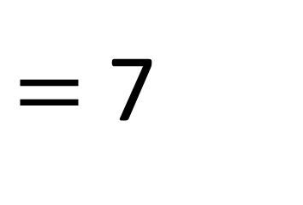
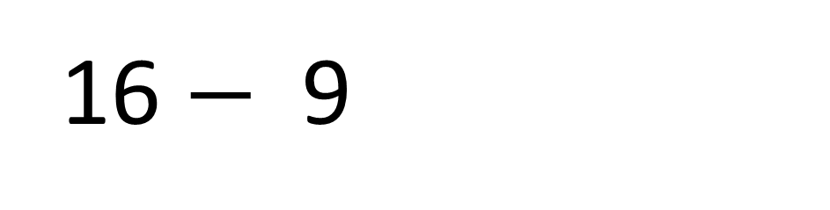
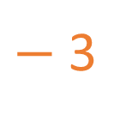
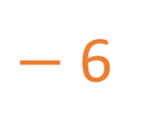
$−$3
$−$6
7
8
9
10
11
12
13
14
15
16
17
16 $−$9
$=$ 7
6
3

Slide 14

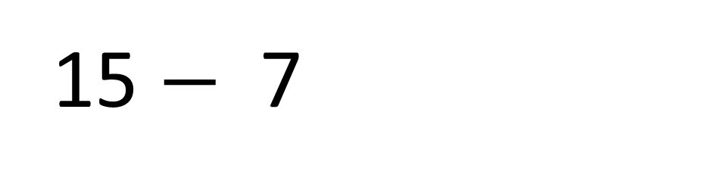
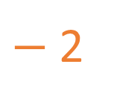
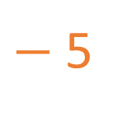
$−$2
$−$5
7
8
9
10
11
12
13
14
15
16
17
15 $−$7
$=$ 8
5
2

Slide 15

52 $−$ 8
8
8
8
3
5
2
6
4
4
Which of the ways to partition 8 would be
most useful for this calculation?

Slide 16

84 $−$ 8
8
8
8
3
5
2
6
4
4
Which of the ways to partition 8 would be
most useful for this calculation?

Slide 17
Find the difference between 25 and 8
The difference between 25 and 8 is 17

Slide 18
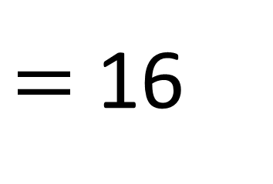

23 $−$ 7
$=$ 16

