Slide 1
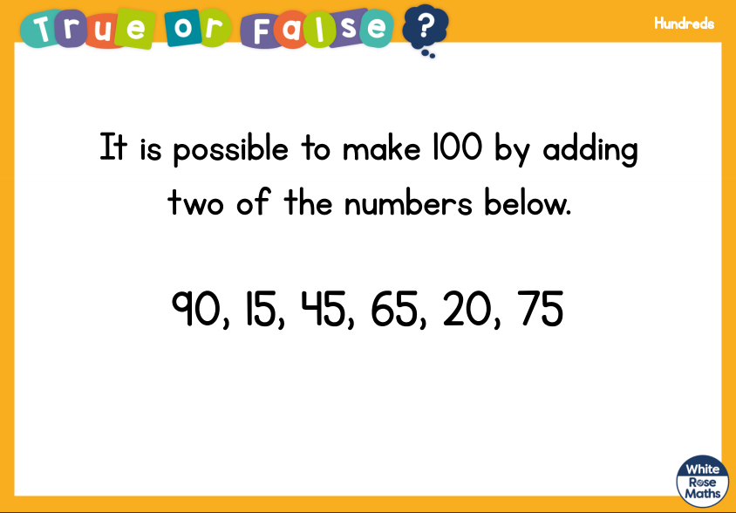
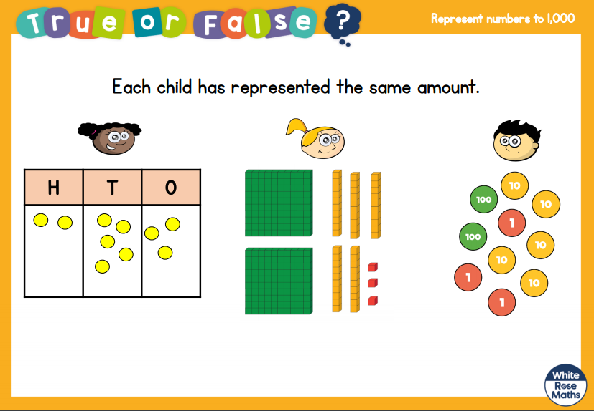
3.11.20
LO: To add and subtract
C: To add a 3 digit number to a1 digit number – crossing 10

Slide 2
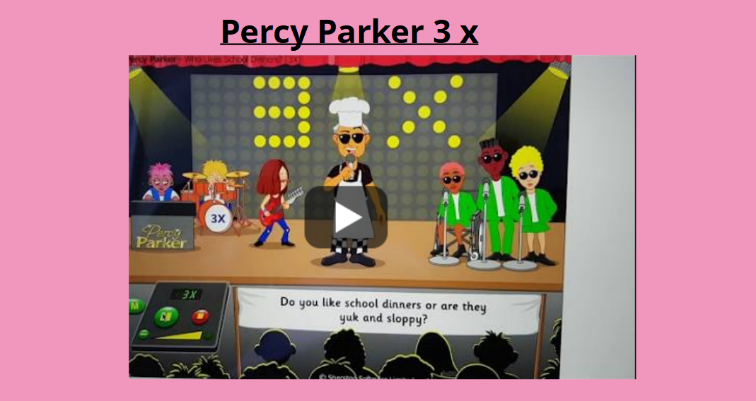

Slide 3
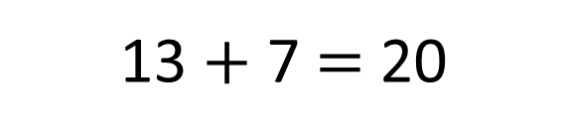
Quick fire number bonds!
13
13 $+$ 7 $=$ 20

Slide 4
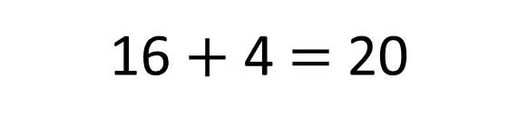
16
16 $+$ 4 $=$ 20

Slide 5
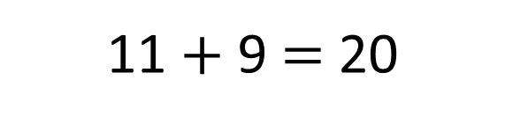
11
11 $+$ 9 $=$ 20

Slide 6
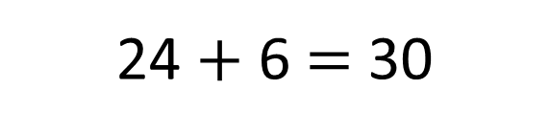
24
24 $+$ 6 $=$ 30

Slide 7
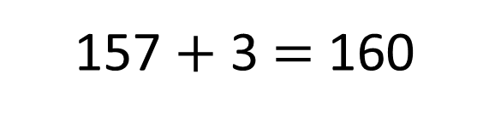
157
157 $+$ 3 $=$ 160

Slide 8
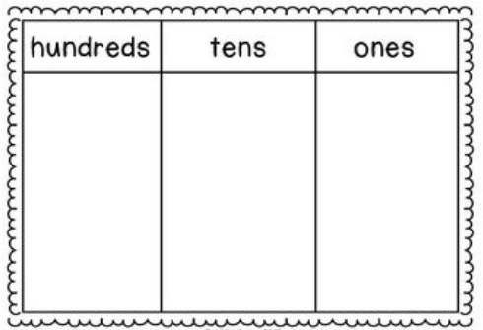
I do 234 + 8 pictorially

Slide 9
I do 234 + 8 = 242

Slide 10
We do 119 + 3 pictorially

Slide 11
We do 119 + 3 = 122

Slide 12
You do 336 + 6 pictorially

Slide 13
You do 336 + 6 = 342

Slide 14
We do 112 + 8 pictorially

Slide 15
We do 112 + 8 = 120

Slide 16
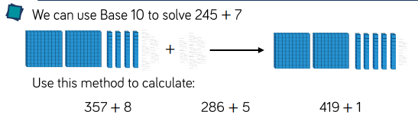
Challenge:

