Slide 1
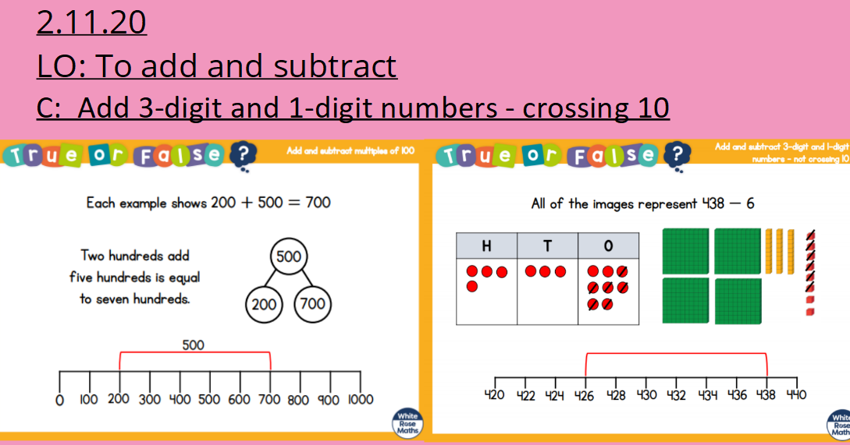

Slide 2
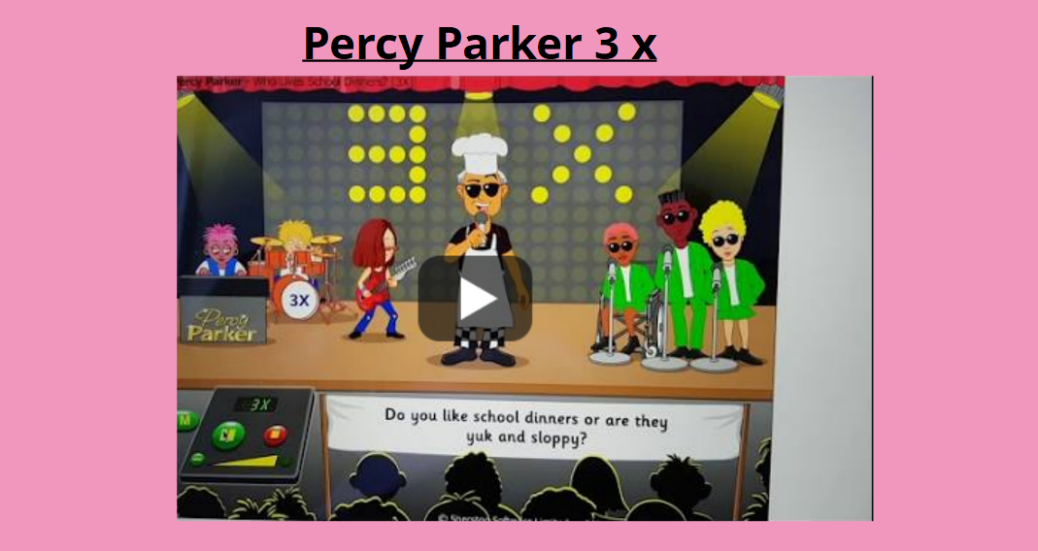

Slide 3

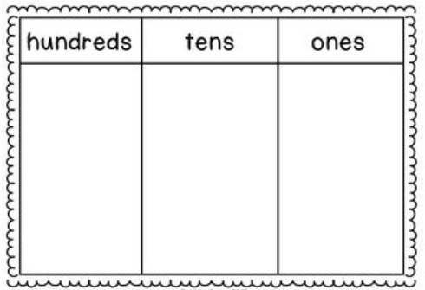
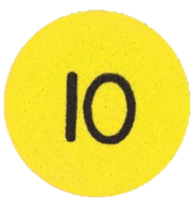


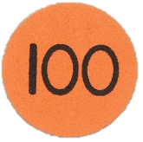
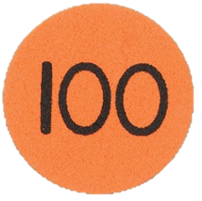
I do 147
+ 4 =

Slide 4
We do 125
+ 8 =

Slide 5

You do 316
+ 6 =

Slide 6
We do 113
+ 7 =

Slide 7
You do 214
+ 9 =

Slide 8
Now try…
142 + 9 =
628 + 3 =
919 + 6 =
421 + 9 =
245 + 6 =
513 + 7 =

