Slide 1
Monday 7th June 2021
LO: to investigate materials
C: States of Matter

Slide 2

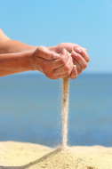
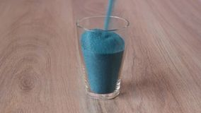
Sand can be poured, so does that make it a liquid?
What do you know about solids?
What do you know about liquids?
Can you name any materials that you know for sure belong in one of these categories?
Are there any materials you are not so sure about?

Slide 3
Sand is a solid and water is a liquid.
Although sand can be poured and it takes the shape of the container, it is not a liquid.
Sand is made up of lots of small grains and each grain is a solid made up of lots and lots of particles that are tightly packed together and do not more apart.
Liquids will always have a flat top when allowed to settle, whereas tiny solids (like sand) will make a mound when poured.

Slide 4
Collect some materials from around your house.
You might collect: pieces of wood, metal, plastic, sugar, salt, stones, fruit, baking powder, water, washing up liquid, milk, honey, vinegar, juice.
Look at the materials – would you class them as a solid or a liquid?

Slide 5
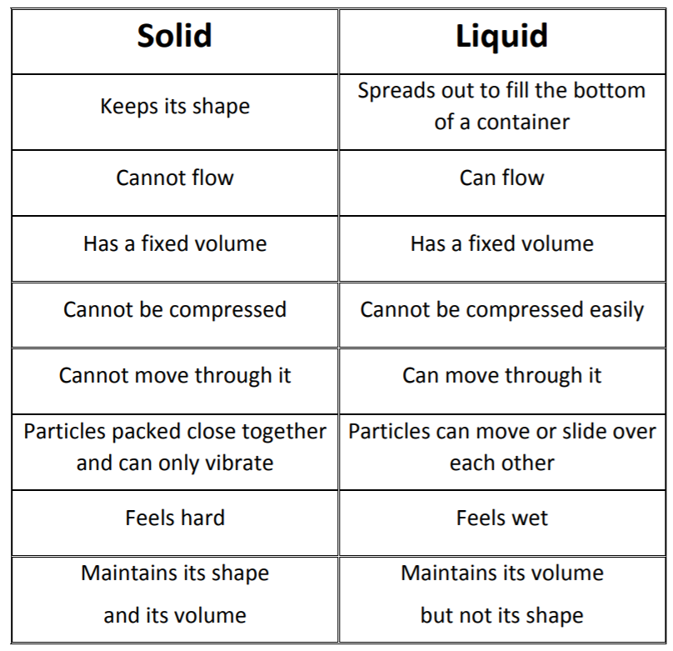
Use this list of properties for solids and liquids to help you!

Slide 6
Activity
Complete the table below.
Try to explain your classifications using scientific language.
Item | Solid | Liquid | Why?
Juice |  | Yes | Juice is a liquid because it has a flat top when it is settled in a container.

Slide 7
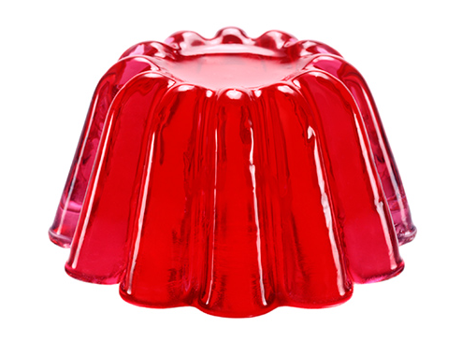
Red Pen
Sam and Lola are eating jelly.
Sam thinks jelly is a liquid.
Lola thinks jelly is a solid.
Who do you agree with you?
Explain your reasoning.

