Slide 1
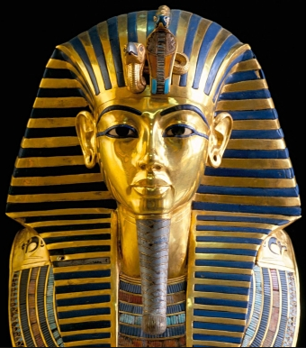
Who was Tutankhamun?

Slide 2
Tasks – how deep will you dive?
Paddling: Order Tutankhamun’s life events and stick into books.
Snorkelling: Use the prompts to help you write key facts about Tutankhamun.
Diving: Summarise the key facts you have learnt about Tutankhamun.

Slide 3
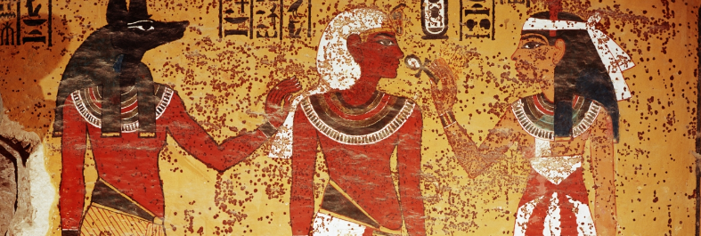
https://www.youtube.com/watch?v=dmkDPaHSBzg

Slide 4
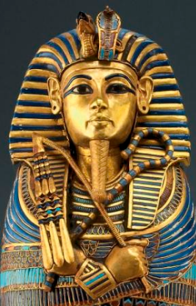
Tutankhamun was born Tutankhaten. Akhenaten, Tutankhamun's father, wanted Egyptians to worship one god, the Sun God Aten, instead of the multitude of gods they already worshipped. The "Aten" at the end of Tutankhaten and Akhenaten's names refers to this.
Akhenaten's changes weren't too popular, so when Tutankhaten was in charge, he changed things back to how they were. He reopened the various closed temples around the country and changed his name to Tutankhamun.

Slide 5
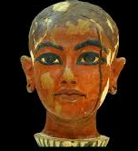

Pharaoh Akhenaten died after reigning over Egypt for seventeen years, and King Tut was only nine years old when he took his father's place. Can you imagine how nervous you would be to be in charge of an entire country at the age of nine? Because he was so young when he took the throne, King Tut was most likely advised by Egyptian elders. During his short rein, King Tut tried to restore political and religious order for Egypt.

Slide 6
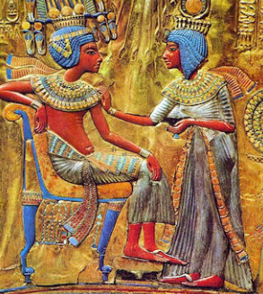
Tutankhamun was said to have a lame leg – probably because his parents were brother and sister. Tutankhamun went on to marry his own half sister. They had two daughters that died before they were born.

Slide 7
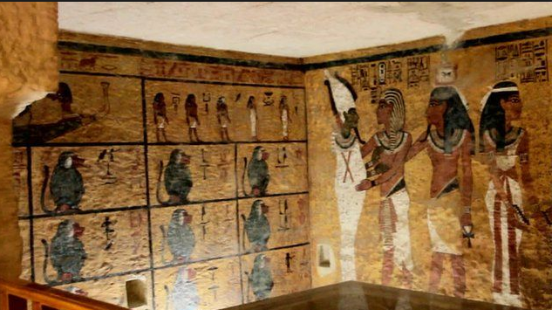
Tutankhamun was only King for about ten years before dying aged 19. It was estimated that he ruled from 1333 BC to1324 BC

Slide 8
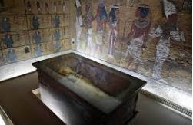
Over the years, scientists have used available technology to determine the cause of Tutankhamun's death. The two most popular theories about his death are that he suffered a blow to the back of the head, either accidentally or deliberately (in other words, murder), or that he broke or fractured his leg which became infected - an infection that led to his death possibly only days later.

Slide 9
Tasks – how deep will you dive?
Paddling: Order Tutankhamun’s life events and stick into books.
Snorkelling: Use the prompts to help you write key facts about Tutankhamun.
Diving: Summarise the key facts you have learnt about Tutankhamun.

