Slide 1
Friday 13th November 2020
L.O: To apply the features of a recount.
C: Recount

Slide 2

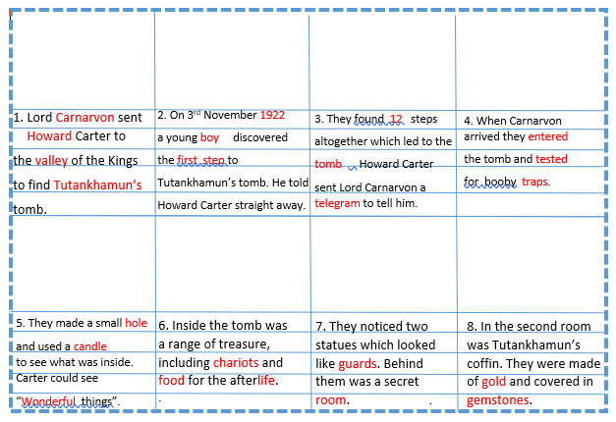
Today we are going to start writing the middle sections of our recounts!
Can you find your plan we made last week?
It should look like this with pictures.

Slide 3

Today we are going to start writing the middle sections of our recounts!
We’ve introduced the characters using our 5w’s in our opening.

Slide 4
Today we are going to start writing the middle sections of our recounts!
Now it is time to try writing the next few sections.

Slide 5
I’ve written two paragraph starters! Which is better and why?
On 2nd November 1922, one of the young boys working within my plot bolted over to me with an astonished look on his face! He had hit something rock solid…
One day a kid ran over. He looked happy. He thought that he had found something.

Slide 6
It’s your turn!
Have a go at writing using the new checklist!

Slide 7

Book on book!
Work with your partner to RED PEN your work against the checklist!

