Slide 1
Tuesday 8th June 2021
LO: to reflect
to understand values
C: Buddhism

Slide 2
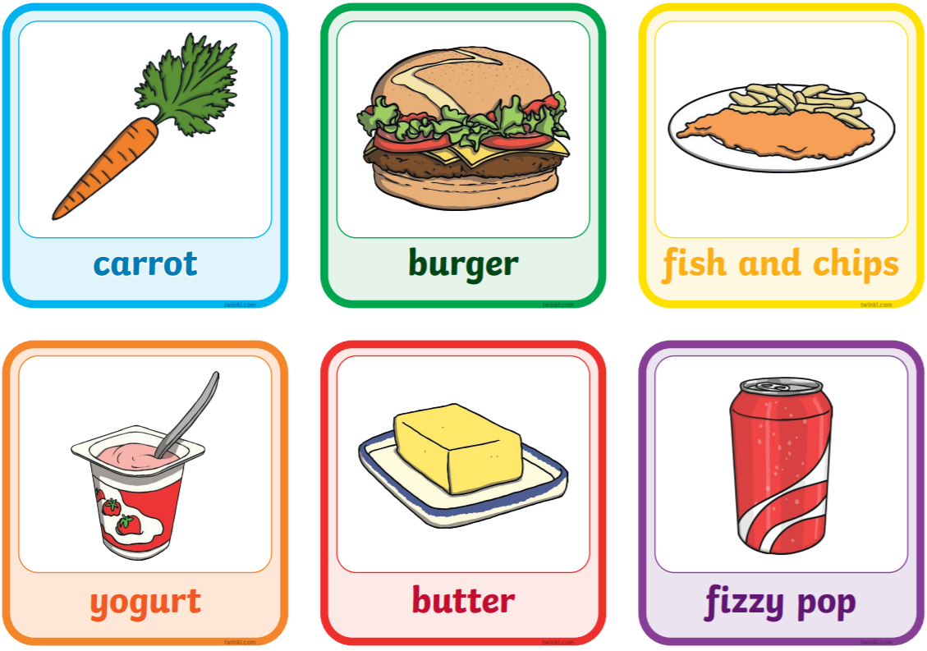
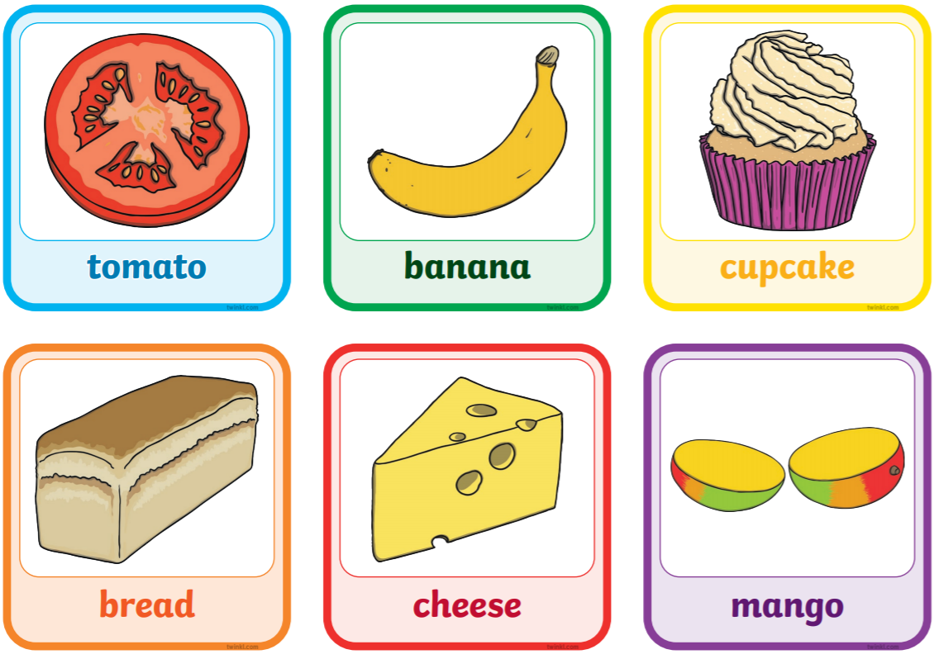
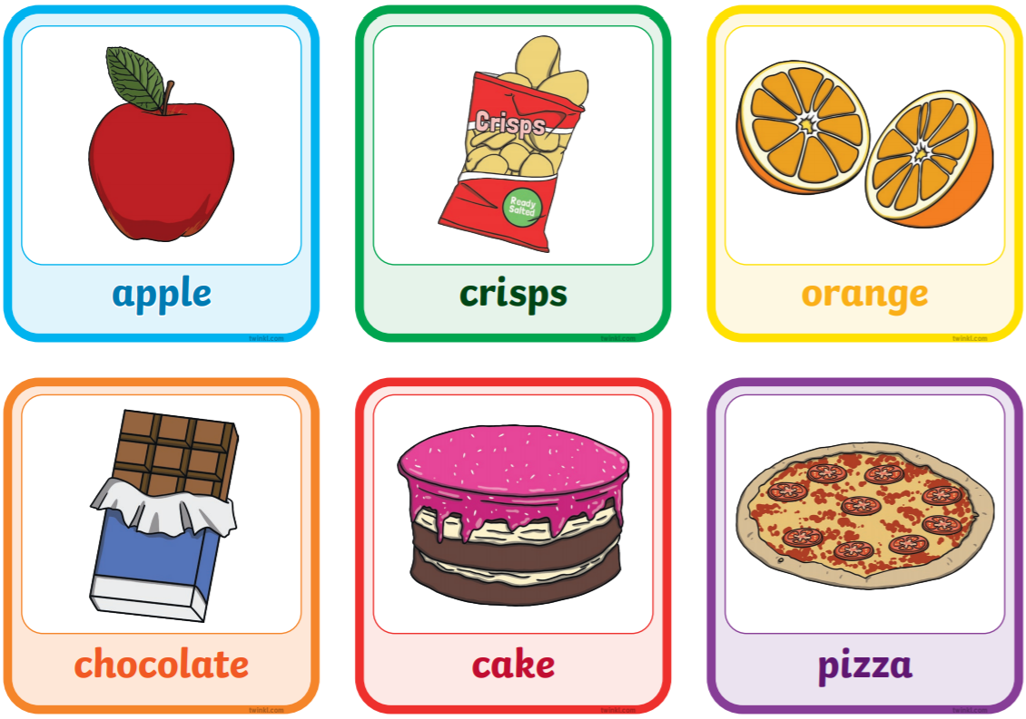
Starter
What do you eat?
What choices would you make to stay healthy?
What healthy choices would you make here?

Slide 3
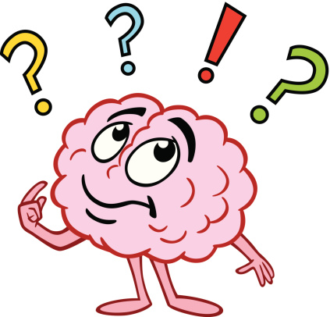
Why might it be a good thing to make healthy food choices?
Why would this be good for you and other people?
What does make a ‘good choice’ mean in this situation?
How do we know what ‘good’ means?
Have we been taught this?

Slide 4

You are in the playground with your friends and the new child comes to ask if they could join in your game.
What choices could you make?
Which choice would be best for the children involved?
Which choice would not be so ‘good’ for the children involved?
What would the consequences be for you and the other children involved?

Slide 5
You promised your grandma you would help her on Saturday, but you get invited to go on a fun trip that day with your friends.
What choices could you make?
Which choice would be best for the people involved?
Which choice would not be so ‘good’ for the people involved?
What would the consequences be for you and the other people involved?

Slide 6

What helps us make the good choices we make?
How do we know what makes a ‘good’ choice?

Slide 7
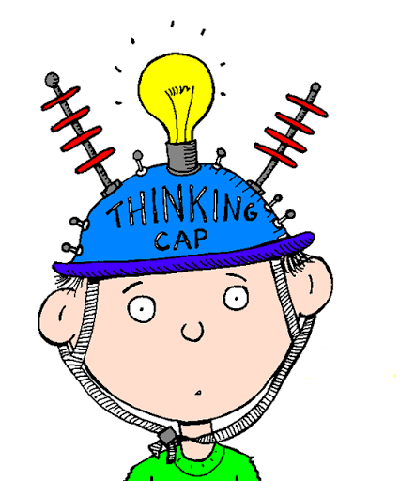
What would help our class feel safe and happy?
Create a list of eight things.

Slide 8

What might help a Christian to make a ’good’ choice?
A Jewish person?
A Sikh?
Etc.

Slide 9
Activity
How do I know what makes a ‘good’ choice?
Paddling: create a bubble map to answer the question.
Snorkelling and Diving: write a short paragraph to answer the question.
Red Pen: what might help different religious believers to make a ‘good’ choice?

