Slide 1
Tuesday 10th November 2020
LO: To use paragraphs effectively.
C: Recount

Slide 2

Think Pair Share!
What is a paragraph?
How can you tell?
Why do we need them?

Slide 3
Let’s watch the paragraph song!
https://www.youtube.com/watch?v=yhOJZwLG8C4

Slide 4


Let’s learn- Who has put the sentences in the most logical order?
Howard Carter used a long stick. They carefully stepped through the crumbling archway of the tomb. They checked for booby traps.
Marcus
They carefully stepped through the crumbling archway of the tomb. To check the first room was safe, Howard Carter used a long stick to test for booby traps.
Anita

Slide 5
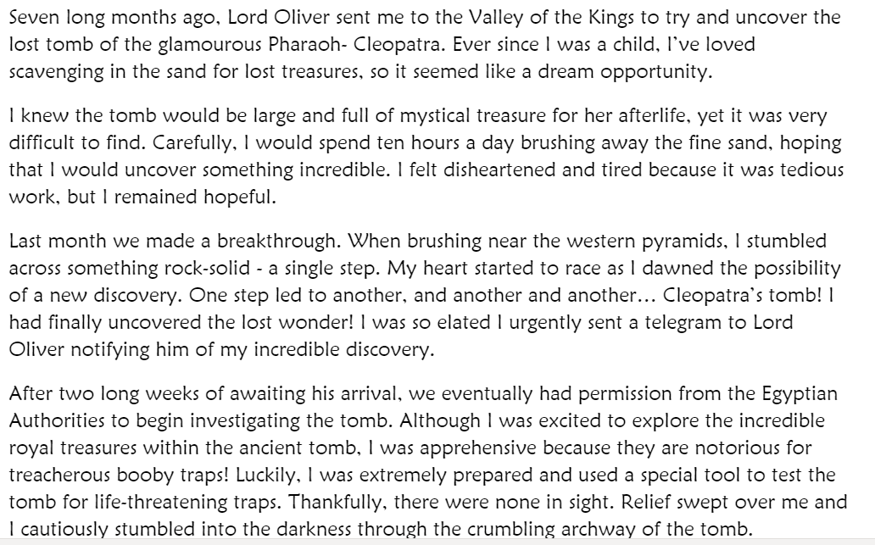
What is the first word of each paragraph?

Slide 6
In which paragraph did I make a breakthrough?

Slide 7
Which paragraph could I add this sentence to?
to introduce a
new character
to introduce a
new speaker
to introduce a new event or action

