Slide 1
Monday 9th November 2020
LO: To apply 1st 2nd and 3rd person.
C: Recount

Slide 2
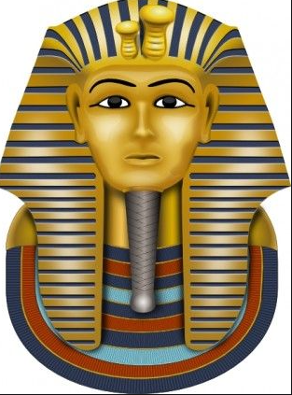
Think Pair Share!
What does “point of view” mean?

Slide 3
Who’s point of view are these snippets from?
I couldn’t believe it! I hit something rock-solid. I knew it had to be something incredible!
Through the light of my candle I could see piles of wonderful things!
I received the insightful telegram and knew I had to leave for Egypt that very afternoon.

Slide 4
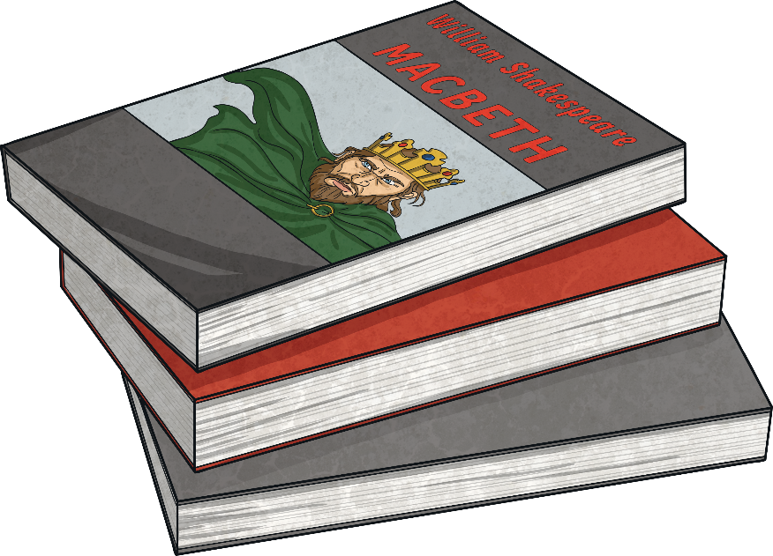
Point of View
I was going to the funfair today. I was so excited!
Have you ever wondered what life would be like as a superhero?
A story can be told from different points of view.
It can be written in the first, second or third person.
The boys ran from the house screaming. Riley was terrified.

Slide 5
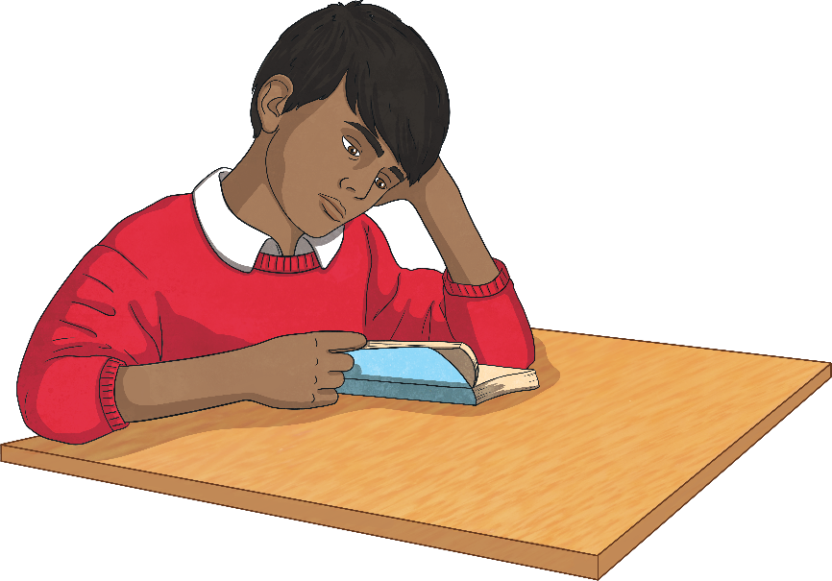
First Person
Other pronouns used in the first person:
my
me
mine
we
our
ours
us
If writing a story in the first person, write as though you are a character inside the story.
Describe how you feel and what you are doing or have done.
Use the pronoun ‘I’
For example:
Last year, I went to Spain with my family. I loved it!

Slide 6

Second Person
Other pronouns used in the second person:
Your
Yours
If writing in the second person, talk to the reader directly.
Use the pronoun ‘you’.
The second person is used a lot non-fiction as well as in fiction texts.
For example:
Before you begin, make sure that you have all of the tools listed above.

Slide 7
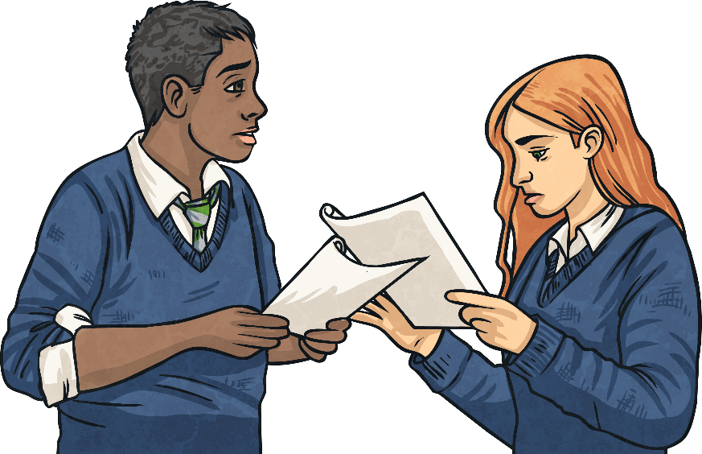
Third Person
Other pronouns used in the third person:
her/hers
his
theirs
If you are writing in the third person, you write about other people or characters.
You use the character’s name or pronouns such as ‘he’, ‘she’ and ‘they’.
For example:
Michelle sped off at top speed and was soon in first place. She couldn’t believe that she was going to win!

Slide 8

Let’s Test Our Knowledge!
Can you work out if these sentences are in first, second or third person?

Slide 9
Let’s Test Our Knowledge!
You need to be careful when entering an ancient tomb, as there could be life-threatening booby traps!

Slide 10
Let’s Test Our Knowledge!
Howard Carter noticed two statues in the treasure chamber. He investigated further and discovered a magnificent hidden room.

Slide 11
Let’s Test Our Knowledge!
When I received the telegram, I knew I had to head straight to Egypt to join Howard Carter.

Slide 12
Your Turn
Have a go at your sheet!
Remember to use your pronoun table to help you!
If you need help, please stay in your seat and put your hand up!

Slide 13
Plenary
I’ve written my sentence in first person.
“When Howard Carter lit his candle, he was flabbergasted as he could not believe the beauty of the wonderful treasures inside.”
Is the pharaoh correct? Why or why not?

