Slide 1
13.11.20
LO: To add and subtract
C: Spot the pattern – making
it explicit.

Slide 3


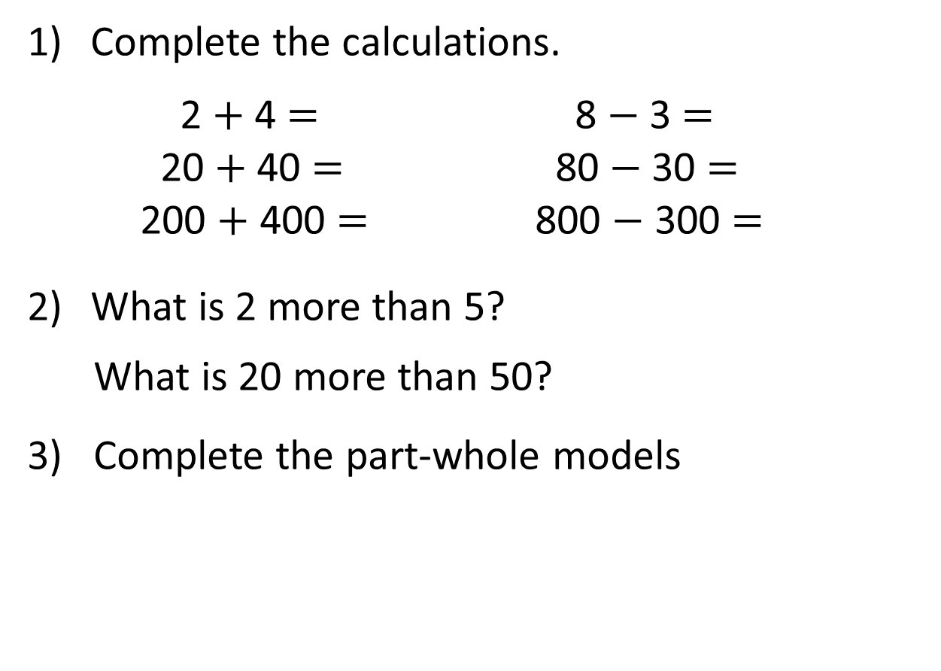
Complete the calculations.
  2 $+$ 4 $=$ 8 $−$ 3 $=$
  20 $+$ 40 $=$ 80 $−$ 30 $=$
200 $+$ 400 $=$ 800 $−$ 300 $=$
What is 2 more than 5?
What is 20 more than 50?
3) Complete the part-whole models
200
300
200
30
60

Slide 4
Complete the calculations.
  2 $+$ 4 $=$ 8 $−$ 3 $=$
  20 $+$ 40 $=$ 80 $−$ 30 $=$
200 $+$ 400 $=$ 800 $−$ 300 $=$
What is 2 more than 5?
What is 20 more than 50?
3) Complete the part-whole models
6
5
60
50
600
500
7
70
90
200
300
200
30
60
700

Slide 6
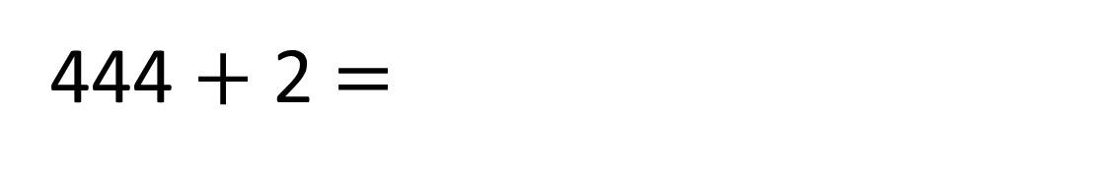
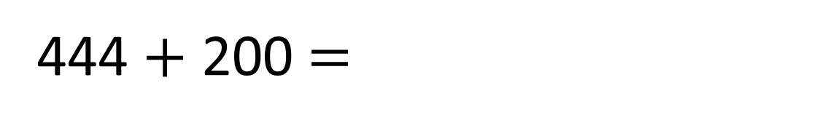
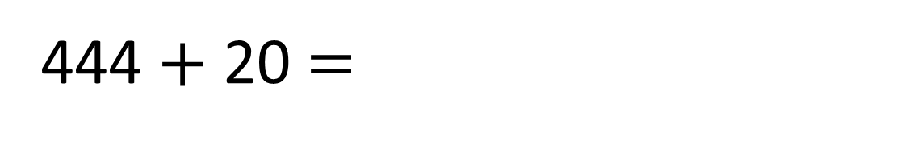
444 $+$ 2 $=$
446
444 $+$ 20 $=$
464
444 $+$ 200 $=$
644

Slide 7





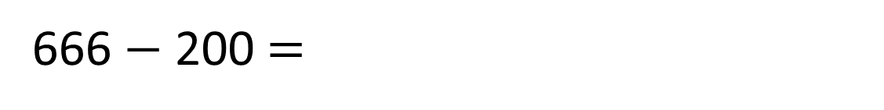
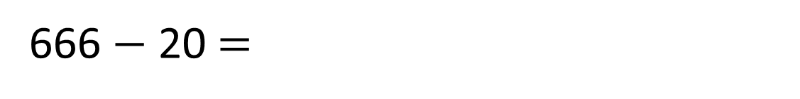
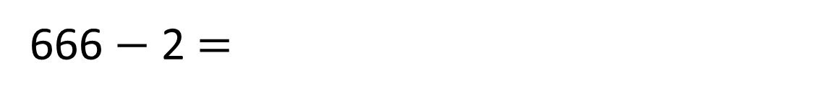
What could Annie’s new number be?
Hundreds | Tens | Ones
666 $−$ 200 $=$
466
646
666 $−$ 20 $=$
664
666 $−$ 2 $=$
Have a think

Slide 8
Have a go at questions
1 - 3 on the worksheet

Slide 9


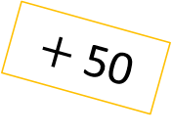
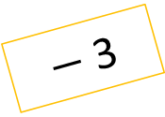

Hundreds | Tens | Ones
Have a think
5 2 8
525
578
328
$−$ 3
$+$ 50
$−$ 200

Slide 10



Dexter puts in 231
He gets out 281
281
231
231

Slide 11

Dexter puts in 231
He gets out 281
She gets out 367
Whitney puts in 317
367
317
317

Slide 12

Dexter puts in 231
He gets out 281
Whitney puts in 317
She gets out 367
Tommy puts in 209
259
209
209
What number will he get out?

Slide 13

Dexter puts in 231
He gets out 281
She gets out 367
Whitney puts in 317
895
845
What number did Ron put in?

Slide 14


2 8 7
Add
400
Subtract30
Subtract 5
Subtract 10
687
657
652
642
What will their new number be?
Have a think

