Slide 1
10.11.20
LO: To add C: Add and subtract 2-Digit
numbers and 2-digit numbers
- crossing 100

Slide 3
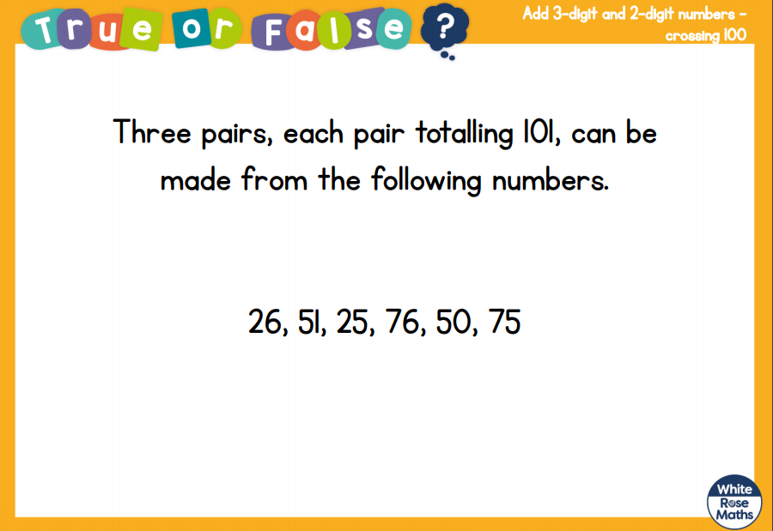

Slide 4
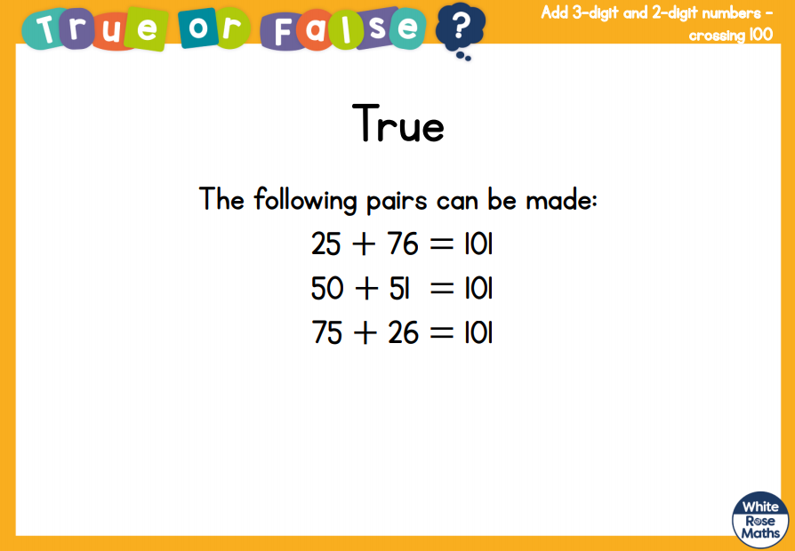

Slide 5
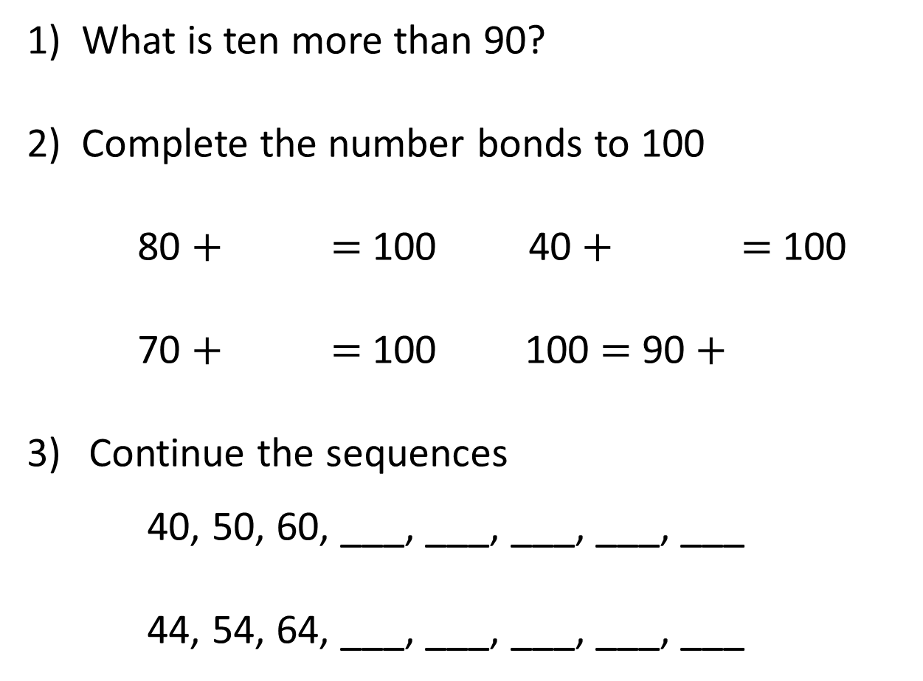
1) What is ten more than 90?
2) Complete the number bonds to 100
80 $+$ $=$ 100 40 $+$ $=$ 100
70 $+$ $=$ 100 100 $=$ 90 $+$
Continue the sequences
40, 50, 60, ___, ___, ___, ___, ___
44, 54, 64, ___, ___, ___, ___, ___

Slide 6
1) What is ten more than 90?
2) Complete the number bonds to 100
80 $+$ $=$ 100 40 $+$ $=$ 100
70 $+$ $=$ 100 100 $=$ 90 $+$
Continue the sequences
40, 50, 60, ___, ___, ___, ___, ___
44, 54, 64, ___, ___, ___, ___, ___
100
20
60
30
10
70
80
90
100
110
74
84
94
104
114

Slide 8
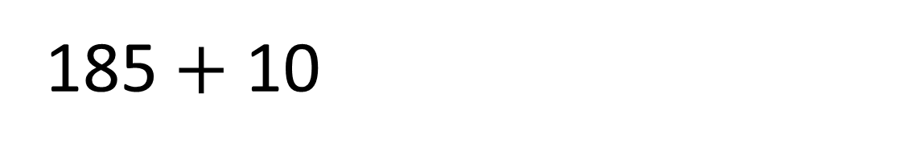
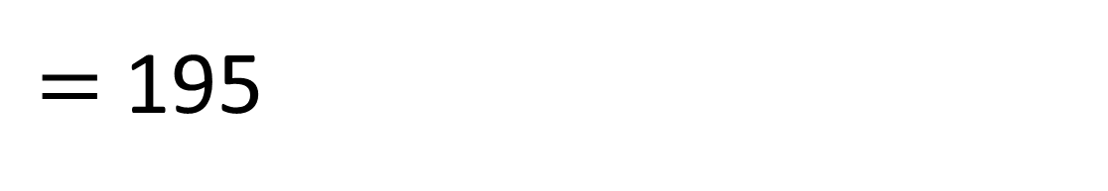
$=$ 195
185 $+$ 10

Slide 9
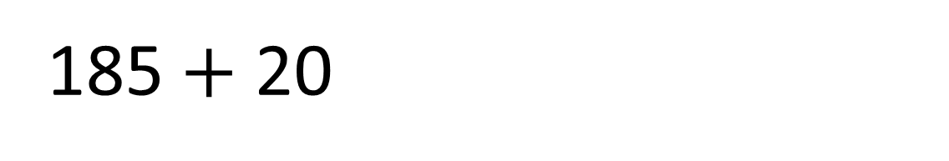
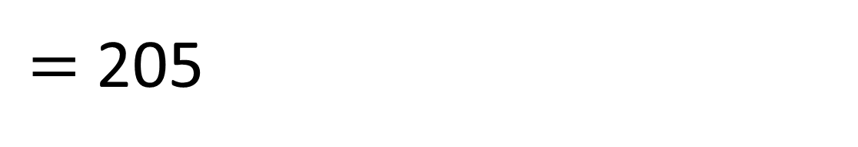
$=$ 205
185 $+$ 20

Slide 10
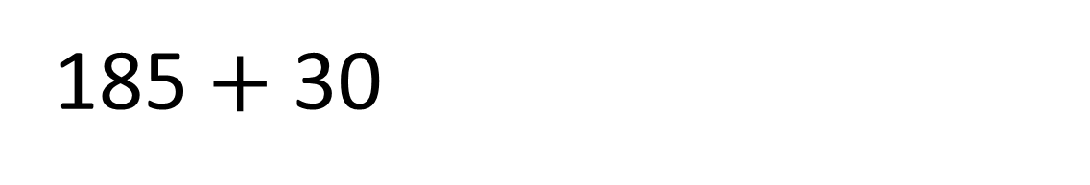
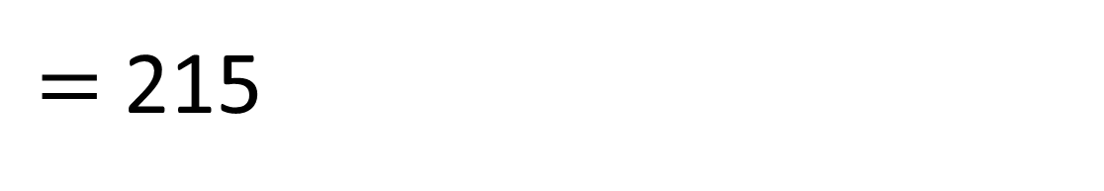
$=$ 215
185 $+$ 30

Slide 11

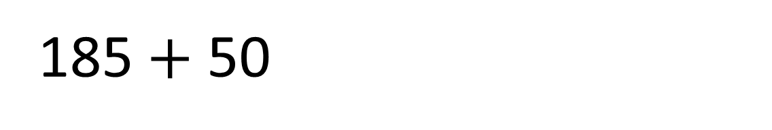
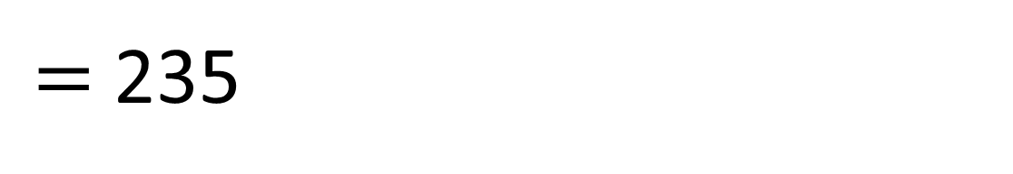
$=$ 235
185 $+$ 50
Have a think

Slide 12



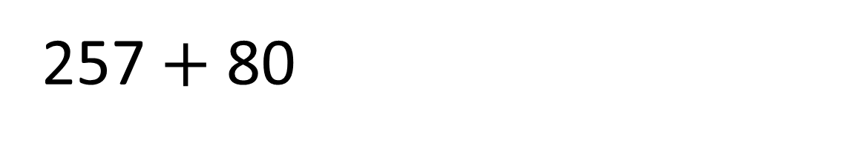
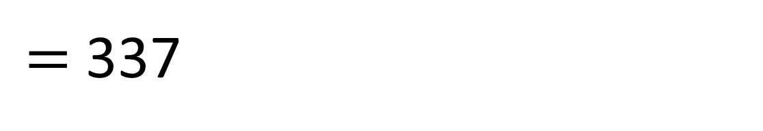
$=$ 337
257 $+$ 80
Hundreds | Tens | Ones

Slide 13
Have a go at questions
1 - 5 on the worksheet

Slide 14

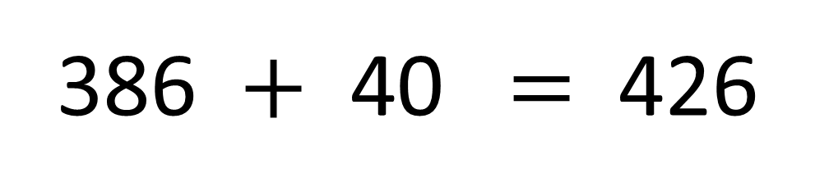
What number is froggy hiding?
386 $+$ 40 $=$ 426
Have a think

Slide 15
Have a go at questions
6 and 7 on the worksheet

Slide 16
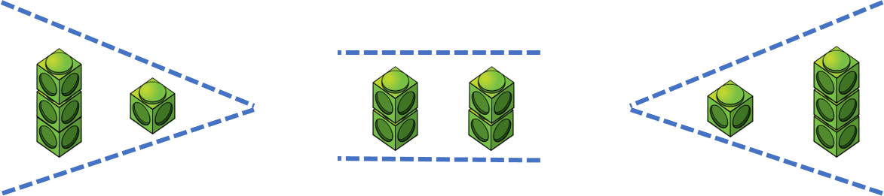


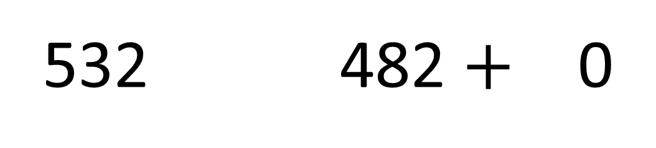
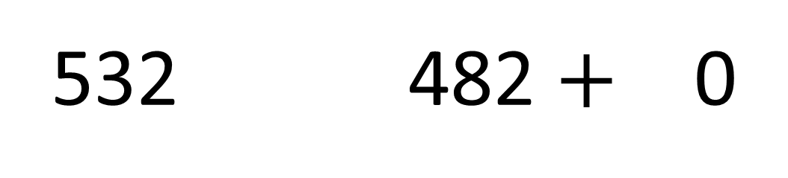
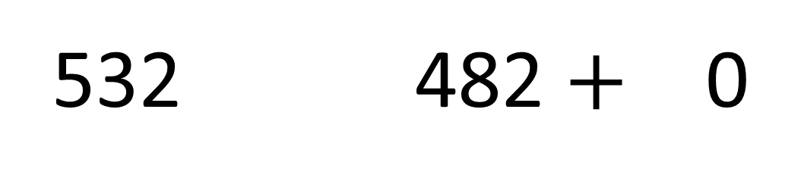

What digits could go in the boxes?
$$>$$
v
532 482 $+$ 0
1, 2, 3, 4
$$=$$
Have a think
532 482 $+$ 0
5
$$<$$
532 482 $+$ 0
6, 7, 8, 9

Slide 17
Have a go at the rest of the questions on the worksheet

