Slide 1
09.11.20
LO: To add and subtract
C: Add and subtract 2-Digit
numbers and 2-digit numbers
- not crossing 100

Slide 3





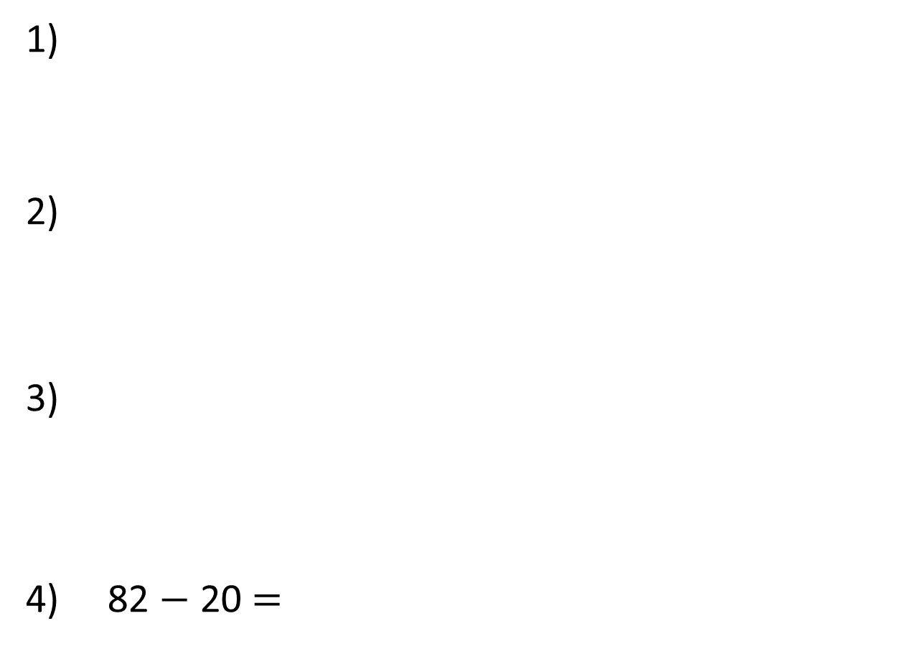

1)
2)
3)
4) 82 $−$ 20 $=$
$$+$$
$$=$$
$$+$$
$$=$$
$$−$$
20
$$=$$

Slide 4
1)
2)
3)
4) 82 $−$ 20 $=$
$$+$$
$$=$$
60
$$+$$
$$=$$
65
$$−$$
20
$$=$$
60
62

Slide 6


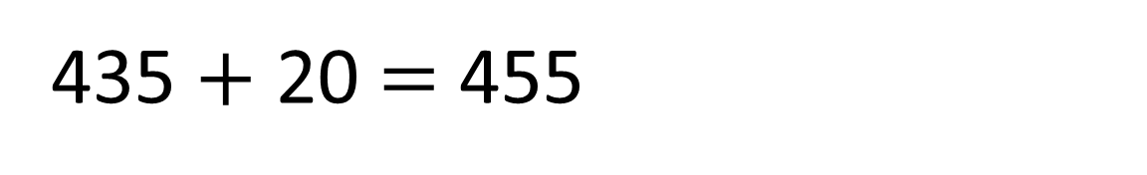
I DO
How many pencils altogether?
10 pencils
100
pencils
100
pencils
10 pencils
100
pencils
100
pencils
10 pencils
435 $+$ 20 $=$ 455
10 pencils
10 pencils
I know that ____ tens plus ____ tens equals _____ tens. Therefore _ _ _ + _ _ = _ _ _

Slide 7

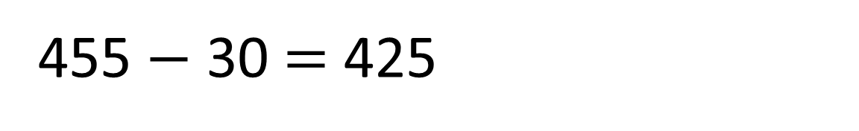
WE DO
How many pencils will be left?
10 pencils
100
pencils
100
pencils
10 pencils
100
pencils
100
pencils
10 pencils
We need 30 pencils please.
10 pencils
455 $−$ 30 $=$ 425
10 pencils
I know that ____ tens plus ____ tens equals _____ tens. Therefore _ _ _ + _ _ = _ _ _

Slide 8



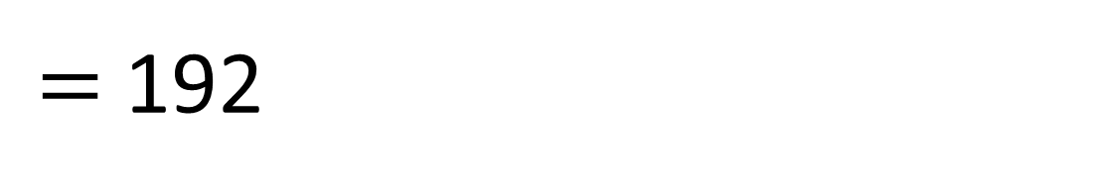
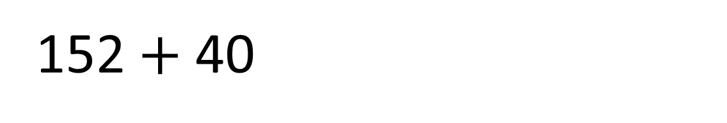
YOU DO
$=$ 192
152 $+$ 40
Hundreds | Tens | Ones
9
2
1
5
I know that ____ tens plus ____ tens equals _____ tens. Therefore _ _ _ + _ _ = _ _ _

Slide 9
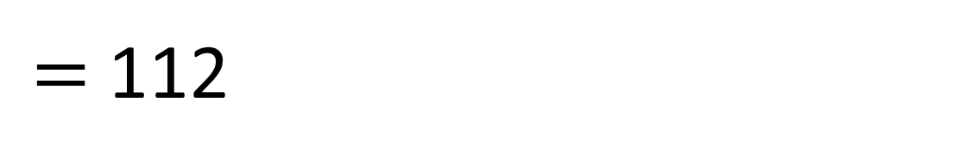
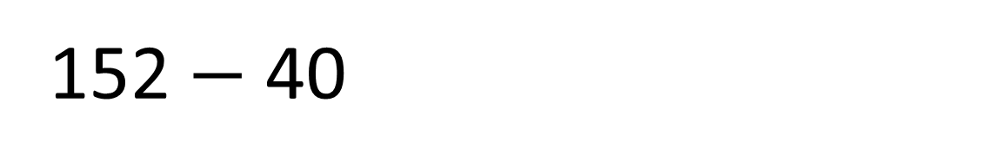
WE DO
$=$ 112
152 $−$ 40
Hundreds | Tens | Ones
1
2
1
5
I know that ____ tens plus ____ tens equals _____ tens. Therefore _ _ _ + _ _ = _ _ _

Slide 10

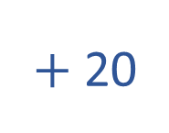
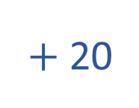

Add 20 to each number
Have a think
$+$ 20
I DO
2
4
725
563
806
745
$+$ 20
WE DO
583
$+$ 20
YOU DO
826
I know that ____ tens plus ____ tens equals _____ tens. Therefore _ _ _ + _ _ = _ _ _

Slide 11
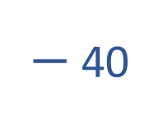
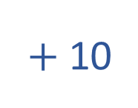
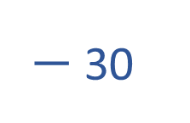
What operation does each arrow represent?
$−$ 30
I DO
8
385
163
396
355
5
$+$ 10
WE DO
6
7
173
$−$ 40
YOU DO
9
356
5
I know that ____ tens plus ____ tens equals _____ tens. Therefore _ _ _ + _ _ = _ _ _

Slide 12

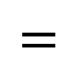

Plenary
Have a think
3
5
8
3
6
8
7
8
1
9
2
3
$$+$$
4
0
v
$$=$$
v

