Slide 1
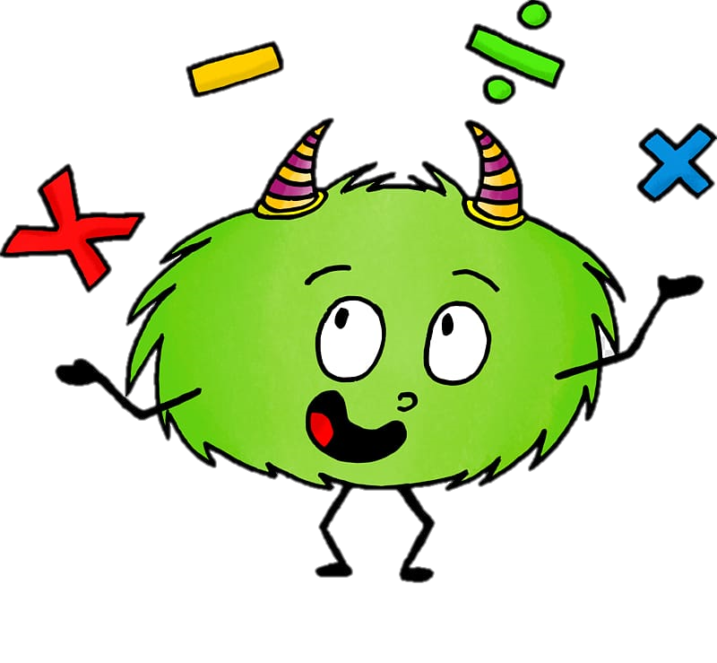
Friday 18th September 2020
10:30-11:20
L.O: To know and use numbers.
C: : Find 1, 10 100 more than a given number
Today, Miss Watton is looking for growth mindset!

Slide 2
Warm Up Game!
Times table time!
Let’s practice our 4 times tables!
https://www.topmarks.co.uk/maths-games/hit-the-button

Slide 3
Let’s recap yesterday!
We are going to play a game!
You all need to listen carefully so we can make a TALKING domino chain!

Slide 4
Word problems.
Jake has 642 blocks in his castle. Alice takes 10 of them. How many blocks does Jake have in his castle now?
Write it as a number sentence:

Slide 5
Word problems.
Abby has been collecting stamps for 107 days. Ahmed has been collecting stamps for 100 days more. How long has Ahmed been collecting stamps?
Draw the answer with dienes:

Slide 6
Your turn

Slide 7
Plenary!
BINGO!

