Slide 1
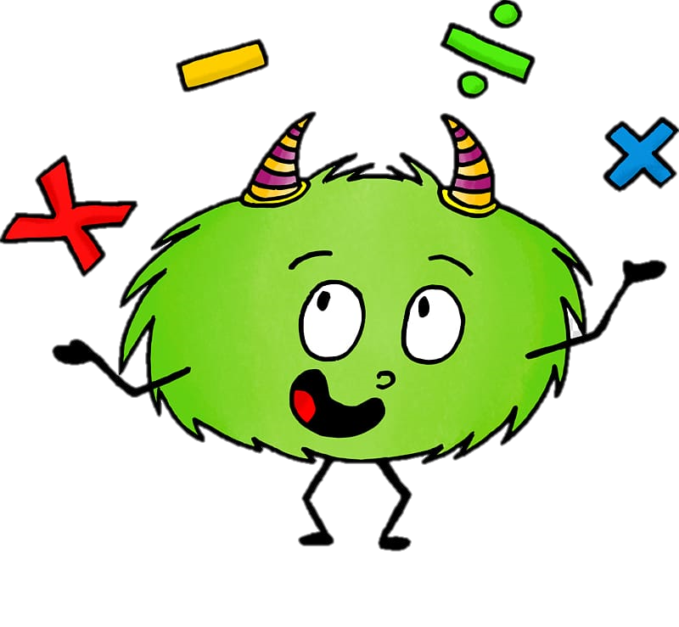
Thursday 17th September 2020
10:30-11:20
L.O: To know and use numbers.
C: : Find 1, 10 100 more than a given number
Today, Miss Watton is looking for growth mindset!

Slide 2
Warm Up Game!
Times table time!
Let’s practice our 4 times tables!
https://www.youtube.com/watch?v=8QU_E0u-tP4

Slide 3
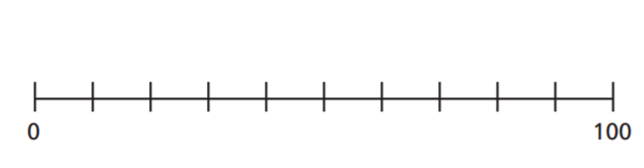
Let’s recap yesterday!
Abby and Alice collect lego. Alice has 4 lego men and Abby has 5 times as many.
Mark on the number line how many lego men Abby has.
?

Slide 4
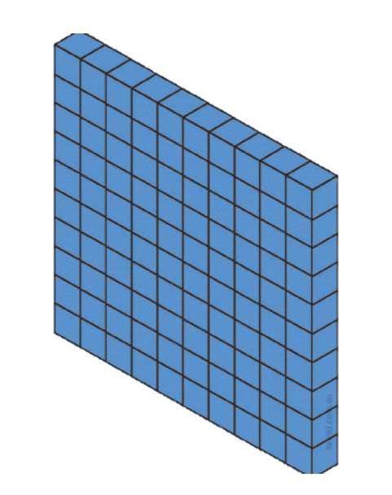
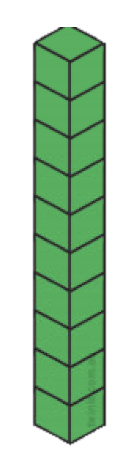

What number is this?

Slide 5
What number is it now?
What changed?

Slide 6
What number is this?

Slide 7
What number is this now ?
What changed?

Slide 8
Which digit represents my tens in
279

Slide 9
How do I increase 279 by ten?
We need to add one lot of ten to the tens column.
T
O
H

Slide 10
How do I decrease 279 by ten?
We need to remove one lot of ten from the tens column.
T
O
H

Slide 11
Which number represents my hundreds in
738

Slide 12
How do I increase 738 by one hundred?
We need to add one lot of one hundred to the hundred column.
T
O
H

Slide 13
How do I decrease 738 by one hundred?
We need to take away one lot of one hundred from the hundred column.
T
O
H

Slide 14
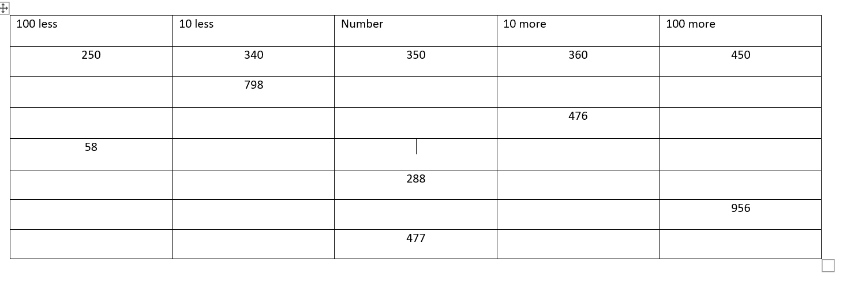
Your turn!

Slide 15
Plenary!
I’m thinking of a number.
Guess it to go out to break!

Slide 16


