Slide 1

Wednesday 16th September 2020
10:30-11:20
L.O: To know and use numbers.
C: Number line to 1000
Today, Miss Watton is looking for growth mindset!

Slide 2
Warm Up Game!
Times table challenge!
Write 1-10 down your whiteboard

Slide 3
Warm Up Game!
3x3
3x7
3x2
3x10
3x1
3x6
3x8
3x9
3x5
3x4
3x11
3x12

Slide 4
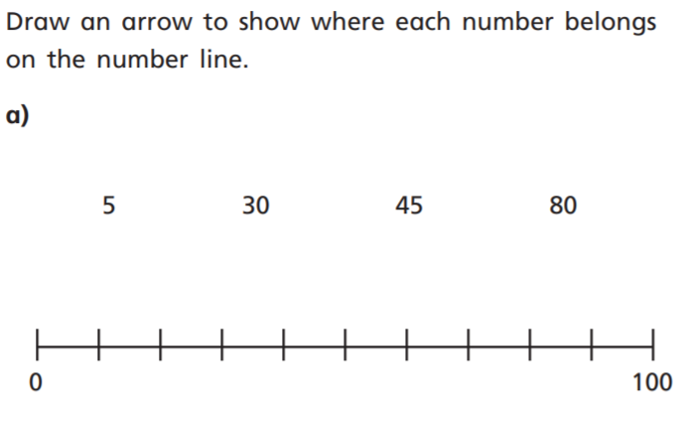
Let’s recap yesterday!
?
?
?

Slide 5


Problem Solving 1
Rachelle has drawn this number line.
Her friend Alistair has drawn a different number line with the same midpoint.
What could the start and end points of his number line have been?
600 | 640
© Classroom Secrets Limited 2018

Slide 6
Problem Solving 1
Rachelle has drawn this number line.
Her friend Alistair has drawn a different number line with the same midpoint.
What could the start and end points of his number line have been?
Possible answers: 610 and 630, 520 and 720.
600 | 640
© Classroom Secrets Limited 2018

Slide 7
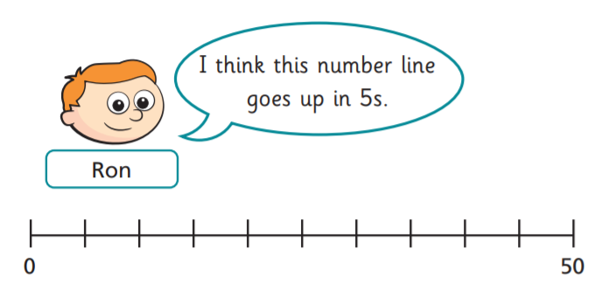
Think, Pair, Share is Ron correct?
?
10s
?
?

Slide 8
We are going to practice our estimating skills!
What does estimating mean?

Slide 9
What number could this be?
(See whiteboard drawing)

Slide 10
Your turn!

Slide 11
Plenary!
Lets count in multiples of 3 to get out to break!

