Slide 1
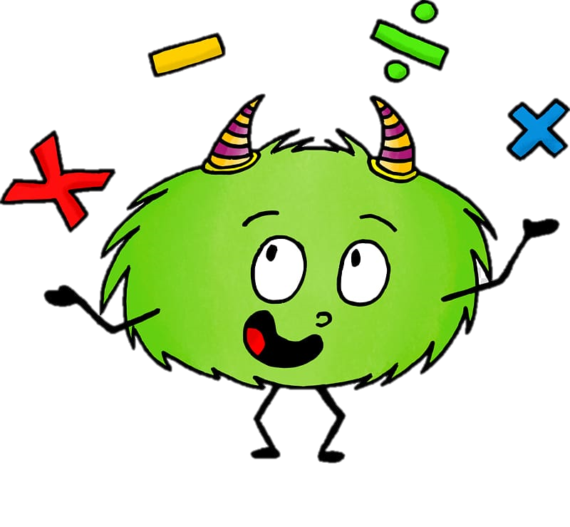
Monday 14th September 2020
10:30-11:20
L.O: To know and use numbers.
C: 100s, 10s and 1s
Today, Miss Watton is looking for growth mindset!

Slide 2
Warm Up Game!
Times table challenge!
We are going to practice our 3 times tables today!

Slide 3
Recap
10:30-11:20
Write this number is numerals and words

Slide 4
10:30-11:20
I’m going to try and trick you out!

Slide 5
Recap
10:30-11:20
Write this number is numerals and words

Slide 6
10:30-11:20
Today we are going to PARTITION numbers!
What does partition mean?

Slide 7
10:30-11:20
Partition means split a number into its separate parts.

Slide 8
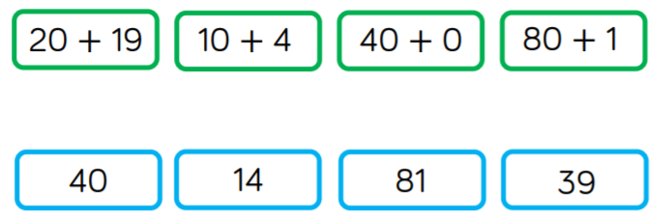
10:30-11:20

Slide 9
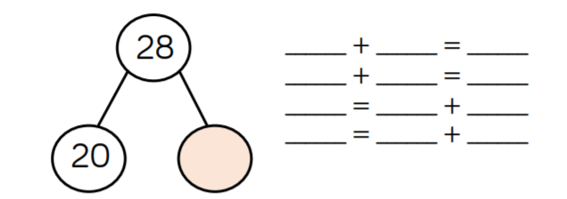
10:30-11:20
?
?
?
?
?
?
?
?
?
?
?
?
?

Slide 10

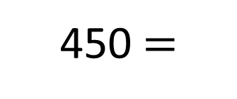
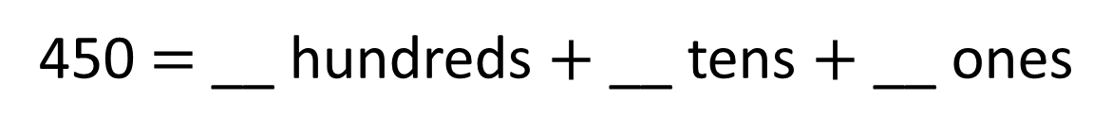
10:30-11:20
4
5
0
450 $=$ __ hundreds $+$ __ tens $+$ __ ones
$$+$$
450 $=$
400
50

Slide 11


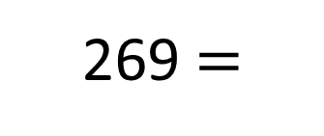
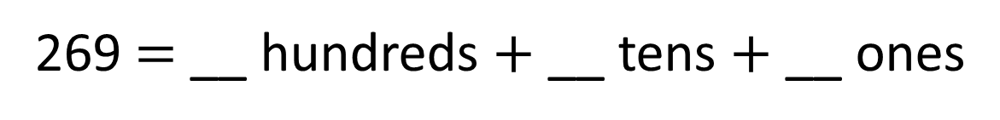
10:30-11:20
?
?
?
269 $=$ __ hundreds $+$ __ tens $+$ __ ones
$$+$$
$$+$$
269 $=$
?
60
?

Slide 12
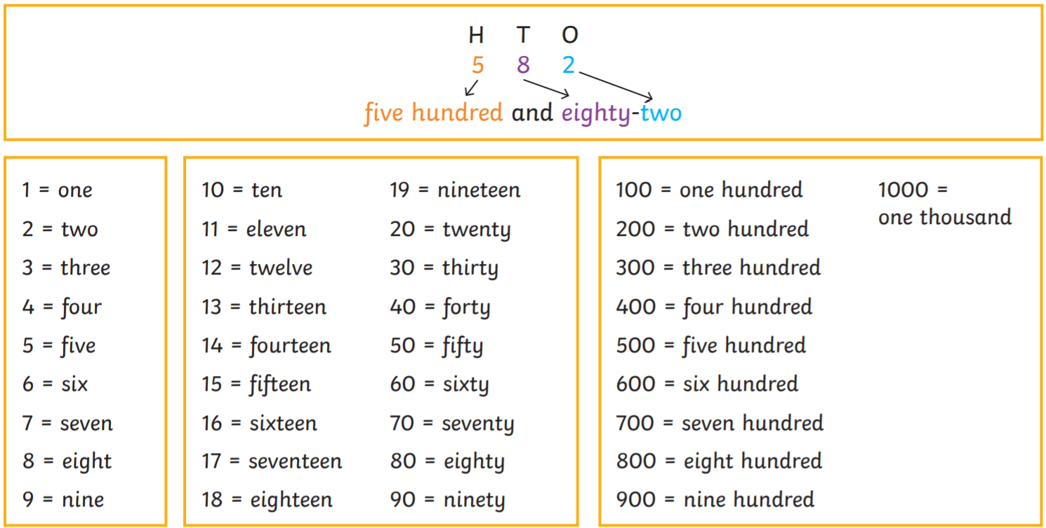
10:30-11:20

Slide 13
Plenary
10:30-11:20
What is the value of the 6 in each number?
H
T
O
462
621
206
?
?
?

Slide 14
Plenary
10:30-11:20
What is the value of the 6 in each number?
H
T
O
462
621
206
60
6 tens
600
6 hundreds
6
6 ones

