Slide 1

Tuesday 15th September 2020
10:30-11:20
L.O: To know and use numbers.
C: Number line to 1000
Today, Miss Watton is looking for growth mindset!

Slide 2
Warm Up Game!
Times table challenge!
Let’s test our 3x tables memory!
https://www.topmarks.co.uk/maths-games/hit-the-button

Slide 3


Introduction
What number does each arrow point to?
A
B
C
D
0 |  |  |  |  |  |  |  |  |  | 1,000
© Classroom Secrets Limited 2018

Slide 4
Introduction
What number does each arrow point to?
A
B
C
D
0 | 100 |  |  | 400 |  | 600 |  |  | 900 | 1,000
© Classroom Secrets Limited 2018

Slide 5
Varied Fluency 1
Label the midpoints of these number lines.
550 |  | 650
550 |  | 570
550 |  | 750
© Classroom Secrets Limited 2018

Slide 6
Varied Fluency 1
Label the midpoints of these number lines.
550 | 600 | 650
550 | 560 | 570
550 | 650 | 750
© Classroom Secrets Limited 2018

Slide 7
Varied Fluency 2
Circle the letter that represents 730.
A
B
C
D
700 | 800
© Classroom Secrets Limited 2018

Slide 8
Varied Fluency 2
Circle the letter that represents 730.
A
B
C
D
700 | 800
© Classroom Secrets Limited 2018

Slide 9
Varied Fluency 3
This number line has divisions of 50. What number is labelled?
100
© Classroom Secrets Limited 2018

Slide 10
Varied Fluency 3
This number line has divisions of 50. What number is labelled?
300
100
© Classroom Secrets Limited 2018

Slide 11
Varied Fluency 4
Draw an arrow to represent the number three hundred and fifty.
100 | 400
© Classroom Secrets Limited 2018

Slide 12
Varied Fluency 4
Draw an arrow to represent the number three hundred and fifty.
100 | 350 | 400
© Classroom Secrets Limited 2018

Slide 13
Varied Fluency 5
True or false?
200 is a good estimate for M.
M
300
400
© Classroom Secrets Limited 2018

Slide 14
Varied Fluency 5
True or false?
200 is a good estimate for M.
False
M
300
400
© Classroom Secrets Limited 2018

Slide 15
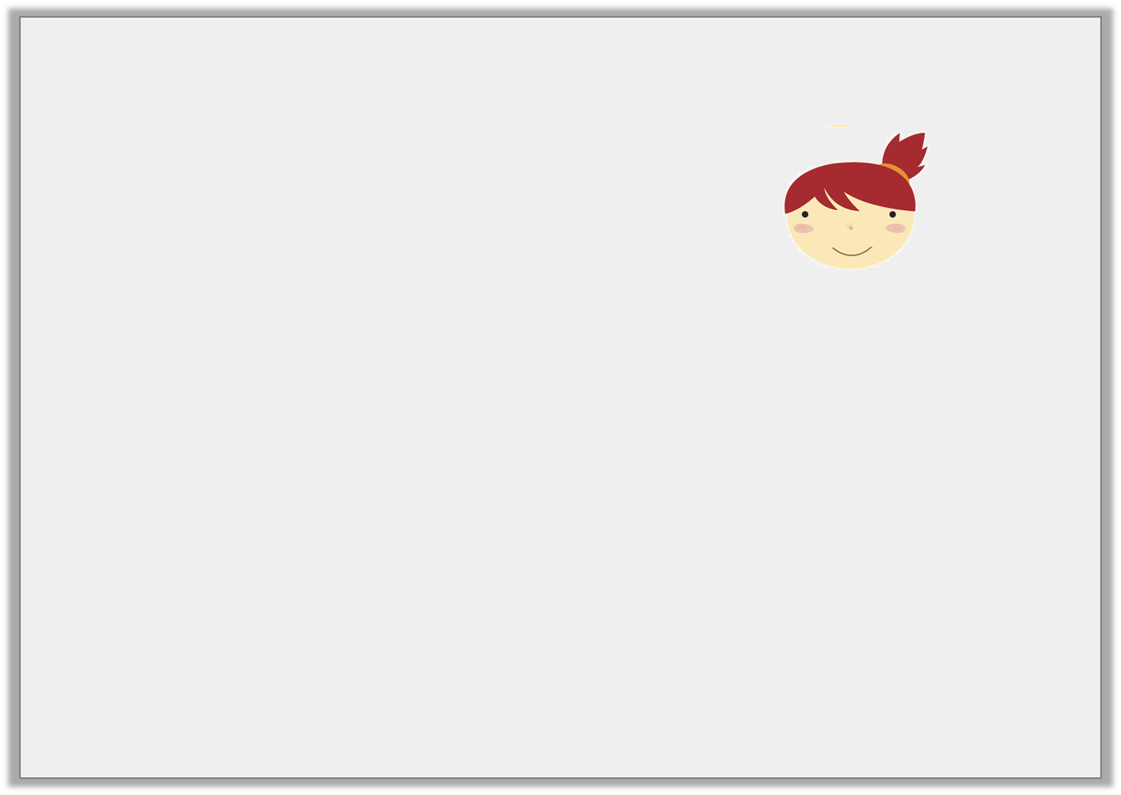
Reasoning 1
Aisling says,
Do you agree? Convince me.
I have placed the same number on these number lines.
200 | 300
230 | 250
© Classroom Secrets Limited 2018

Slide 16
Reasoning 1
Aisling says,
Do you agree? Convince me.
Aisling is correct because...
I have placed the same number on these number lines.
200 | 300
230 | 250
© Classroom Secrets Limited 2018

Slide 17
Reasoning 1
Aisling says,
Do you agree? Convince me.
Aisling is correct because both number lines show 240.
The first number line has increments of 10 and the second number line shows the midpoint between 230 and 250.
I have placed the same number on these number lines.
200 | 300
230 | 250
© Classroom Secrets Limited 2018

