Slide 1
Wednesday 16th September 2020
LO: To draft the final section of a story using a range conjunctions
C: Hope where are you?

Slide 2
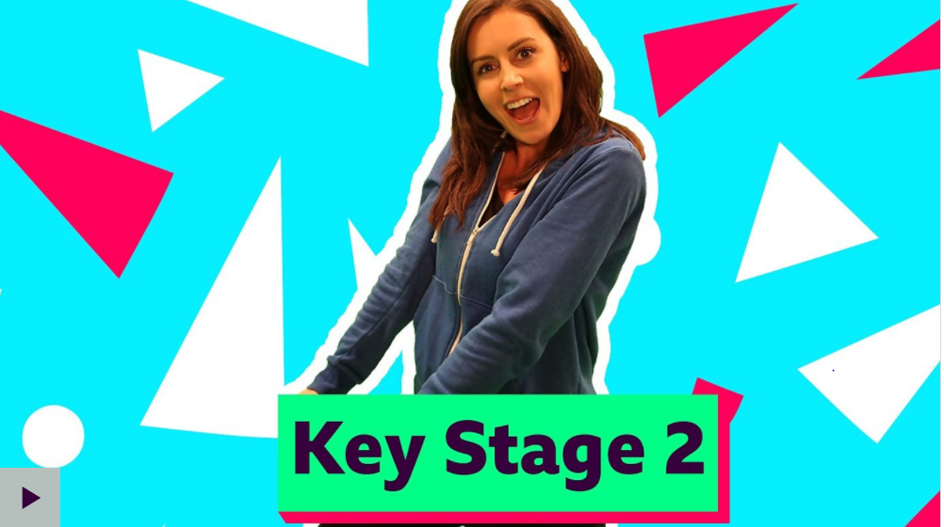
What are conjunctions?
https://www.bbc.co.uk/teach/supermovers/ks2-english-conjunctions-with-laura-bubble/zv4hd6f

Slide 3
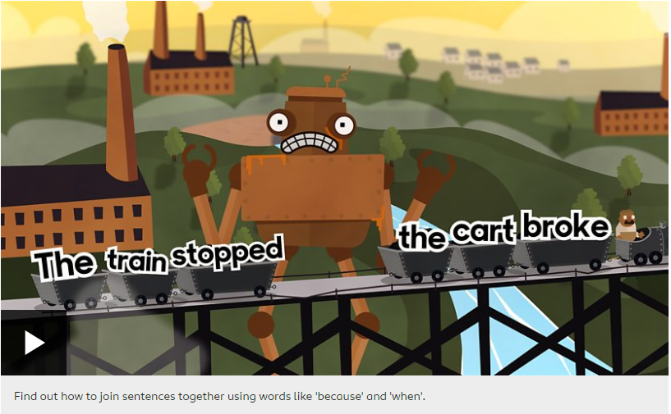
Subordinating Conjunctions
https://www.bbc.co.uk/bitesize/topics/zwwp8mn/articles/zqk37p3

Slide 4
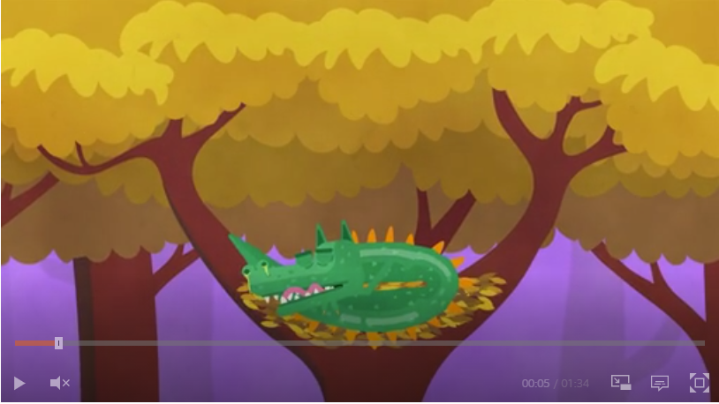
Proper nouns and common nouns
https://www.bbc.co.uk/bitesize/topics/zrqqtfr/articles/zpd8ng8

Slide 5
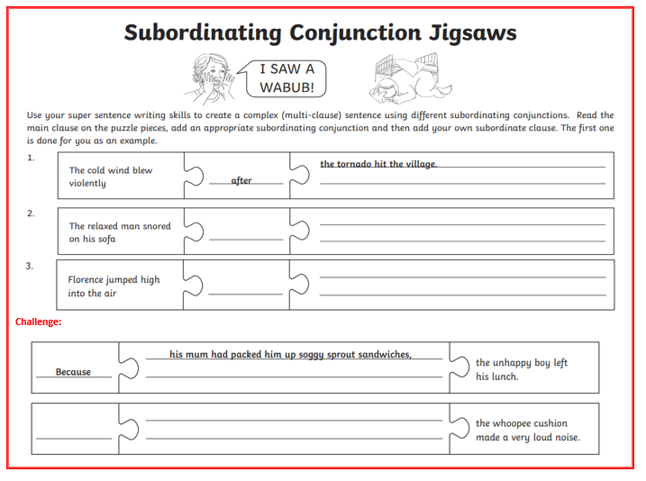
Now try this…

Slide 6

How does Alessandro’s emotions change throughout Covid?

Slide 7
How did your emotions change during Covid?

Slide 8
My final paragraphs

Slide 9
It’s your turn to write…

