Slide 1
Monday 14th September 2020
LO: To draft a first paragraph for a story
C: Hope where are you?

Slide 2
Adjectives, Nouns and Verbs
What are they?
Adjectives – describing words
Nouns – name of people, places or things
Verbs – doing words (actions)

Slide 3
Adjectives, Nouns and Verbs
What are they?
Adjectives – describing words
Nouns – name of people, places or things
Verbs – doing words (actions)

Slide 4
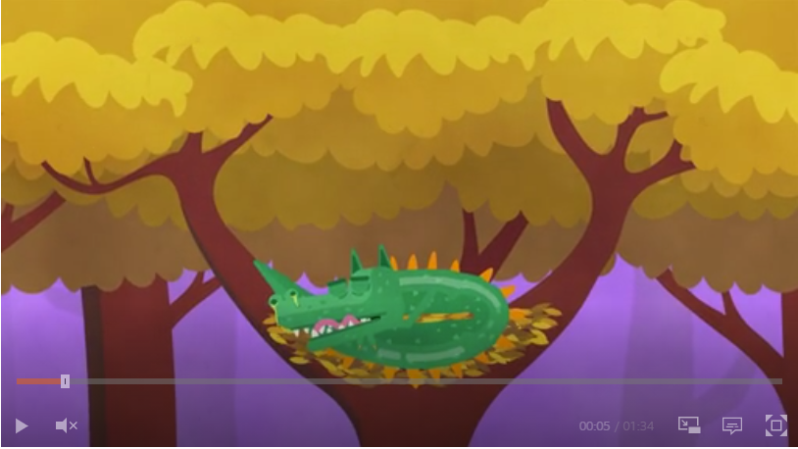
Proper nouns and common nouns
https://www.bbc.co.uk/bitesize/topics/zrqqtfr/articles/zpd8ng8

Slide 5
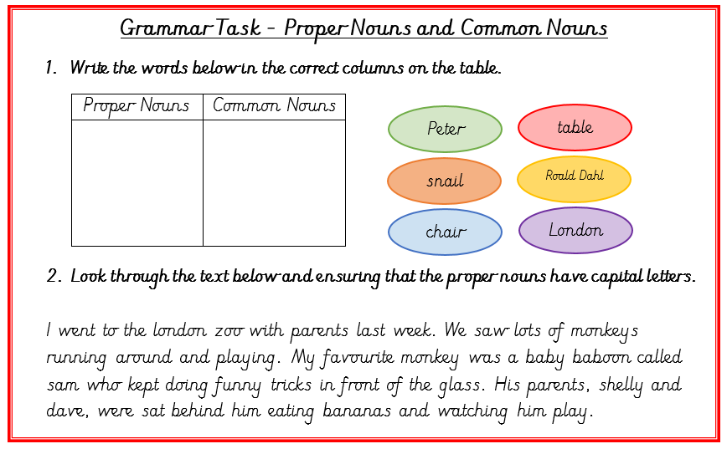
Now try this…

Slide 6
What are we going to change?
I can see my parents are worried. I'm worried as well. We can't talk or visit grandma. I'm very sad. I am struggling to express my feelings and don't want to bother my parents.
We live in a small apartment, but I still feel very alone. I'm not myself. We get the phone call that Grandma is gone. Just like that. I didn't get to say goodbye.

Slide 7
Write your next two paragraphs on a whiteboard with your partner.
Be ready to share your writing with the rest of the class.

