Slide 1
Monday 14th September 2020
LO: To draft a first paragraph for a story
C: Hope where are you?

Slide 2
Adjectives, Nouns and Verbs
What are they?
Adjectives – describing words
Nouns – name of people, places or things
Verbs – doing words (actions)

Slide 3
Adjectives, Nouns and Verbs
What are they?
Adjectives – describing words
Nouns – name of people, places or things
Verbs – doing words (actions)

Slide 4
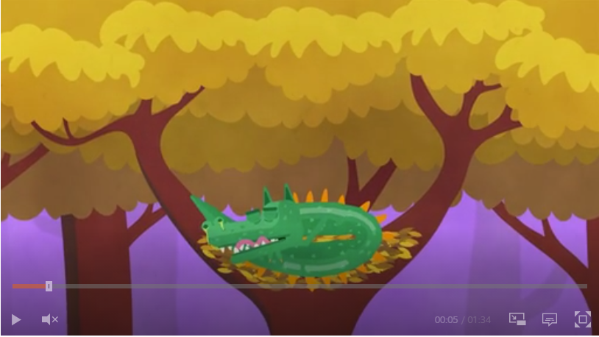
Proper nouns and common nouns
https://www.bbc.co.uk/bitesize/topics/zrqqtfr/articles/zpd8ng8

Slide 5
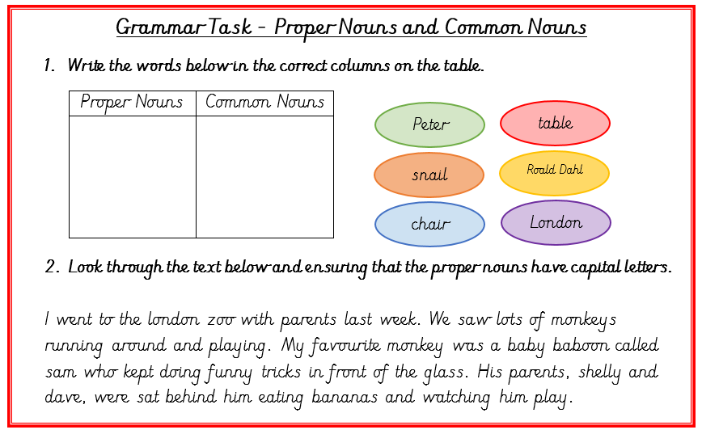
Now try this…

Slide 6
What are we going to change?
It's been a couple of weeks since we started learning from home. My teacher made sure I brought my books and things home, including my violin, before the school closed. It's been hard. Grandma has been very sick.

Slide 7
Write your new paragraph neatly in your book.

