Slide 1
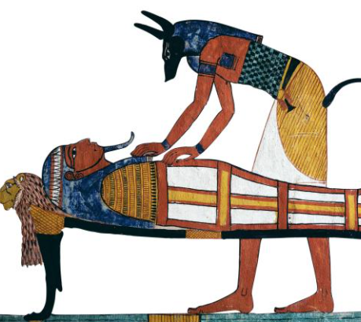
Wednesday 9th December 2020
L.O: To apply time conjunctions.
C: Explanation Text
We are going to learn some conjunctions we can use in our writing!

Slide 2
Can you make up a sentence using one of these conjunctions?
before
where
after
since
wherever
when
yet
because
while
so

Slide 3
Let’s try to sort these conjunctions into categories!
before
where
after
since
wherever
when
yet
because
while
so
Time | Place | Cause

Slide 4
Can you spot the conjunctions in my sentences?
Before the mummy is lowered into the sarcophagus, there are many important, sacred steps to complete.

Slide 5
Can you spot the conjunctions in my sentences?
Egyptians spent many hours on the mummification process, because they believed it was essential for a prosperous afterlife.

Slide 6
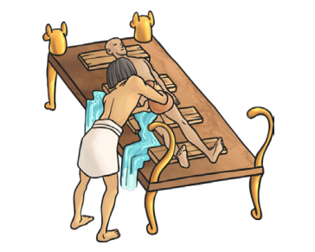
Can you think of a sentence to go with this picture? Remind to include a time conjunction!

Slide 7
It’s your turn! Have a go at using your new knowledge to complete your worksheet.
We are going to do a quiz later!

